Slide 1
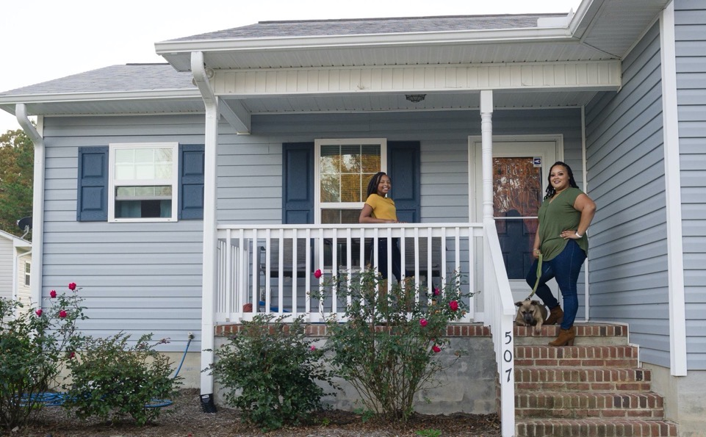
New Homebuyer Orientation
Building strength, stability, and self-reliance through shelter.

Slide 2
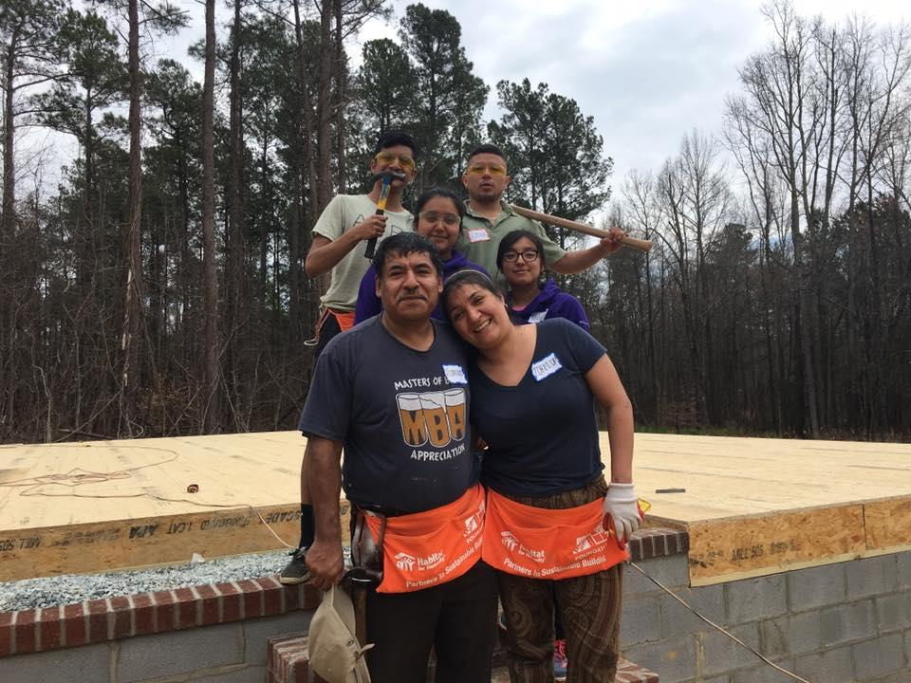
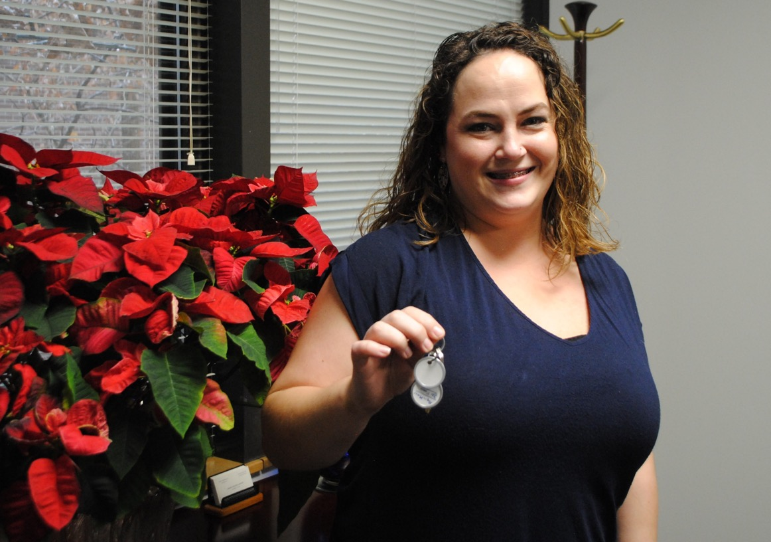
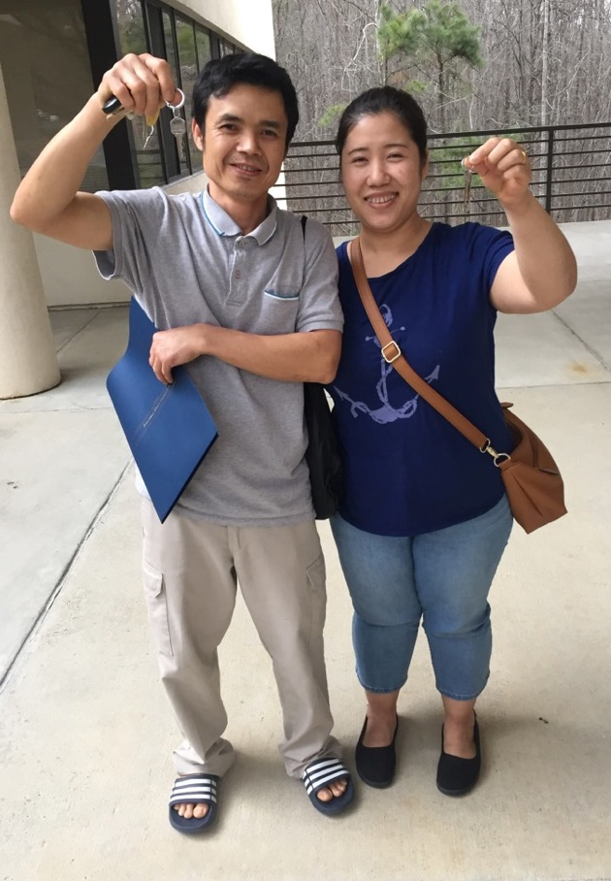
Overview
About Habitat
Homeownership Program
Sweat Equity Opportunities
Home Construction
Mortgage Information
Getting Started
Building strength, stability, and self-reliance through shelter.

Slide 3
About Habitat
Building strength, stability, and self-reliance through shelter.

Slide 4
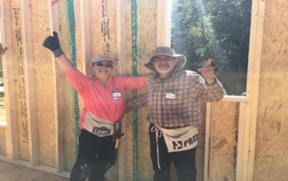
Our Mission & Vision
Mission:
Seeking to put God’s love into action, Habitat for Humanity of Orange County brings people together to build homes, communities, and hope.
Our Vision
Everyone in Orange County has a decent place to live.
Building strength, stability, and self-reliance through shelter.

Slide 5
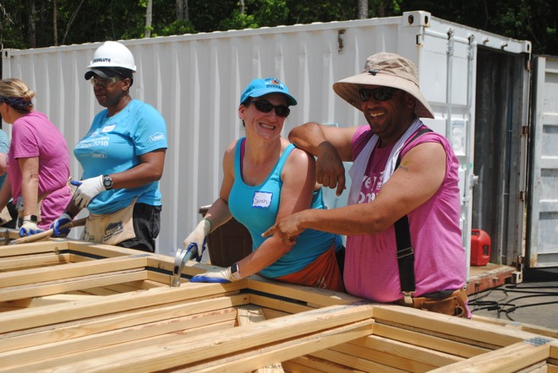
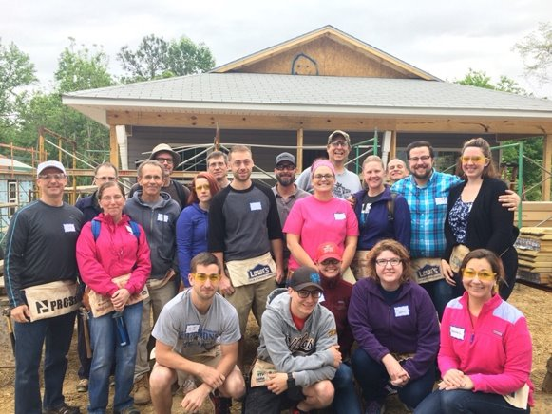
Our History
One of 1,400+ Habitat affiliates located in the U.S.
30+ years building homes in Orange County
Built 300+ homes in Orange County
Completed 200+ home repairs
We partner with families to create better, healthier, more financially stable lives.
Building strength, stability, and self-reliance through shelter.

Slide 6
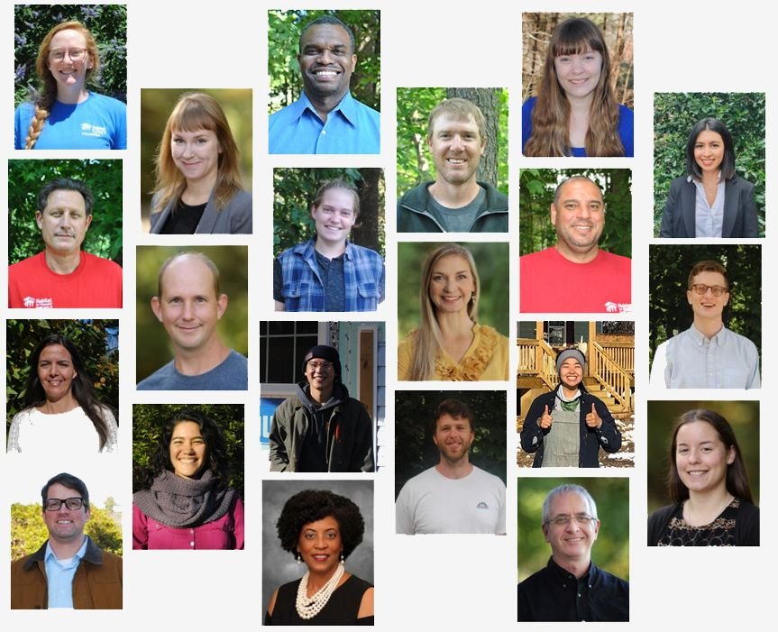
Our Staff
Building strength, stability, and self-reliance through shelter.

Slide 7
The Homeownership Program
Building strength, stability, and self-reliance through shelter.

Slide 8
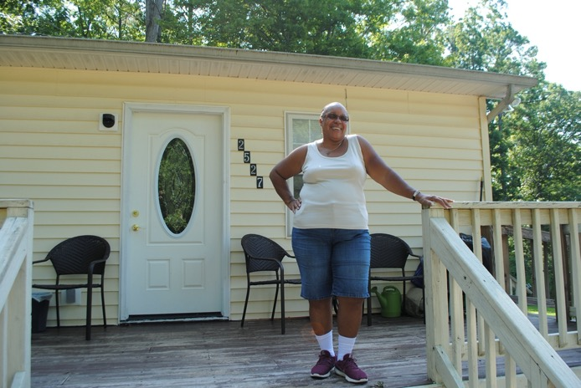
The Homeownership Program
Individuals and families in need of decent, affordable housing work with Habitat to build and purchase their own home.
Homebuyers invest sweat equity hours into building Habitat homes, completing financial education, and preparing for homeownership.
Once, all partnership requirements have been met and home construction is complete, the home is sold to the homebuyer with a long-term 0% interest mortgage. The homebuyer is a now a homeowner!
Building strength, stability, and self-reliance through shelter.

Slide 9
The Home Buying Process
Step 1: Applicant
Step 2: Trial Period
First 90 days
Complete 50 sweat equity hours
Step 3: Home Buyer
Complete 275 sweat equity hours
Complete home buyer education
Work with development team
Step 4: Pre-Closing
Pay all closing costs ($1700)
All sweat equity completed
Step 5: Closing
Financing your home
Get your keys!
Step 6: Homeowner!
The Home-buying process (from application to closing
typically takes about 18 months!
Building strength, stability, and self-reliance through shelter.

Slide 10
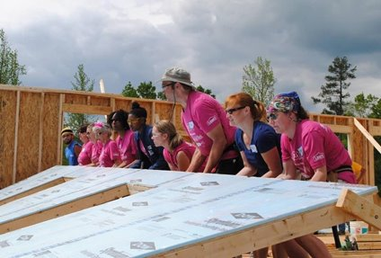
What is Sweat Equity?
Sweat equity is time committed to supporting Habitat's mission.
Sweat equity provides the opportunity for homebuyers to work alongside volunteers and future neighbors.
Sweat equity takes many forms! More on this momentarily.
Homebuyers are required to invest a minimum of 275 sweat equity hours
Building strength, stability, and self-reliance through shelter.

Slide 11
Sweat Equity Requirements
Trial Period: 50 hours must be completed within first 90 days.
Monthly Minimum Requirement: must complete 20 hrs / month.
Designated Person(s):
Applicant & co-applicant are eligible to contribute hours
Single applicants may designate one person to contribute hours.
After the trial period, friends and family may assist with a total of 50 hours towards the sweat equity requirement.
All sweat equity hours must be completed before you can close on your home.
Building strength, stability, and self-reliance through shelter.

Slide 12
Sweat Equity Opportunities
Building strength, stability, and self-reliance through shelter.

Slide 13
Habitat Construction Site
What: The place Habitat homes are built!
Min. 100 hours at the construction site must be completed
No prior construction experience needed.
No one under 16 years old allowed to work on site.
Where: Depends on construction schedule. Construction staff will send a weekly email with construction updates.
When: Wednesdays, Fridays, and Saturdays.
How to get started:
Create a Volunteer Hub account to sign up for shifts.
Check out the Construction FAQs for more info.
Building strength, stability, and self-reliance through shelter.

Slide 14
Habitat Restore
What: Home improvement stores that sell used furniture and household goods. Proceeds support Habitat.
Volunteer opportunities include: Cashier, Sales Floor Associate, Customer Service Associate, and Donation Receiver.
Where: 10 locations (closest in Hillsborough & Durham-CH)
When: Mon-Fri 9-6, Sat 9 -5
How to get started:
Fill out a Background Screening Form to register.
Once approved, you will receive a registration link to sign up for orientation. Two orientation days offered each week
Building strength, stability, and self-reliance through shelter.

Slide 15
Educational Opportunities
What: Habitat regularly offers workshops. Workshops are aimed for homeowner success.
Mandatory Homebuyer Education Course
Other topics: financial education, home maintenance, and more!
Where: Depends. Online, Habitat office and more.
When: Varies by season
How to get started:
Opportunities shared on Homeowner Announcements
Contact homeownerservices@orangehabitat.org
with questions.
Building strength, stability, and self-reliance through shelter.

Slide 16
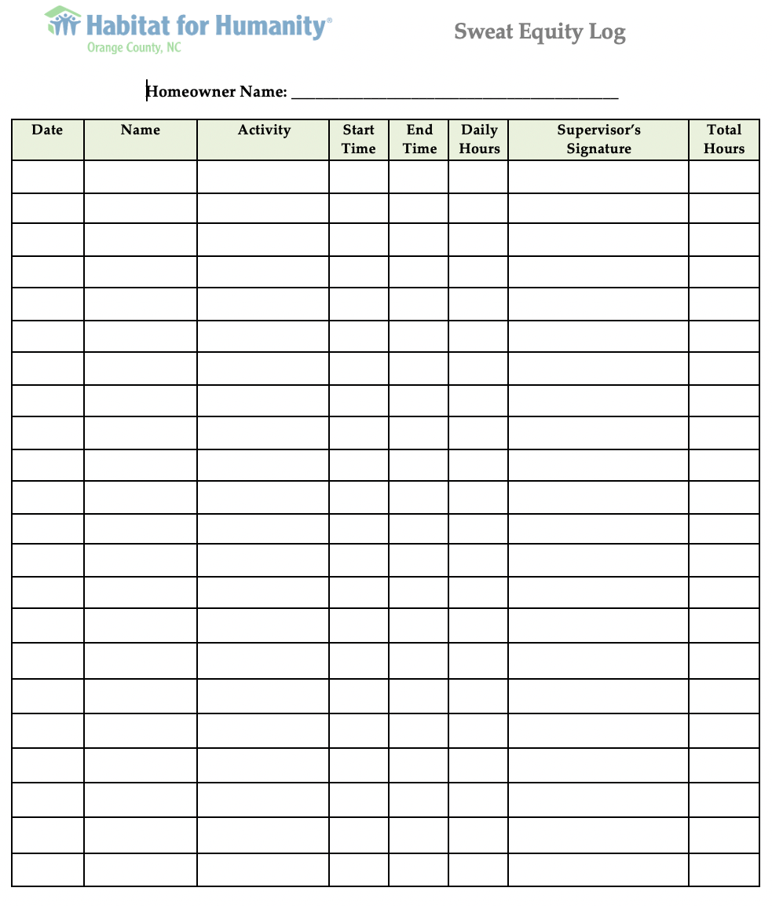
Sweat Equity Tracking
You are responsible for tracking all sweat equity hours.
You will receive a form used to track hours.
Hours must be signed or reviewed by a staff member.
You must submit sweat equity hours on the 1st of each month.
Building strength, stability, and self-reliance through shelter.

Slide 17
Home Construction
Building strength, stability, and self-reliance through shelter.

Slide 18
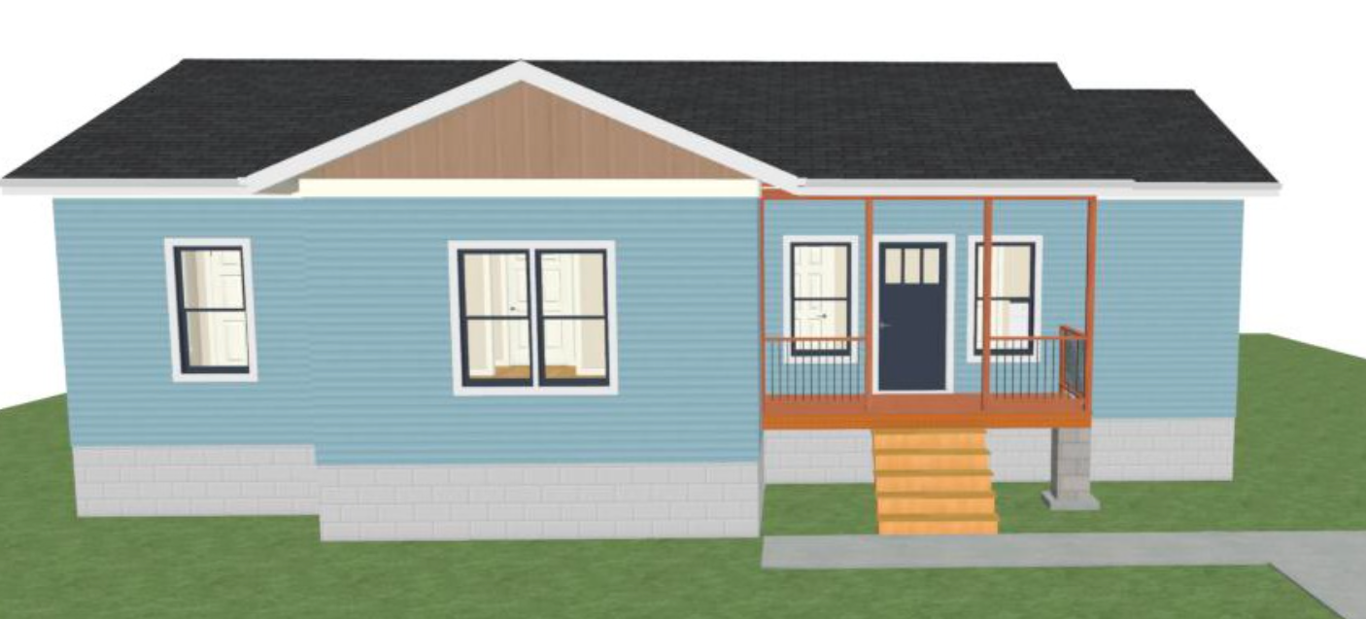
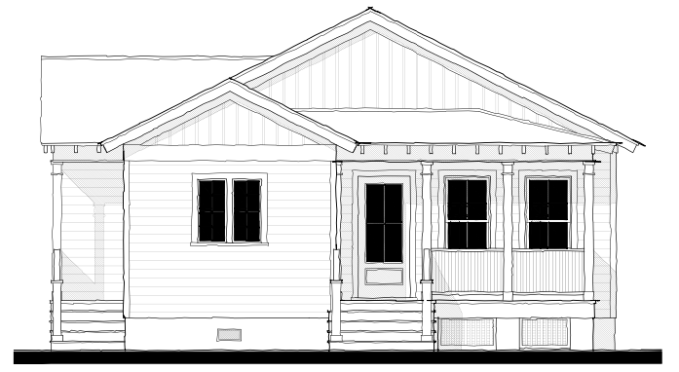
Our Hillsborough Single Family Homes
Features:
Single-family home with spacious lots
Energy-Efficient,
Accessible Design
Local Amenities:
Close to downtown
Quick access to US 70
Close to Fairview park & community garden
Orange County School System
Building strength, stability, and self-reliance through shelter.
Notes:
\

Slide 19
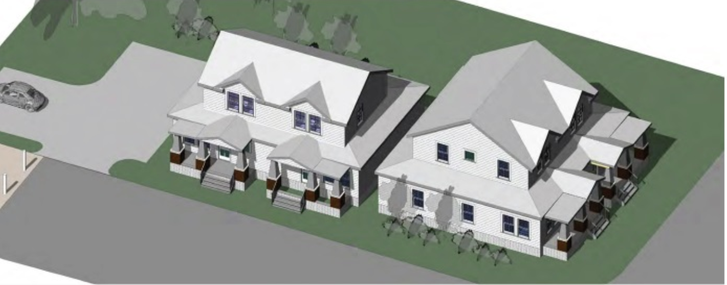
Our Carrboro Town Homes
Features:
Two 3 BR and two 2 BR units
Energy-Efficient
Accessible Design
2 BR units are ADA-compliant
Local Amenities:
Located within Historic Northside neighborhood
Walkable to downtown
Carrboro Chapel Hill schools
Building strength, stability, and self-reliance through shelter.

Slide 20
Home Construction
Donated Materials & Volunteer Labor
1-Year Warranty
Construction Plan
Schedule (cannot be guarenteed)
Building strength, stability, and self-reliance through shelter.
Notes:
\

Slide 21
Costs of Building A Home
The average cost to build a Habitat home in Orange County:
Land: $47,500
Materials: $85,000
Site Supervision: $16,500
Administrative: $14,900
_______________________
Total Cost: $163,900
Building strength, stability, and self-reliance through shelter.

Slide 22
Mortgage Information
Building strength, stability, and self-reliance through shelter.

Slide 23
Affordable Mortgage
Habitat offers affordable, 0% interest mortgages that are paid over a specific period (typically 30 years.).
Mortgage payments (including homeowner insurance, HOA dues & property taxes) will not exceed 30% of household gross monthly income (at time of closing.)
Mortgage payments are cycled back into the community to help build additional Habitat houses.
Mortgages generally contain subsidies from local government and other non-profit agencies.
Closing costs ($1700) must be paid 30 days prior to closing.
Building strength, stability, and self-reliance through shelter.

Slide 24
Mortgage Example
Mortgage Breakdown
Appraised Value: $200,000
Sale Price: $200,000
First Mortgage: $160,000
Second Mortgage: $25,000
Residual Mortgage: $15,000
______________________________________
Total Cost: $200,000
Payment Breakdown
Principal Payment: $445.00
Escrow Payment: $200.00
-Property Taxes: $150
-Insurance: $50
-HOA Fees: $45.00
________________________________
Monthly Payment: $645.00
Building strength, stability, and self-reliance through shelter.

Slide 25
Ownership Restrictions
Primary Residence
Right of First Refusal
$
Deed Restrictions
Covenants
Shared Appreciation
Building strength, stability, and self-reliance through shelter.

Slide 26
Program Termination
Habitat has the right to withdraw the Homebuyer from the Program at any time.
Situations that can lead to program withdrawal include:
Application: any information on application is fraudulent
Financial Circumstance: Change in employment, income, or household size; increased level of debt ratio beyond 43% (Habitat’s acceptable guidelines.)
Program Commitment:
Failure to complete sweat equity requirements
Failure to complete any educational requirements required by Habitat.
Failure to pay closing cost payment at least one month before closing.
Building strength, stability, and self-reliance through shelter.

Slide 27
Getting Started!
Building strength, stability, and self-reliance through shelter.

Slide 28
Next Steps
Review and sign the New Homebuyer documents to officially enter the program.
Letter of Intent & Closing Cost Agreement
Get started on sweat equity!
Check out the sweat equity opportunities handout for sign up information !
Start saving toward closing costs!
Contact homeownerservices@orangehabitat.org anytime!
Building strength, stability, and self-reliance through shelter.

Slide 29
Congratulations!
Building strength, stability, and self-reliance through shelter.

