Slide 1
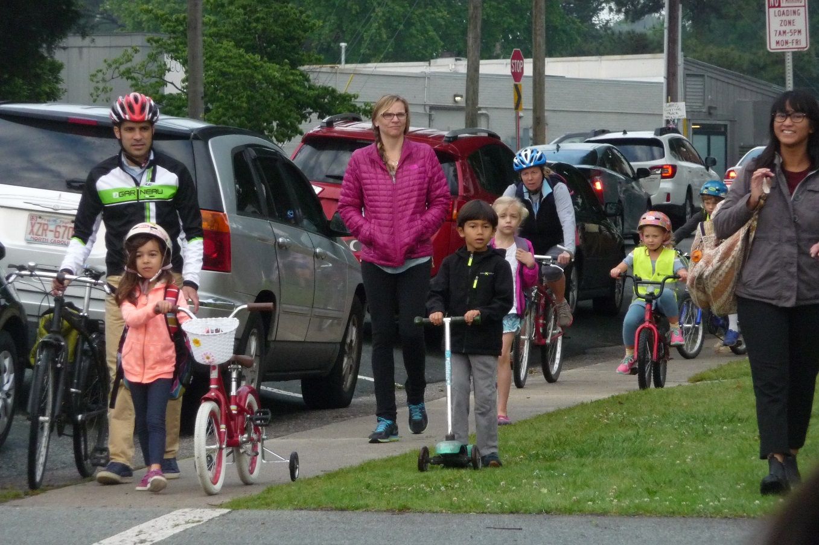

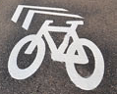
Triangle Bicycle and Pedestrian Workshop
March 16, 2018
Town of Carrboro
Notes:
Welcome/Introduce Self

Slide 2
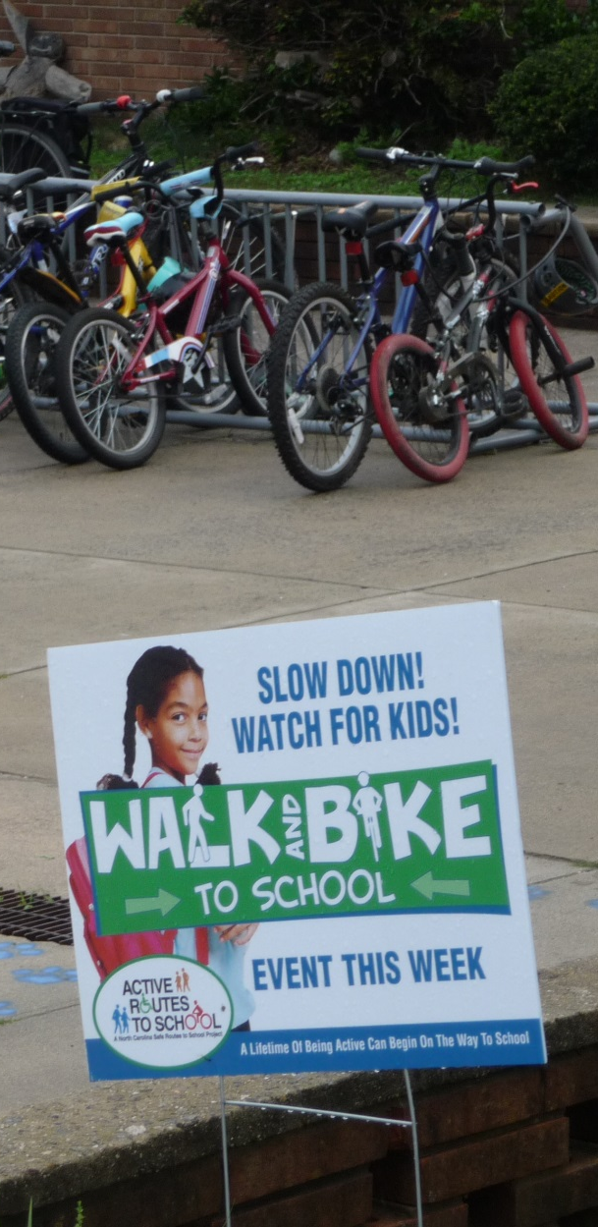
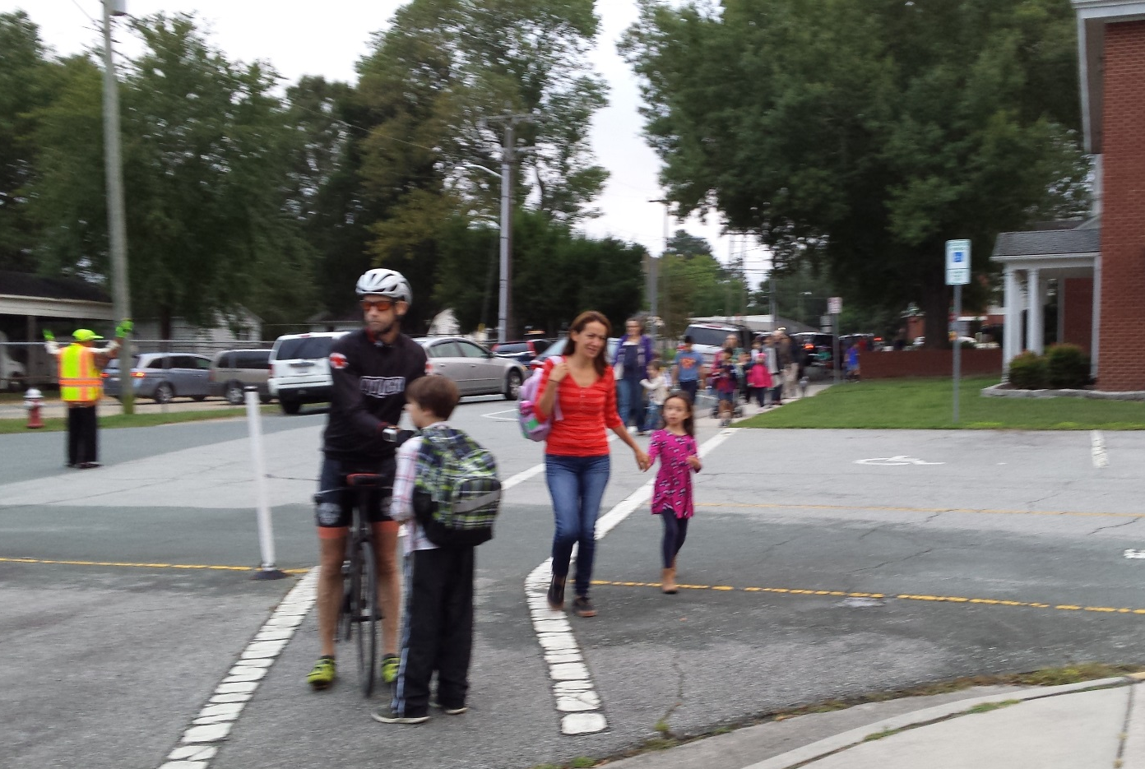
Walk – Bike to School Day
October 2017
Notes:
Mention SRTS + Committee, Watch for Me NC efforts, along with this

Slide 3
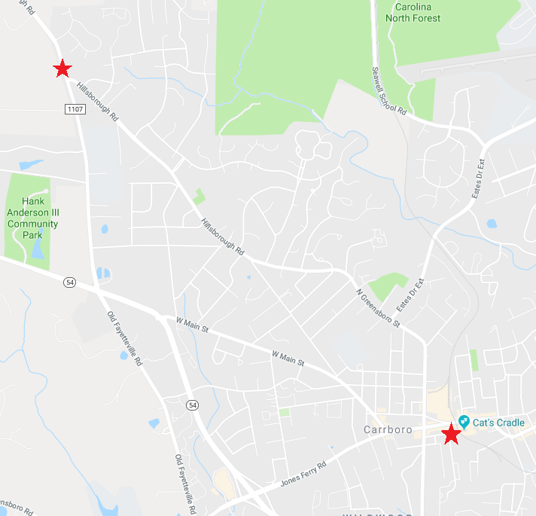
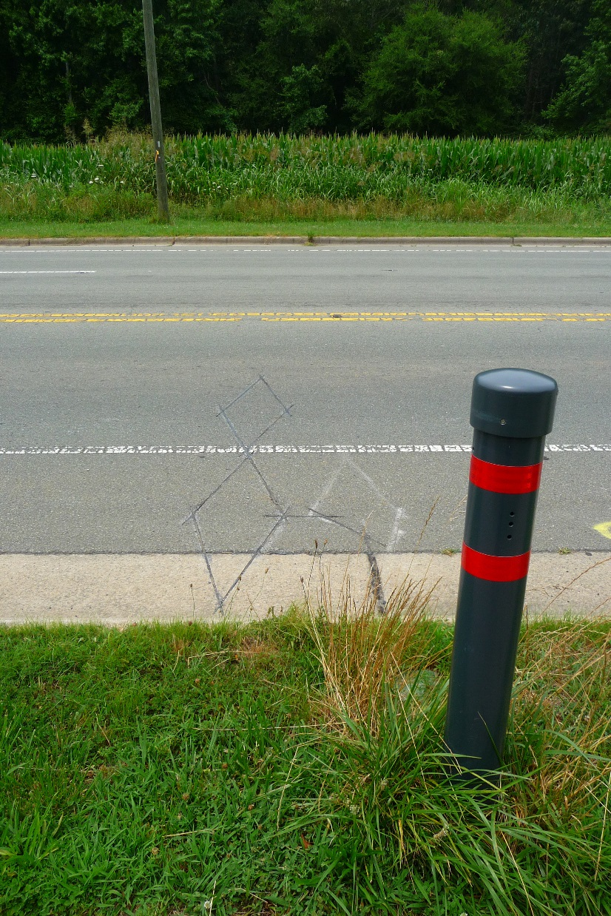
ITRE Bike Counters
Notes:
We were one of the pilot projects for the ITRE bike counters
Now taking over the maintenance and working out some of the kinks (battery replacement esp)

Slide 4
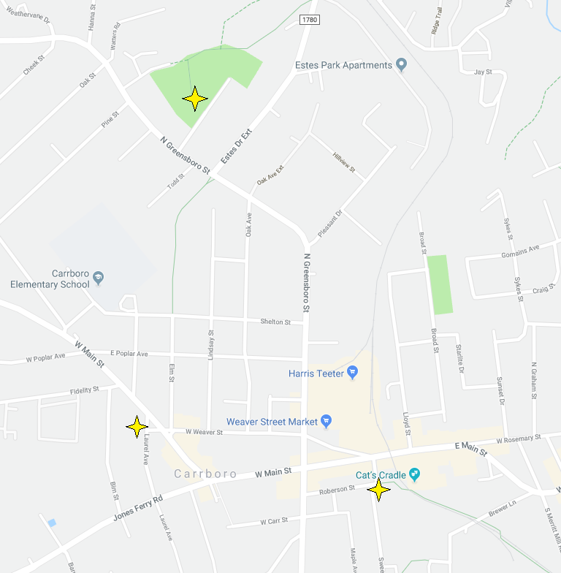
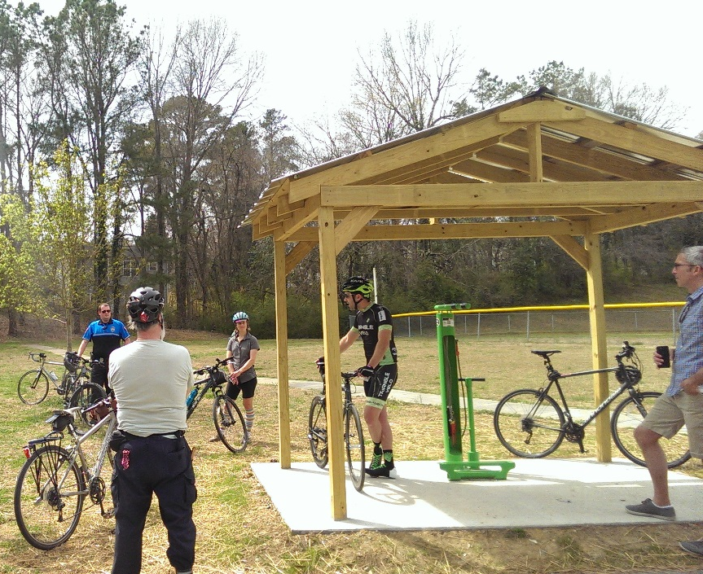
Fixit Stations
Notes:
Not really new… but we’ve had some growing pains
Had vandalism issues in the past but those have subsided

Slide 5
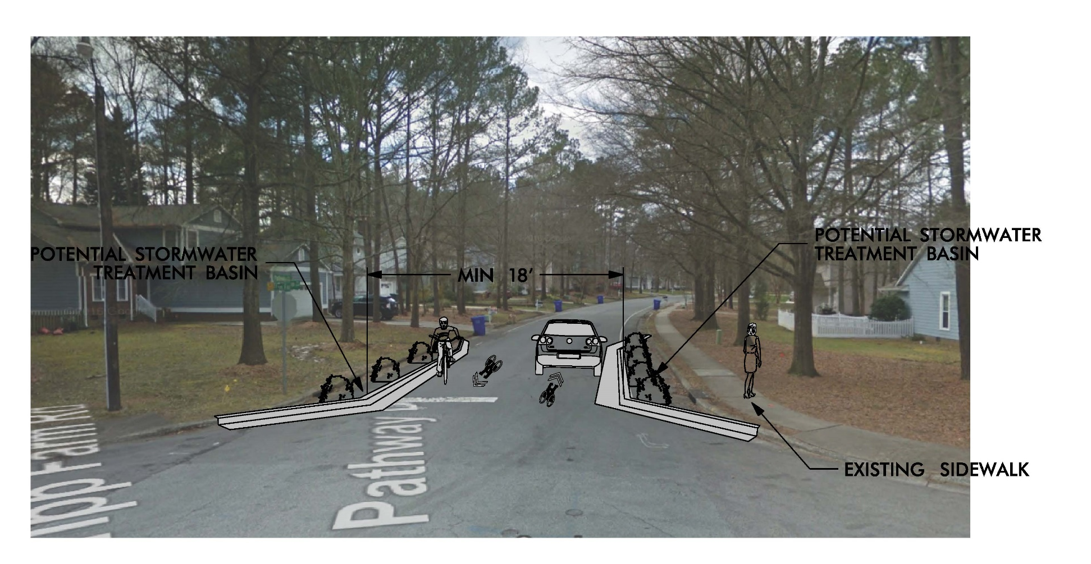
Pathway Drive – Traffic Calming Concept
Notes:
We have a residential traffic calming program which allows citizens to submit requests
We want to update this program because it focuses a lot on speed tables currently
Want to be able to use many different types of calming treatments and incorporate public works/stormwater improvements where beneficial

Slide 6
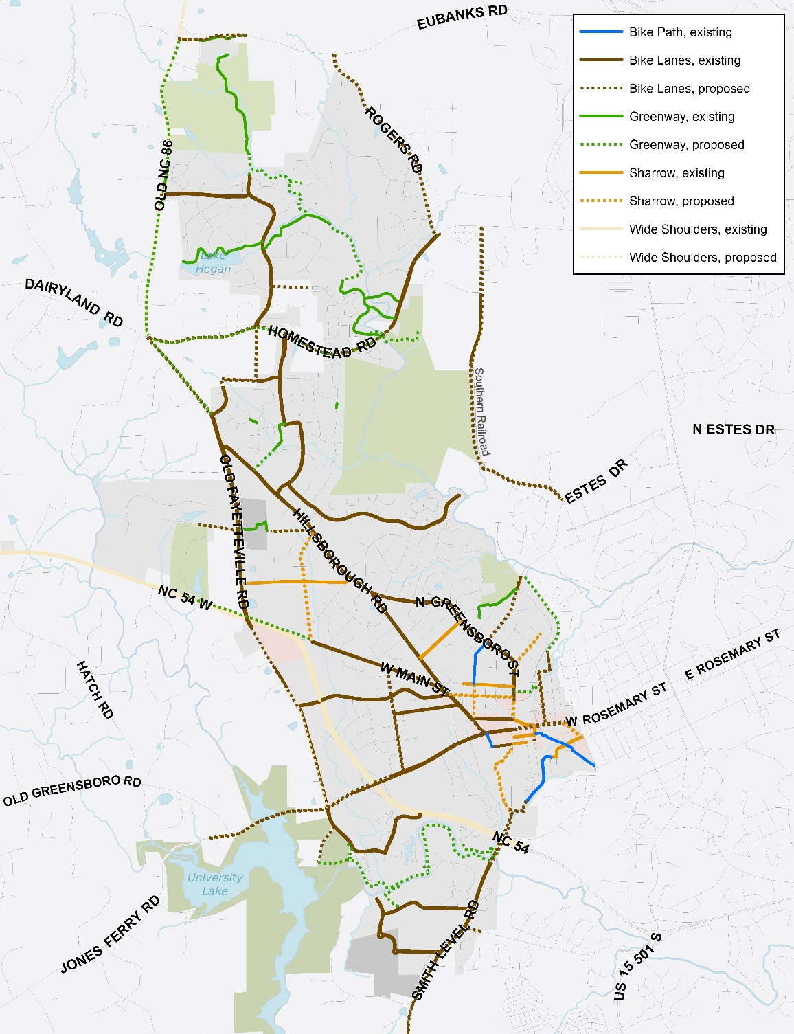
Bike Plan
Notes:
Point at: Blue bikeways (Frances shetley, PTA, Roberson, Libba Cotten)
Greenways Planned: Morgan Creek & Homestead MUP

Slide 7
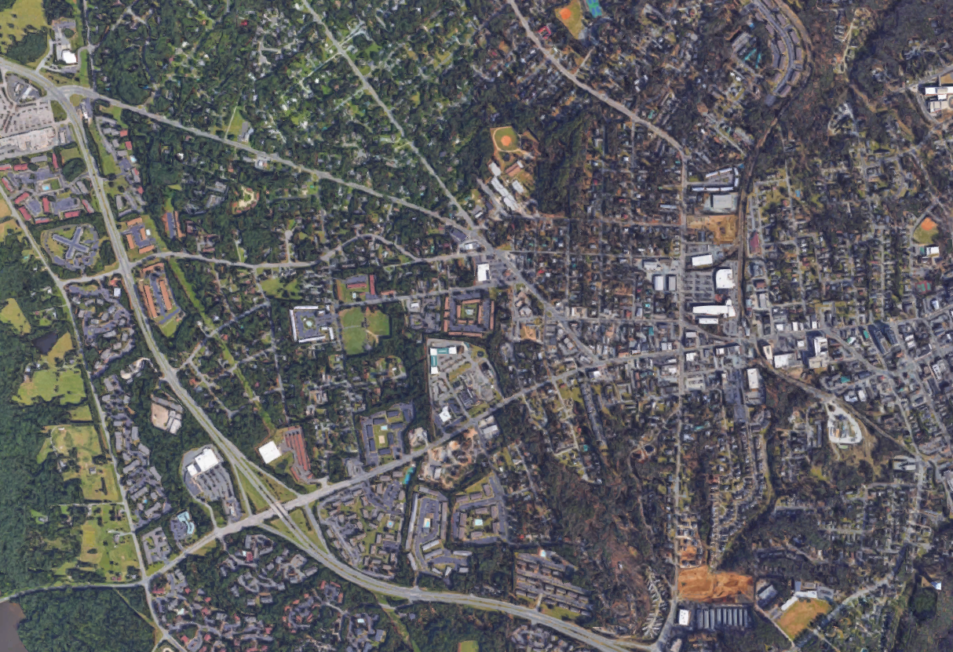
Proposed Downtown Improvements
Bicycle Loop Detectors
Roundabouts
Bike/Ped Rail Crossing
East Main Restriping Proposal
Notes:
Bike detectors being re-bid: no response from consultants first time
Roundabouts: N Greens @ Estes done by NCDOT, S Greens done by developer
Bike/Ped Crossing: Key missing link, want to be able to identify and fill small gaps in downtown network
East Main: Chance to take another look at the cross section when NCDOT goes to resurface

Slide 8
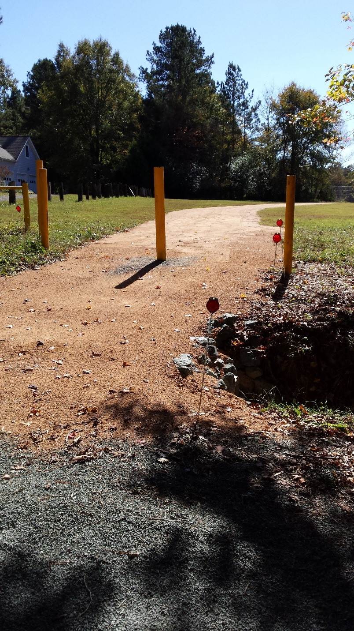
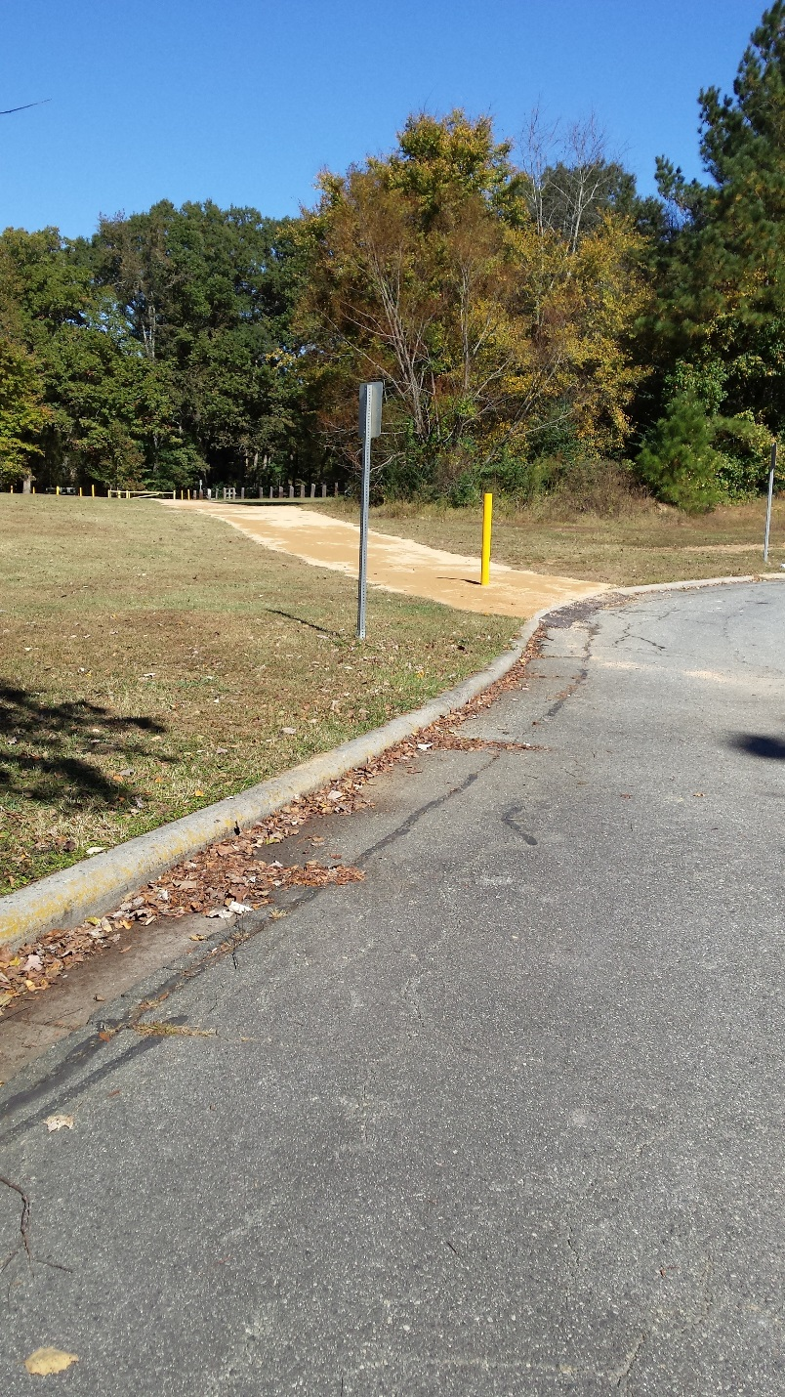
Stroud Lane Bike Path
Notes:
Some of the greenways progress which had been made

Slide 9

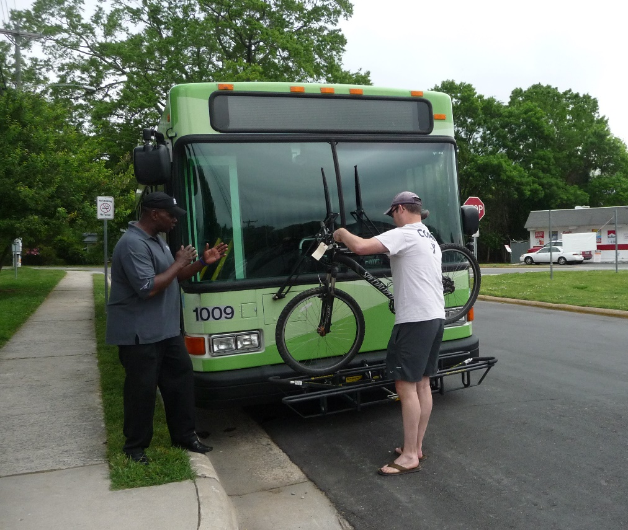
Upcoming Events
Notes:
Open Streets – 4/8
Bike on Bus – 5/11
Bike Breakfast – 5/15
Bike Plan Update – currently scoping
Bike Friendly Cities – going for gold

Slide 10
Questions?
Contacts:
Tina Moon
Planning Administrator
cmoon@townofcarrboro.org
Zachary Hallock
Transportation Planner
zhallock@townofcarrboro.org

