Slide 1
CAPITAL AREA MPO
Locally Administered Projects Program LAPP Applicant Training
August 17, 2023

Slide 2
Today’s Agenda
Introduction to LAPP & FFY25 Schedule
LAPP Eligibility & Pre-Submittal Process
FHWA & NCDOT Processes
LAPP Application Process
LAPP Scoring & Selection Criteria

Slide 3
LAPP: Introduction
In March 2010, the TAC directed staff to create the Locally Administered Projects Program.
Holistic approach to identify & prioritize highly effective projects
Utilize available fund sources in a more efficient manner
Avoid future Federal rescissions to the maximum extent possible
Establish an annual modal investment mix to guide investments
Create an appropriate project tracking system to monitor status and ensure obligation and expenditure of programmed funds
Establish a training program

Slide 4
LAPP: Introduction
LAPP Committee established to assist in development of the program
LAPP Committee consulted to update LAPP for FFY 2025
Separate Impartial Selection Panel

Slide 5
FFY25 Target Investment Mix

Slide 6
Following the Money & Scope, Funding and Schedule Changes
All LAPP Awarded projects are funded with CAMPO STBG-DA and TAP appropriations, NC CMAQ allocations, and CRP funds.
Funds are programmed (not yet guaranteed). CAMPO over-programs because some projects get delayed or cancelled.
Funds obligated by FHWA are committed to the project.
FFY (Oct 1-Sept 30)
.

Slide 7
FFY 25 Schedule
August 17, 2023
Call for Projects Opens
Training for LAPP applicants
September 20, 2023
Deadline to sign up for pre-submittal meeting
September 25, 26, & 28
Pre-submittal project meetings
October 31, 2023, at noon
Call for projects closes

Slide 8
FFY 25 Schedule
November – December 2023
Project Scoring
Selection Committee Meetings
January 2024
TCC recommends project list to Executive Board for 2025 LAPP projects
January – May 2024
Public Involvement
TIP & STIP Amendment Process
CMAQ Applications
February – March 2023
Executive Board adopts project list
Training for manager of selected LAPP projects

Slide 9
FFY 25 Schedule
March – September 2024
Municipal Agreements signed by local gov.
Municipal Agreements signed by NCDOT by September 15th
FTA Request for Draft Grant # for Transit Flex Projects
May -June 2024*
Begin Process for FFY 2026 LAPP
Final Submittals for FFY 2024 Roadway and Bike/Ped Projects
Final Chance for FFY 2024 Transit Funds Flexed to FTA
*June Reprogramming Exercise*
October 1, 2024– September 30, 2025
Obligate FFY 25 LAPP Funds

Slide 10
FFY 25 Schedule*
May 2024
Final submittals must be made prior to June 1
June 2024
Consideration given to reprogramming funds that are not anticipated to be obligated before October *June Reprogramming Exercise*
September 15, 2024
Final Deadline for Funding Obligation: All unobligated funds for LAPP projects are eligible for de-programming.
NOTE: Upon obligation of funds for any project phase, the applicant has the obligation year plus two more years to complete the project and expend the funds authorized for that project phase.
NOTE: Since funds are anticipated to be over-programmed (i.e., more funds will be programmed for projects than may be available for projects) annually, applicants are encouraged to achieve obligation as quickly as possible for each phase requested through LAPP.

Slide 11
Eligibility Requirements
Federal Aid Eligible
FHWA helps evaluate this during pre-submittal
Highway projects must be classified as an urban collector or higher on the federal aid system.
Safety projects and bridge rehabilitation or replacement projects on any road are eligible but must meet strict requirements to establish the need.
Bicycle and pedestrian projects that serve a transportation purpose (as opposed to a recreational-loop purpose) are eligible.
Transit projects that encourage the development, improvement and use of public mass transportation systems are eligible. Transit vehicles are not eligible.
Each funding source has separate eligibility requirements (STP/TAP/CMAQ/CRP/Other)

Slide 12
Eligibility Requirements
Intelligent Transportation Systems (ITS)
In the approved ITS Deployment Plan for the Metropolitan Area or in a Local Plan with NCDOT Approval.
Results in complete deployment systems including central computer and communication devices, such as cameras, loop detectors or other technology to measure congestion, detect incidents and communicate with the central system.
Must include all functionally beneficial locations.

Slide 13
Eligibility Requirements
Locally Administered
By applying, the applicant is committing to sponsor the project.
The sponsor will be responsible for all federal and state reporting requirements.
There will also be reporting on a regular basis required by CAMPO.
An inter-local agreement will be required between NCDOT and the project sponsor.
Local sponsors will be required to front all project costs, invoice NCDOT, and get reimbursed for the agreed upon federal percentage.

Slide 14
Eligibility Requirements
MTP Compliant
Roadway projects must be identified as a 1st -horizon year project 2nd- horizon-year project, operational improvement, or safety improvement.
Greenway/multi-use path or on-road bicycle projects must be identified as a statewide, regional or local tier project on the MTP.
Sidewalk projects are included in the MTP programmatically and are eligible. Safe Routes to Schools (SRTS) Infrastructure projects may be submitted.
Transit projects must be identified as a 1st -horizon year project, 2nd - horizon-year project, operational improvement, safety improvement, or in the Wake Transit Work Plan.

Slide 15
Eligibility Requirements
LAPP-Eligible Project Phase (by fiscal year of obligation)
NEPA / Design (beyond 30% plans)
Mitigation
Utilities (municipally owned are not eligible)
Right of Way purchase
Construction
Transit Capital Projects, excluding Transit Vehicles
Travel Demand Management Projects, coordinated through CAMPO TDM Program
ITS Project Implementation
Projects that reach Construction phase are priority.

Slide 16
Eligibility Requirements
Shovel Ready
Design, NEPA, Right-of-way and Construction.
To fulfill the Shovel Ready Purpose of the program, the following schedule standards apply:
Fully Executed Agreement including NCDOT final signature, must be received at least 15 days prior to the start of the federal fiscal year for the phase and year the project is awarded (prior to September 15).
Final submittals must be made to NCDOT prior to June 1 for all approvals required for authorization of the funded phase (the final funded phase if a multi-phase project).
Funding Authorization must be received at least 15 days prior to the end of the federal fiscal year for that funding round (prior to September 15). The deadline is the core deadline of the program, allowing CAMPO to fulfill Goals 2 and 3 of the LAPP.

Slide 17
Eligibility Requirements
Highly Effective Solution to Current Transportation Problem
Does Not Supplant Local or NCTA Funds
Locally Funded Minimum Match Committed – 20%
TIP Friendly
LAPP is NOT for study-only projects.
The UPWP funds special studies. The call for projects is now open (closes 10/31/22).

Slide 18
Project Scope
Project funding limit
$200,000 minimum total project size for Roadway and Bicycle/Pedestrian.
$100,000 minimum total project size for Transit.
$100,000 - $200,000 project size for Roadway and Bicycle/Pedestrian may be allowed, but subject to approval by CAMPO Exec. Dir. prior to submittal.
Individual projects cannot exceed modal target funding limit

Slide 19
Project Submittal Limits
Per-Agency project submittal limit
Transit, 3 per transit agency
NCDOT Divisions, 3 per Division
Local Jurisdiction, Based on Population (Roadway and Bike/Ped)
> 200,000 = 5 projects per mode (10 total)
100,000 – 200,000 = 4 projects per mode (8 total)
< 100,000 = 3 projects per mode (6 total)

Slide 20
Project Submittal Limits
Applicants with prior projects that have not obligated funds must reduce the number of allowable applications by the number of prior LAPP projects that did not meet authorization prior to the end of the federal fiscal year.
Example: Community A has a population < 100,000 and has two prior year bike/ped LAPP projects that do not have their funding authorization.
The policy allows Community A to submit one project per mode.
If Community A has three outstanding LAPP projects, Community A would still be allowed to submit one total project.

Slide 21
Unfunded Projects
No unfunded project carryover
Project resubmittal with updated information required
Scope may change
Cost may change
Priority may change
Prior submittal notation

Slide 22
Pre-Submittal Process
Review of project submittals to ensure:
Scope clarity
Better understanding of project specifics
Pre-Submittal Panel
NCDOT, FHWA, CAMPO staff

Slide 23
Required Pre-Submittal Information
Items required prior to the Pre-Submittal Meeting:
Project Description
Problem Statement
Project Estimate
Project Schedule
Project Map
GIS Data
Parallel Route for New Location Roadway Projects
Pre-Submittal Deadline: September 20, 2023

Slide 24
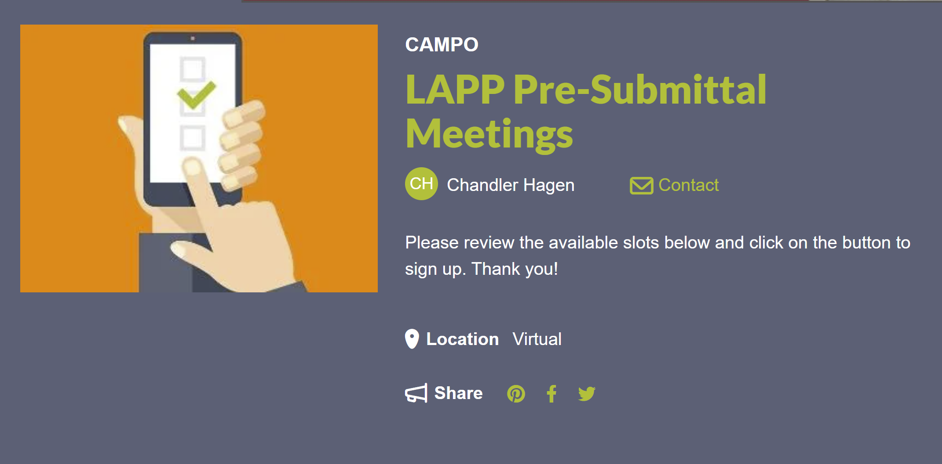
Pre-Submittal Sign-Up
Link to Sign-Up Genius
Meeting Schedule:
September 25, 26, & 28.
Schedule 30 – 60-minute windows to review submissions, depending on number of projects (up to 2 per half hour)
Deadline to sign up is September 20, 2023.

Slide 25
Cost Estimates
Cost Estimate Must be 2 Years within Application Year
Contingency:
Required Contingency: 25%
STRONGLY Recommended Variable Contingency
NCDOT Review Fees for Roadway and Bike/Ped Projects (10% or $5,000 – whichever is greater)
Phases Completed |  |  | Recommended Contingency
PE | ROW | CON | 45%
PE | ROW | CON | 30%
PE | ROW | CON | 25%

Slide 26
Parallel Route Selection Requirement
Roadway project on new location are evaluated using a “parallel route”
TEAAS (Safety)
V/C Ratio
Travel Time Savings
Add field to application for parallel route and require submittal prior to pre-submittal meetings. This will allow time for discussion and collection of TEAAS reports prior to submittal window deadline.

Slide 27
FHWA Transportation Conformity CMAQ/NEPA
Joe Geigle & Loretta Barren

Slide 28
Transportation Conformity

Slide 29
What is Transportation Conformity?
It’s how we ensure that Federal funding and approval goes to transportation activities that are consistent with air quality (AQ) goals

Slide 30
CAMPO Conformity Impacted Counties
Franklin
Granville
Johnston
Wake

Slide 31
What if conformity determination cannot be made?
The use of Federal aid funds is stopped
Impacts design work, right-of-way acquisition, construction, permitting and approval of environmental documents

Slide 32
What are conformity triggers?
Change of project scope
Change in number of lanes
Auxiliary lanes
Managed lanes (HOV/HOT)
Change in project length
Addition/deletion of an interchange
Replacing an intersection with an interchange

Slide 33
What initiates the need for a conformity determination?
Adoption or amendment of a MTP
Adoption or amendment of a local TIP or STIP (project scope, horizon year or termini change during project development – NEPA)

Slide 34
Transportation Conformity Implications
Conformity Implications
NO Conformity Implications
Projects in non-attainment or maintenance areas
Amendments (unless the project is exempt)
Projects NOT in non-attainment or maintenance areas
Administrative Modifications
Exempt projects

Slide 35
Planning and Transportation Conformity Amendment Timelines
Planning (no conformity)
2 to 3 months to add a project to MTP/TIP/STIP
Planning (with transportation conformity)
4 to 6 months conformity without a regional emissions analysis
9 to 12 months conformity with a regional emissions analysis

Slide 36
CMAQ
Congestion Mitigation & Air Quality Program

Slide 37
Congestion Mitigation & Air Quality Program (CMAQ)
Federal program that provides funding for projects or programs in air quality concern areas to help achieve & maintain air quality standards
Jointly administered by FHWA & FTA, in conjunction with EPA
Funding available for areas that are (or were) non-attainment or maintenance
Eligible projects / programs include those with air quality benefit that are likely to contribute to the attainment and maintenance of the standards
Notes:
Amendments required further reductions in allowable tailpipe emissions, more stringent control measures in nonattainment areas, and provided a stronger link transportation and air quality planning
CMAQ program was established to help realign the focus of transportation planning toward a more inclusive, environmentally-sensitive, and multimodal approach to addressing transportation problems
CMAQ has been included with each highway bill reauthorization
Since its inception, CMAQ has provided more than $13 billion in funding for more than 16,000 projects across the country
SAFETEA-LU funded CMAQ at approximately $1.7 billion per year which was a 27% increase over the TEA-21 authorization (BUT THIS HAS BEEN IMPACTED RECENTLY BY THE FEDERAL FUNDING RESCISSIONS)

Slide 38
Eligible CMAQ Projects
Congestion Reduction & Traffic Flow Improvements
Transit & Public Transportation Improvements
Bicycle & Pedestrian Facilities/Programs
Transportation Control Measures (TCMs)
Travel Demand Management
Public Education & Outreach
Idle Reduction
Alternative Fuels & Vehicles
Carpooling & Vanpooling
Diesel Engine Retrofits & Other Advanced Truck Technologies
Value/Congestion Pricing
Notes:
CMAQ projects generally fall into one of three broad categories:
Projects that reduce the number of vehicle trips and/or vehicle miles traveled (VMT)
Projects that reduce emissions by improving traffic congestion
Projects that reduce emissions through improved vehicle and fuel technologies
FUNDING SUMMARY ON NEXT SLIDE

Slide 39
CMAQ
Project Submittal Process
Initial Discussion with Applicants to Pre-screen Projects
CMAQ Application
Submitter review
MPO/RPO Endorsement and Approval

Slide 40
CMAQ
Interagency Review
FHWA, NC Division of AQ (NCDAQ), Environmental Protection Agency (EPA) and Federal Transit Administration (FTA) review applications for eligibility and provide review comments to NCDOT
Projects are not approved until comments/questions are addressed

Slide 41
FHWA CMAQ Project Authorization
CMAQ Application with Emissions Benefits
Metropolitan Transportation Plan (MTP)/Transportation Improvement Program (TIP)/State TIP
Federal Share
Environmental Document
Right of Way Authorization
Construction Authorization
Project Completion Date

Slide 42
NEPA
National Environmental Policy Act

Slide 43
NEPA
NEPA of 1969 (signed January 1, 1970)
Established Nat’l environmental policy & goals
Required agency disclosure of impacts of proposed actions and possible mitigation
Created basis for environmental impact statements (EIS) for major Federal actions
Created Council on Environmental Quality (CEQ)-monitors Federal actions, provides overall guidance, tracks trends and resources.

Slide 44
When Does NEPA Apply?
For FHWA, basically when a project is proposed for Federal-aid Highway Funding
Action-highway or transit project proposed for FHWA funding, but…
…actions must also include activities such as multiple use permits or changes in access control that may or may not involve commitment of funds

Slide 45
What must be considered?
Natural and “built” environments
Agencies must take a “hard look” at consequences of actions and keep public informed
NEPA goal: Promote efforts which will prevent or eliminate damage to the environment

Slide 46
What are Classes of Actions?
Categorical Exclusion (CE)-actions which do not individually or cumulatively have a significant effect on the human environment
Environmental Assessment (EA)-significance of environmental impact is not clearly established; to determine the appropriate environmental document required
Environmental Impact Statement (EIS)-detailed written statement on major Federal actions significantly affecting the human environment

Slide 47
Categorical Exclusion (CE)
Current Version is October 2019
General Documentation
Consultations

Slide 48
What will be needed to receive the Federal Funds?
Completed/approved environmental document (PCE/CE/EA/EIS)
Approved change in access if building/modifying and Interstate interchange.

Slide 49
Additional NEPA Resources
Federal Aid Essentials for Local Public Agencies
http://www.fhwa.dot.gov/federal-aidessentials/
NCDOT Local Projects Administration
https://connect.ncdot.gov/municipalities/funding/Pages/default.aspx
Local Programs Management (LPM) Handbook Updates
https://connect.ncdot.gov/municipalities/Funding/Pages/LPM%20Handbook.aspx

Slide 50
Questions????

Slide 51
FHWA Funding, Monitoring & Reporting
NCDOT Local Project Delivery
Tammy Richards - FHWA

Slide 52
FHWA’s Role
To provide Federal funding for your project.
To ensure that our Federal dollars are spent appropriately.
To ensure that there is no fraud, waste and/or abuse.
To ensure that the recipient/sub-recipient has a good project.
To ensure that the recipient/sub-recipient has every opportunity to keep every dollar of their Federal funds.
I AM NOT here to make the process hard for you or to “ding” you, but there are regulations that YOU have agreed to uphold by asking for and receiving our money.

Slide 53
NCDOT’s Role
Although NCDOT doesn’t have any funds in LPA projects, they have oversight of all LPA projects.
23 CFR 635.105(a) & (b)
The State Transportation Department (STD) has responsibility for the construction of all Federal-aid projects, and is not relieved of such responsibility by authorizing performance of the work by a local public agency or other Federal agency. The STD shall be responsible for insuring that such projects receive adequate supervision and inspection to insure that projects are completed in conformance with approved plans and specifications.
Although the STD may employ a consultant to provide construction engineering services, such as inspection or survey work on a project, the STD shall provide a full-time employed State engineer to be in responsible charge of the project.
If funds have to be re-paid or deemed non-participating, they are taken from NCDOT and then the municipality will be responsible for paying NCDOT (or it will be taken from your Powell Bill).

Slide 54
Common Terms
Contract Authority U.S. Congress: “You (NCDOT) might be able to obligate X dollars . . .” Obligation Ceiling (or Obligation Limitation) “. . . but, based on overall budget conditions, you can only obligate Y dollars” Funds programmed (not yet guaranteed) NCBOT adopts a new "Funding Program" (7-year STIP) every two years Funds obligated (safe from rescission axe) Upon NCDOT request, FHWA agrees to reimburse for a specific project Rescission (“Houston, we have a problem”) Congress decreases the State’s Contract Authority

Slide 55
2 CFR 200 “The Supercircular”
Period of Performance:
Imposes a period when project costs can be incurred
Start Date (Project Effective Authorization Date) through the End Date
Costs can only be incurred within start and end date
After project end date - no additional costs can be incurred
Requires that projects be closed out 15 months after the “End Date” established and documented on the FHWA Authorization
Extension/modification of End Date is authorized by the awarding agency when there is a project delay beyond the control of the recipient/subrecipient

Slide 56
Project/Funds Authorization
FHWA commitment that Federal funds are available for the project
Preliminary Engineering (PE) – (you have 10 years to construct the project – “Studies” are not a good idea) CFR 630.112(2)
Right of Way acquisition (ROW)
Construction (CON)
Authorization is required prior to incurring any expenses
End Dates should be constructed based on Historical Data
Work done before the date of FHWA Division authorization is NOT eligible for reimbursement

Slide 57
Inactive Projects
- An Inactive Project is defined as any project (regardless of the dollar value) that has not had any expenditures charged to it in FHWA’s system in the given timeframe (6 Months).
Once a project hits the 1-year report, FHWA’s Finance Section is REQUIRED to deobligate the funding.
Remember that the Municipal Agreement states that a project must be invoiced at least once every 6 months to keep the project active and eligible for Federal funding.
The Municipal Agreement also states:

Slide 58
Review Findings
1. Expenditures occurred before FHWA Authorization was signed
2. Projects not competitively bid
3. Improper pay records/diaries
4. Improper weigh tickets
5. Improper certified payrolls
6. Improper wage rate interviews
7. Improper material received reports
8. Improper Buy America Certification
9. Improper testing/test reports
10. Improper DBE documentation
11. Improper NCDOT oversight
12. NCDOT personnel were not verifying pay quantities before approving invoices
13. Force Account by local agency
14. Municipality destroyed records before the end of the records retention date

Slide 59
Items Typically Reviewed
Advertisement/Bid documents
Consultant Selection process
Project Diaries
Pay Record Books
Concrete/Asphalt/ABC test results/frequencies
Weight tickets
Pay Estimates
Supplemental Agreements
Wage Rates/Interviews
DBE/Subcontractors
Grading
Traffic Control
Erosion Control
Signs
Material Certifications
Job-site Posters
LPA/NCDOT Oversight
Project Final Acceptance Process

Slide 60
Preliminary Project Reviews
LPA Program Manager will be conducting two types of reviews:
Pre-Construction Conference Attendance/Review – When you receive your Concurrence In Award letter from NCDOT, it will have on it that an invitation to the Pre-Construction Conference should be sent to your NCDOT contact, NCDOT M&T Contact, as well as myself.
Please don’t “forget” to invite NCDOT. Someone from DOT (or their representative) needs to be at each Pre-Construction Conference.
Records Reviews – Will consist of a review of all project records and documentation for the project around 50%-75% of project completion. (I will provide a copy of the checklist that I use!)

Slide 61
Material Certification
In order to achieve project final certification, the NCDOT (Materials & Test Unit) will need to certify your project (requested by an NCDOT-1446B form). Please make sure all records are available for their review.
Note to NCDOT & Municipalities: Please schedule M&T’s review, the punch list walk through, final invoice, etc. as soon as you can in the final acceptance process to ensure proper (and timely) project closeout.
2 CFR 200 (aka: Supercircular) - Requires that projects be closed out 15 months after the “End Date” established and documented on the FHWA Authorization.
If timeframes are not met, the Supercircular states that ALL project funds shall be taken back.

Slide 62
Project Closeout & Records Retention
A Federal project is not closed out until FHWA closes it in our project tracking system (FMIS). After NCDOT fiscal has received the NCDOT-1446B and the Material Certification Letter from M&T, they close the project in their accounting system and send it electronically to our FMIS system for closure.
A Final Voucher Date is assigned to the project once it has been closed in FMIS.
The NCDOT Division will send the municipality a letter letting you know what your Final Voucher Date is.
Keep all project records for three years after the Final Voucher Date as they can be audited by FHWA until that time!

Slide 63
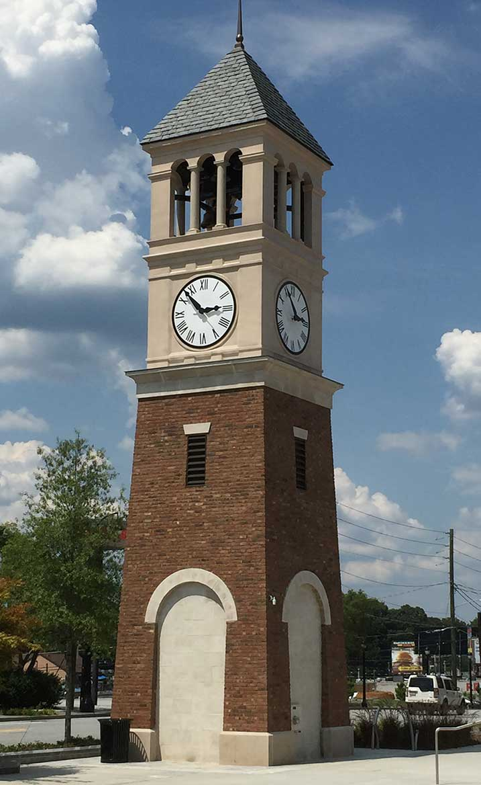
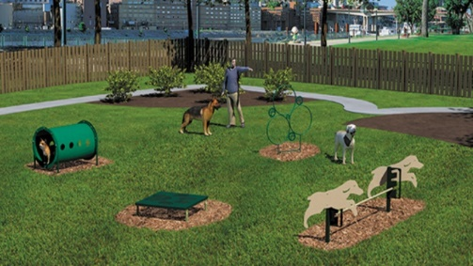
Example of Items That Are Not Eligible

Slide 64
Don’t Be Afraid To Ask For Help!
Remember: If you have questions, run into a problem or don’t know how to handle something, please ask your NCDOT partners. They are there to help you and to keep you out of trouble!

Slide 65
Questions?
Tammy Richards
FHWA – Local Programs Manager
(919) 747-7005
Tammy.Richards@dot.gov

Slide 66
Application Overview for Local Projects
Copy/paste any of the icons below into your presentation. Please change color to white if using them on a dark background.
Marta Matthews and Raymond Hayes, PE
August 17, 2023

Slide 67
CAMPO Applicant Training
Other slide variations are available. Select Insert above and choose “new slide” to see all the options.
WHAT MAKES A GOOD PROJECT?
SCHEDULE
SCOPE
BUDGET

Slide 68
CAMPO Applicant Training
Other slide variations are available. Select Insert above and choose “new slide” to see all the options.
PROJECT COORDINATION – FHWA REQUIREMENTS
LPMO
DIVISION
Procedural
Requirements
/Agreements
Engineering
Requirements
Budget Availability
CAMPO

Slide 69
CAMPO – CHANDLER HAGEN
Other slide variations are available. Select Insert above and choose “new slide” to see all the options.
CAMPO Applicant Training
Initial Source of Funding
Manages Scoring & Project Selection Process
Additional funding for your Project
Transferring funds from one Project to Another
Scope Changes to your Project

Slide 70
Local Programs Management Office (LPMO)
Other slide variations are available. Select Insert above and choose “new slide” to see all the options.
CAMPO Applicant Training
Division 4 & 6: Justin Jorgensen
Division 5: Sheila Gibbs
EBS (Enterprise Business Services)
Agreement / Supplemental Agreements
Funding Authorizations
Professional Services Reviews
RFLOI
Man-day estimates
Contracts
PE Claims (reimbursements)

Slide 71
DIVISION OFFICE
Other slide variations are available. Select Insert above and choose “new slide” to see all the options.
CAMPO Applicant Training
Division 4: Addison Gainey
Division 5: Raymond Hayes
Division 6: Cedrick Graham
CE Document and CE Consultation
ROW Appraisal Review
ROW Certification
Utility/RR Certification
Plans (25%, 65%, 90% and Final)
ROW/Construction Claims (reimbursements)
Contract Proposal
Closeout

Slide 72
LPMO or DIVISION
Other slide variations are available. Select Insert above and choose “new slide” to see all the options.
CAMPO Applicant Training
We all work together, so please reach out for questions or assistance as you work through your project.

Slide 73
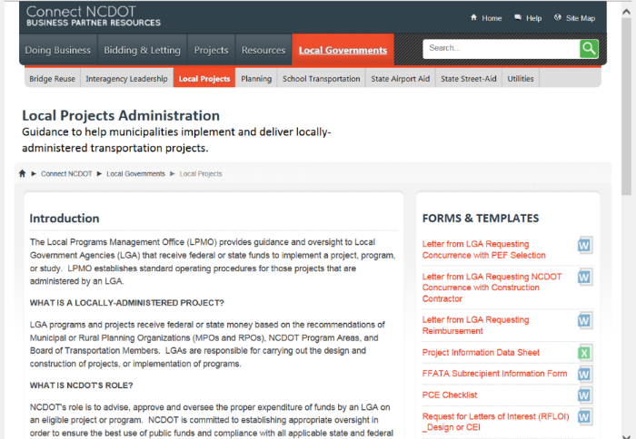
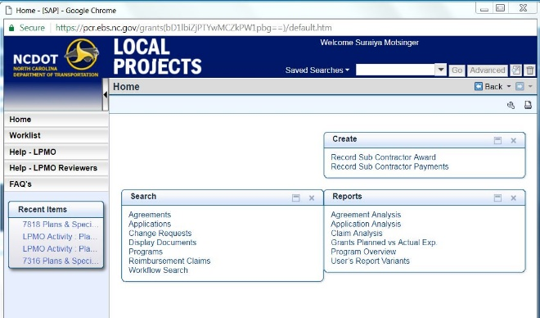
Project Development Communication Protocol
Other slide variations are available. Select Insert above and choose “new slide” to see all the options.
CAMPO Applicant Training
AVAILABLE TOOLS
EBS PORTAL
LPMO FORMS/TEMPLATE LETTERS
E-MAILS/PHONE/TEAMS
SHARE POINT

Slide 74
General Overview of Project Delivery
CAMPO Applicant Training
Other slide variations are available. Select Insert above and choose “new slide” to see all the options.
MTIP Approval
Scope Refinement
Agreement
PE Authorization
Environmental Approvals
ROW Authorization
ROW
Approvals
PS&E Approvals
Construction Authorization

Slide 75
PROJECT DELIVERY
Other slide variations are available. Select Insert above and choose “new slide” to see all the options.
CAMPO Applicant Training
Major Emphasis with NCDOT
Locally Administered Projects (LAPs) are in the STIP – must have a schedule!
When milestones are missed, EVERYONE gets questions
Be REALISTIC when setting schedules
Expect the Unexpected
Project completion occurs after completion of construction – must close out Projects to complete

Slide 76
MAJOR SHOW STOPPERS
Other slide variations are available. Select Insert above and choose “new slide” to see all the options.
CAMPO Applicant Training
FEASIBILITY
POORLY DEFINED SCOPE
CONSTRUCTABILITY
AVAILABLE RIGHT OF WAY
EXTENT OF UTILITY CONFLICTS

Slide 77
MAJOR SHOW STOPPERS
Other slide variations are available. Select Insert above and choose “new slide” to see all the options.
CAMPO Applicant Training
FUNDING
Unrealistic Estimates
Scope Creep (or Scope Reduction)
Inaccurate quantities (or no quantities)
No estimate for Right of Way
No estimate for Utility Relocation
Environmental Issues

Slide 78
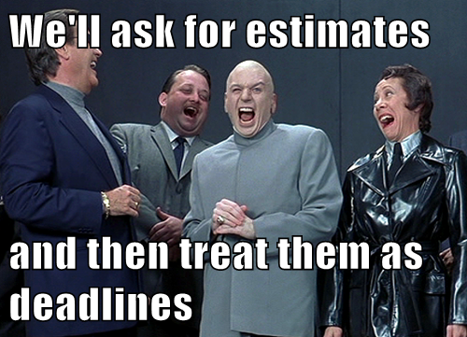
UNREALISTIC ESTIMATES
Other slide variations are available. Select Insert above and choose “new slide” to see all the options.
CAMPO Applicant Training
Do not use bid prices from a previous project
NCDOT publishes average bid prices
Re-advertising issues/problems
Adjusting engineer’s estimate
Negotiating with bidders not permitted
Cost Escalation

Slide 79
RIGHT OF WAY ISSUES
Other slide variations are available. Select Insert above and choose “new slide” to see all the options.
CAMPO Applicant Training
All ROW incorporated into Project must be certified
Must follow the “Uniform Act”
Condemnation
Multiple Property Owners
Title Issues
***This phase always takes longer than you think***

Slide 80
UTILITY ISSUES
Other slide variations are available. Select Insert above and choose “new slide” to see all the options.
CAMPO Applicant Training
Power company will not begin eingeering until plans are complete, at least up to Hydro
What about utilities underground (communication, gas, water/sewer)
Most underground utilities are by encroachment
Permanent Utility Easements (PUEs)
Utility /RR Certification
Utilities can get pricey

Slide 81
OTHER ADMINISTRATIVE COSTS
Other slide variations are available. Select Insert above and choose “new slide” to see all the options.
CAMPO Applicant Training
Funds for each phase of work must be authorized prior to any work being performed
PE is around 10-15% of your construction cost
ROW costs can be harder to predict
Contract Administration/Construction Engineering and Inspection (CEI) shouldn’t exceed 15% of construction contract, but exceptions can be made
Review and Oversight Agreements for NCDOT’s review of plans prior to Federal Fund availability
NCDOT COSTS – We will charge to your project, be prepared for NCDOT’s review costs.

Slide 82
COMMUNICATION
CAMPO Applicant Training
KEEP IN TOUCH!!!

Slide 83
QUESTIONS?

Slide 84
Other slide variations are available. Select Insert above and choose “new slide” to see all the options.
Sheila Gibbs
Raymond Hayes
sbgibbs@ncdot.gov
Ext-rjhayes@ncdot.gov
919-707-6625
919-628-8999

Slide 85
Other slide variations are available. Select Insert above and choose “new slide” to see all the options.

Slide 86
NCDOT Right of Way
Division Office: Authorization & Certification
Raleigh Office: Appraisal Review

Slide 87
Right of Way Acquisition
GETTING STARTED
MUNICIPAL AGREEMENT/SUPPLEMENTALS
MUST BE SIGNED
READ RIGHT OF WAY SECTIONS FOR ADHERENCE
MUST BE SUBMITTED WITH VALUATIONS/APPRAISALS
CONSTRUCTION PLANS
IDENTIFY THE EXISTING RIGHT OF WAY LIMITS
PREFER A PARCEL NUMBER, OWNER’S NAME, DEED REFERENCE, AND PIN
MUST BE APPROVED AND SUBMITTED WITH VALUATIONS/APPRAISALS

Slide 88
Right of Way Acquisition
NEXT
PROGRESS REPORTS AND TIME CHARGES
PARCEL ENTRY SPREADSHEET TO SET UP IN NCDOT SAP
REPORT B TO TRACK PROJECT PROGRESS
APPRAISAL/VALUATIONS
ALL APPRAISALS AND VALUATIONS MUST BE APPROVED BY NCDOT PRIOR TO OFFERS
WAIVER VALUATIONS CAN BE USED FOR VALUES $10,000.00 OR LESS
VALUES IN EXCESS OF $10,000 AND CONDEMNATIONS MUST BE APPRAISED BY NCDOT RECOMMENDED APPRAISERS AND REVIEWED BY NCDOT AREA APPRAISAL DEPARTMENT
OWNERS MUST KNOW THEY HAVE A RIGHT TO ACCOMPANY THE APPRAISER WAIVER VALUATIONS APPROVALS CAN BE FACE TO FACE OR EMAILED

Slide 89
Right of Way Acquisition
DEEDS/AGREEMENTS
ALL DEEDS/AGREEMENTS MUST HAVE A LEGAL DESCRIPTION
LAND CONVEYED TO THE NCDOT MUST BE VETTED AND ACCEPTED
IF NCDOT WILL CONSTRUCT AND/OR MAINTAIN THE RIGHT OF WAY, DEEDS WILL NEED TO BE CONVEYED FROM THE OWNER TO THE LPA WITHOUT SPECIAL PROVISIONS THAT WILL EXTEND TO THE NCDOT
AFTER THE PLANS HAVE RECEIVED NCDOT FINAL APPROVALS OR FINAL CONSTRUCTION APPROVAL THE LPA WILL REQUEST TO CONVEY RIGHT OF WAY TO THE NCDOT FOR ACCEPTANCE
THE NCDOT MUST ACCEPT ALL RIGHT OF WAY TO VALIDATE THE CONVEYANCE

Slide 90
Right of Way Acquisition
GUIDELINES
FOLLOW THE UNIFORM ACT OF 1970
REQUIRED ADHERENCE IF ONE DOLLAR OF FEDERAL FUNDS IS INVOLVED IN THE PROJECT
MAKE OFFERS
ALL OFFERS MUST BE MADE IN WRITING
WAIVER FORMS
MUST BE SIGNED BY PROPERTY OWNERS FOR ALL DONATIONS
MUST ALWAYS BE SIGNED BY THE LPA
CLEAR TITLE
IT IS THE REPONSIBILITY OF THE LPA TO SECURE CLEAR TITLE OF THE LANDS ACQUIRED FOR CONSTRUCTION
TITLES AND RELEASES ARE REQUIRED IF LAND IS TO BE CONVEYED TO THE NCDOT FOR MAINTAINENCE
CONDEMNATIONS
PROPERTY OWNER RIGHTS MUST BE APPLIED

Slide 91
Right of Way Acquisition
GUIDELINES
SETTLEMENTS
CLAIMS ARE SETTLED ONCE THE OWNER ACCEPTS THE APPROVED JUST COMPENSATION OR NEGOTIATED AMOUNT IN WRITING BY DEED/AGREEMENT
CLOSINGS
CLAIMS ARE CLOSED ONCE THE DEED/AGREEMENT IS RECORDED IN THE COURTHOUSE
EMINENT DOMAIN
CLAIMS ARE FILED ONCE THE DOCUMENTS AND JUST COMPENSATION FUNDS ARE DEPOSITED IN THE CLERK’S OFFICE VIA MEMORANDUM OF ACTION DEED BOOK AND PAGE
CERTIFIABLE CLAIM
ONCE ALL CLAIMS ARE CLOSED OR FILED AND THE PROPERTY OWNER OR LIEN HOLDER HAS BEEN PAID

Slide 92
Right of Way Certification
CERTIFICATION REQUEST SUBMISSION PACKAGES
CHECKLIST IS AVAILABLE ON THE CAMPO WEBSITE OR UPON REQUEST
PROJECT SUBMISSION MAY TAKE 2-8 WEEKS TO BE REVIEWED
A FACE-TO-FACE CERTIFICATION MEETING CAN BE SCHEDULED IF ALL RIGHT OF WAY IS ACQUIRED
RIGHT OF WAY DISCUSSION UPON REQUEST BUT NO PARTIAL CERTIFICATION SUBMISSIONS

Slide 93
Right of Way Certification
All acquisition must be in conformance with the “Uniform Act,” whether ROW Acquisition is being reimbursed with Federal funds or not.
Certification is done by the Division ROW Agent:
Div. 4 Lloyd Johnston
Div. 5 Brian Rogers
Div. 6 Raphael A. Marshall
Certification is the document that concurs that the LPA has legal access of all ROW needed for project.
Notes:
The third piece is the ROW Certification – the Division ROW Agent reviews your acquisition process, your property – they usually need a final set of plans and any documentation that shows your “control” of the property – through deeds, lease, easements.

Slide 94
CAMPO
Locally Administered Projects Program
(LAPP)

Slide 95
Application Process
Required Pre-Submittal Project Information
Project Description
Problem Statement
Project Extent
Project Budget
Project Schedule
Project Map and GIS layers
Parallel Route for New Location Roadway Projects
Pre-Submittal Deadline: September 20, 2023

Slide 96
Application Process
Required Final Project Submittal Information
TEAAS Reports (EPDO), CRF
Problem Statement (CTP/NEPA Guidelines)
Copy of all other pertinent project information/justification
Projects with rail crossings
Toll related projects
ITS specifications
Submittal Deadline October 31, 2022, noon
Notes:
Traffic Engineering Accident Analysis System (TEAAS)

Slide 97
Scoring
Highway projects will be scored against other highway projects
Bicycle and pedestrian projects will be scored against other bicycle and pedestrian projects
Transit projects will be scored against other transit projects.
All projects are expected to score at least 50% of the points awarded to the top-scoring project in each mode.
If a project does not score at least 50% of the top project’s point value, the project will be routed to the LAPP scoring committee to determine if the project should be funded, or if the funds from that modal mix element should be reallocated to the other modal mix element to fund higher-scoring projects.

Slide 98
Scoring / Prioritization: Roadway
Selection Criteria:
Local Priority (up to 10 pts /project – 15 pts total)
MTP Compliant (up to 10 pts)
Prior Funding (up to 10 pts)
Modal Effectiveness (up to 50 pts)
Total Points 80 pts

Slide 99
Scoring / Prioritization: Bike/Ped
Selection Criteria:
Local Priority (up to 10 pts /project – 15 pts total)
MTP/Plan Compliant (up to 10 pts)
Prior Funding (up to 10 pts)
Modal Effectiveness (up to 50 pts)
Total Points 80 pts

Slide 100
Scoring / Prioritization: Transit
Selection Criteria:
Local Priority (up to 10 pts /project – 15 pts total)
MTP/Plan Compliant (up to 10 pts)
Prior Funding (up to 10 pts)
Modal Effectiveness (up to 50 pts)
Total Points 80 pts

Slide 101
Scoring Criteria: Local Priority
Local Priority
15 points per agency per mode
All submissions must have at least 1 pt. assigned
No more than 10 pts for any project

Slide 102
Scoring Criteria: MTP/Plan Compliant
Roadway
1st Horizon Year MTP Project (2030) – 10 points
2nd Horizon Year MTP Project (2040) – 5 points
Multi-use Path & On road Bike
MTP Classification (Statewide) – 10 points
MTP Classification (Regional) – 5 points
MTP Classification (Local) – 3 points
Sidewalks (Adopted Plan)
Project included in locally adopted transportation plan – 5 points
Transit (Plan Compliant)
1st Horizon Year MTP Project (2030)/
1st Ten Years of Wake Transit Work Plan -10 Points
2nd Horizon Year MTP Project (2040) - 5 Points

Slide 103
Scoring Criteria: Prior Funding
Prior Agency Funding Amount
Scoring based on Per-Capita Funding
Prior 5 yr. period (FY 17-22)
Funding = $0 = 10 points
Funding < $50 = 8 points
Funding < $100 = 6 points
Funding < $150 = 4 points
Funding < $200 = 2 points
Funding => $200 = 0 points
Use NC Certified Estimates (updated annually)
NCDOT Division projects
Use the points for the project location
Funding will be included in local prior funding score
Regionally significant projects (ITS, Interchange) would not count against the local jurisdiction
Projects to address a Safety concern are exempt

Slide 104
Scoring: Modal Effectiveness (maximum 50 points)
Roadway Effectiveness (*must improve traffic conditions)
Congestion
Safety
Bicycle/Pedestrian Effectiveness
Missing Link
Overcome an Obstacle
Connections
Improve Commuter Patterns
Safety
Benefit/Cost
Transit Effectiveness
Rider Experience
Improved Facilities
Safety and Security Concerns
Reliability Improvements
Connectivity
Benefit/Cost
Project Phase Multiplier
CON = 100% of score
ROW = 50% of score
PE/NEPA = 10% of score

Slide 105
Scoring: Roadway Effectiveness
Congestion(10 pts)
Current Volume to Capacity Analysis
V/C < .2 = 0 points
V/C < .4 = 2 points
V/C < .6 = 6 points
V/C < .8 = 8 points
V/C > .8 = 10 points
Benefit/Cost (20 pts)
Travel Time Savings / Cost to the LAPP Program
Scaled with top project earning 20 points

Slide 106
Scoring: Roadway Effectiveness
Safety (FHWA Crash Reduction Factors) (10 pts)
CRF < 10% = 0 points
CRF > 10% = 2 point
CRF > 20% = 4 points
CRF > 30% = 6 points
CRF > 40% = 8 points
CRF > 50% = 10 points
http://www.cmfclearinghouse.org and https://safety.fhwa.dot.gov/rsdp/
EPDO Score (TEAAS Crash Report) (10 pts) *APPLICANT SUBMITS
Additional TEAAS guidance to be provided.
EPDO Score can be reviewed at pre-submittal meeting

Slide 107
Scoring: Bike/Ped Effectiveness
Missing Link (10 pts)
Both sides connect to existing Bike/Ped facility
Scale by distance of continuous facility (on residential collector or higher)
< .5 mi 1 point
.5 mi to 2 mi 5 points
>2 mi 10 points
Overcoming an Obstacle (5 pts)
Project must create the crossing, not improve an existing crossing
Limited-access facility, Railroad, Major Stream (USGS) - 5 points
Other 4+ Lane Roadway - 3 points
Connections (15 pts)
.25 mi to other mode/greenway or activity center (i.e. school, parks/rec, shopping center, high density res, etc.)
Points per connection

Slide 108
Scoring: Bike/Ped Effectiveness
Proven Demand (5 pts)
Serves a footpath (residential collector or higher)
Within +/- .25 mi of existing or proposed transit services
Safety (5 pts)
Project addresses a documented safety issue (TEAAS crash report, local crash data, roadway safety audit, etc.)
Benefit/Cost (10 pts)
Effectiveness Score / LAPP Cost (Scale to be created based on projects received)

Slide 109
Scoring: Transit Effectiveness
Improved Facilities (10 pts)
# average daily ridership anticipated in 12 months after improvement.
(Scale to be created based on projects received)
Connectivity (10 pts)
Directly connects the transit user with other modes, routes, systems, or destinations.
Benefit/Cost (10 pts)
Effectiveness Score / LAPP Cost (Scale to be created based on projects received

Slide 110
Scoring: Transit Effectiveness
Reliability Improvements (10 pts)
Points awarded based on project type and relative impact to reliability.
Safety and Security Concerns (5 pts)
Points awarded based on project type and relative impact to safety and security.
Rider Experience (5 pts)
Points awarded based on project type and relative impact to rider experience.

Slide 111
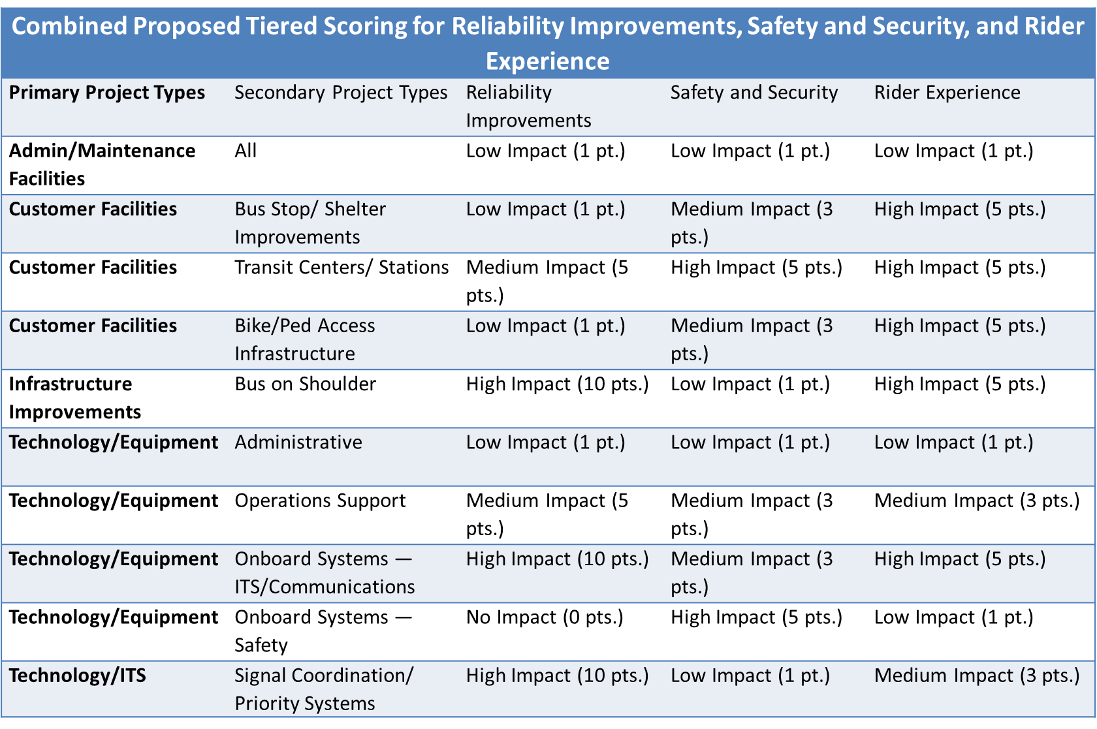
Scoring: Transit Effectiveness

Slide 112
Bundled Transit Projects: Location Requirements
LAPP transit applications are required to include locations of bundled projects Ex: bus stop improvements, enhanced transfer points.

Slide 113
Equity in LAPP Scoring
Equity in Scoring Criteria has been discussed through multiple LAPP iterations
Concerns on how to properly include equity in scoring
Nuances on how equity is measured
Staff Recommendation:
Spring 2023: Use feedback to develop scoring criteria, weights, and measures
FFY 25 LAPP cycle: Incorporate an equity metric into the LAPP scoring criteria for testing purposes only

Slide 114
Equity in LAPP Scoring
Addressing equity in transportation requires historically underserved communities to benefit from access to a generational investment in transportation projects with local impact.
USDOT’s Transportation Equity Scorecard Tool and User Guide (2021)
Integrating Equity into MPO Project Prioritization (2022)

Slide 115
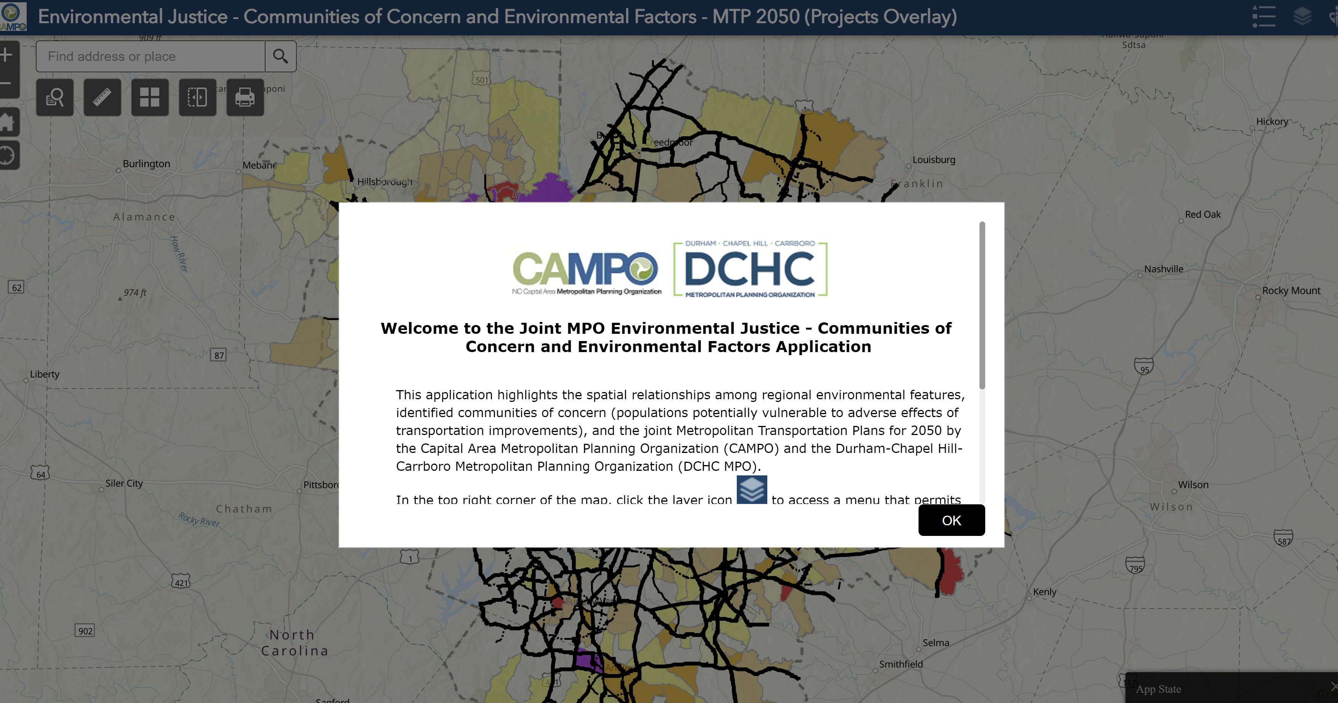
Equity in LAPP Scoring: Communities of Concern (CoC)
For the purpose of LAPP, it is proposed that underserved communities will be identified using CAMPO’s Communities of Concern which classify protected classes using block group census data.
Age 70+
Hispanic/Latino
Limited English Proficiency
Low Income
Minority (Non-white)
Zero Car Household

Slide 116
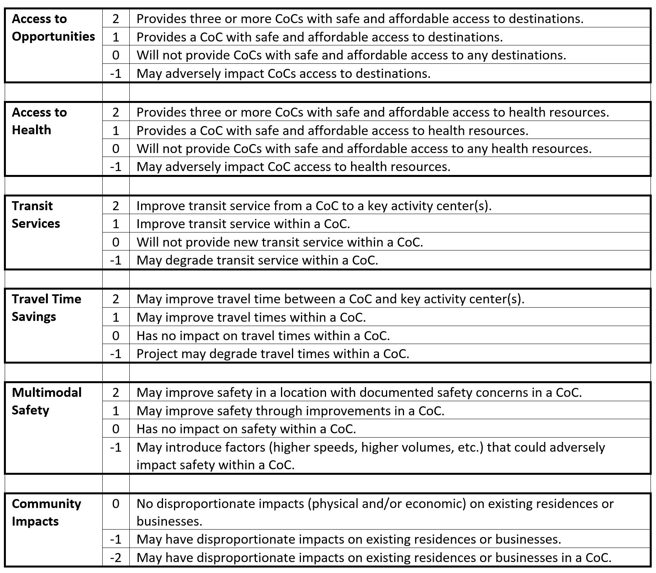
Equity in LAPP Scoring: Draft Scorecard
Earn a maximum of 10 points for projects impacting Communities of Concern. Negative points will be assigned for negative impacts.

Slide 117
Equity in LAPP Scoring: Draft Methodology
Access to Opportunities | 2 | Provides three or more CoCs with safe and affordable access to destinations.
 | 1 | Provides at least one CoC with safe and affordable access to destinations.
 | 0 | Will not provide CoCs with safe and affordable access to any destinations.
 | - 1 | May adversely impact CoCs access to opportunity destinations.
Define “safe and affordable access” as the ability to safely walk or bike to a destination.
Create a quarter-mile radius buffer around the project.
Identify areas with CoCs (origins) and identify the locations of educational facilities and community services (destinations) within the project buffer.
Use GIS or other mapping tools to determine if the project connects or improves connections for cyclists and/or pedestrians between these origins and destinations.
Answer the following application questions:
Does your project provide one or more CoCs with safe and affordable access to opportunity destinations? If YES -
How many CoCs does it connect?
List the opportunity destination(s).

Slide 118
Equity in LAPP Scoring: Draft Methodology
Access to Health Resources | 2 | Provides three or more CoCs with safe and affordable access to health resources.
 | 1 | Provides at least one CoC with safe and affordable access to health resources.
 | 0 | Will not provide CoCs with safe and affordable access to any health resources.
 | -1 | May adversely impact CoC access to health resources.
Travel Time Savings | 2 | May improve travel time between a CoC and key activity center(s)*.
 | 1 | May improve travel times within a CoC.
 | 0 | Has no impact on travel times within a CoC.
 | -1 | Project may degrade travel times within a CoC.
Transit Services | 2 | Improves transit service from a CoC to a key activity center(s)*.
 | 1 | Improves transit service within a CoC.
 | 0 | Will not improve transit service within a CoC.
 | -1 | May degrade transit service within a CoC.
*Key activity centers were defined for the MTP as part of a regional effort and the data set is managed by TJCOG.

Slide 119
Equity in LAPP Scoring: Draft Methodology
Multimodal Safety | 2 | May improve safety with documented safety concerns in a CoC.
 | 1 | May improve safety in a CoC.
 | 0 | Has no impact on safety within a CoC.
 | -1 | May introduce factors (higher speeds, higher volumes, etc.) that could adversely impact safety within a CoC.
Does your project include safety improvements within a CoC? If YES –
Describe the safety improvements or countermeasures included in your project.
These include protected bike lanes, pedestrian refuge islands, signalized midblock crossing treatments, traffic calming, etc.
Does your project address documented safety concerns within a CoC? If YES –
Has documentation of the safety concerns been uploaded?
Provide documentation for safety concerns. A ten-year history TEAAS report is recommended as documentation of a safety concern but local police reports may also be used.

Slide 120
Equity in LAPP Scoring: Draft Methodology
Community Impacts | 0 | No negative impacts (physical and/or economic) on existing residences or businesses.
 | -1 | May have negative impacts on existing residences or businesses.
 | -2 | May have negative impacts on existing residences or businesses in a CoC.
IMPACT
Increases traffic through neighborhoods. | A roadway project that adds capacity to a neighborhood street, referred to by Federal Highway Administration functional classification as “urban local”, “urban collector”, or “local”.
Increases vehicle speeds. | Designs a new roadway or modifies an existing street for higher speeds.
Requires land acquisition for necessary right-of-way. | Determine a threshold for total land acquisition out of total area of parcels impacted.
Requires relocations of homes and businesses. | Identify if a home or businesses is located within the right-of-way.
Results in changes to neighborhood character and land uses. | Automobile-oriented transport planning tends to cause more dispersed, automobile-oriented development (sprawl) while walking and transit improvements tend to have opposite effects, encouraging more compact, mixed, multi-modal development.
Creates a barrier to walking and cycling. | Constructs a new road or widens an existing road without providing safe and accessible crossing accommodations for pedestrians and cyclists.

Slide 121
Equity in LAPP Scoring: Committee Discussion
Create an alternative score where youth (16 years and under) populations are also considered.
Create an alternative score that allows an opportunity for the municipality to provide a narrative that illustrates other benefits to a CoC not captured in the scoring criteria.
Consider using a simplified scoring process that assigns one score based on if a CoC is in proximity to the project.

Slide 122
Project Scoring & Prioritization
All projects are expected to score at least 50% of the top-scoring project for each mode.
If a project does not score at least 50% of the top project’s point value, the project will be reviewed to determine programming eligibility
Un-programmed funds from that modal mix element may be reallocated to the other modes to fund higher-scoring projects.
All recommendations from the LAPP committee will be submitted to the TCC and Executive Board for review and approval.

Slide 123
Selection Process
Project Eligibility Review
Project Scoring
LAPP Scoring Committee Review & Recommendation
TCC Review & Recommendation
Executive Board Review & Programming

Slide 124
Project Reporting Requirements
In addition to the requirements associated with receiving federal funding, the MPO will also require regular reporting on projects funded through the LAPP.
Applicants are required to provide updates to the MPO outlining where the project is in the timeline toward funding obligation of all phases awarded for the project. This includes NEPA, plan and right-of-way submittals.
More frequent communications are required if project location, schedule or funding changes are likely to occur.
Applicant are also required to include CAMPO on key date communications toward implementation of the project, such as bidding, groundbreaking and opening ceremonies.

Slide 125
Important Dates
August 17, 2023 | Opening of LAPP Database
Sept. 20 | Pre-Submittal Deadline
Sept. 25, 26, & 28 | Pre-Submittal Meetings
Oct. 31, NOON | Project Submission Deadline
Nov. 2023 | Eligibility Review & Scoring
Dec. 2023 | LAPP Selection Panel Meeting

Slide 126
Questions????
Chandler Hagen
CAMPO LAPP Manager
Chandler.Hagen@campo-nc.us

