Slide 1

FY 2027 Work Plan Project Agreement Groupings and Reporting Deliverables
Transit Planning Advisory Committee
April 30,2026

Slide 2
FY27 Work Plan Project Agreement Groupings and Reporting Deliverables
Background - The purpose of the agreements is to guide deliverables for funds appropriated in the Wake Transit major capital and operating funds appropriated by the tax district.
Operating Agreements or Master Agreements- an agreement between an agency tasked to provide an Implementation Element, the Tax District and other agencies as needed, or an operating plan if the Implementation Element is to be provided by the Agency. The agreement shall state the details of the service to be provided and detail expectations on funding, responsibilities, schedule and performance. The agreement shall adhere to minimum standards outlined in Section 8.02 of [the Transit Governance ILA]. Master agreements mean an Operating or Capital Funding agreement that directs a discrete logical grouping of projects, operations or studies.
Capital Funding Agreements or Master Agreements - an agreement between an agency and other agencies to provide an Implementation Element or a project plan if the implementation element is to be provided by the Agency. The agreement or project plan shall state the details of the capital improvements to be provided and detail expectations on funding, responsibilities, schedule and performance and shall adhere to minimum standards outlined in Section 7.01 of [the Governance ILA]. Master agreements mean an Operating or Capital Funding agreement that directs a discrete logical grouping of projects, operations or studies.
GoTriangle/Tax District Administration is the Lead Agency for this initiative

Slide 3
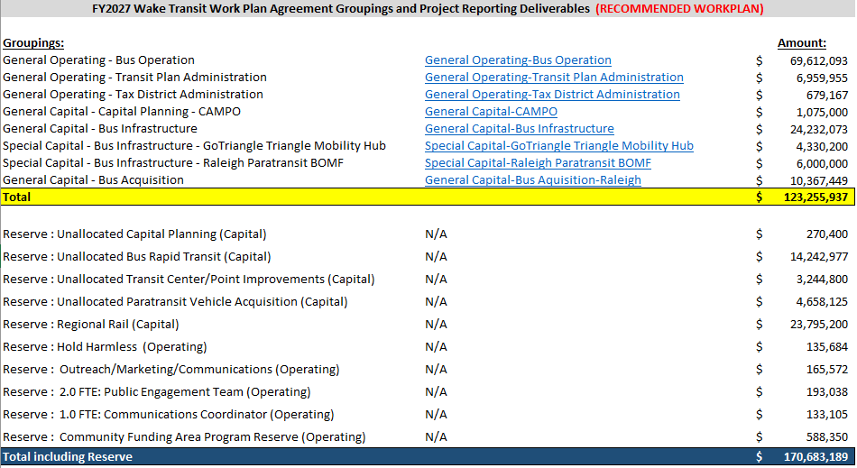
FY27 Work Plan Project Agreement Groupings and Reporting Deliverables
Summary

Slide 4
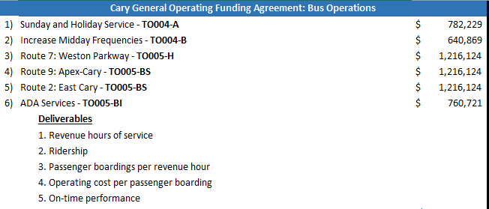
FY27 Work Plan Project Agreement Groupings and Reporting Deliverables
Operating Example

Slide 5
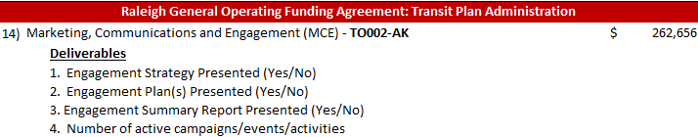
FY27 Work Plan Project Agreement Groupings and Reporting Deliverables
*New* : Deliverables for Marketing and Community Engagement (MCE) Projects

Slide 6
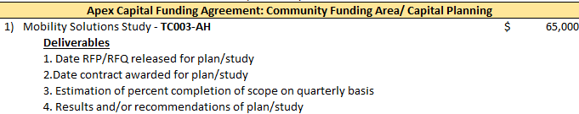
FY27 Work Plan Project Agreement Groupings and Reporting Deliverables
Capital Example
Project sponsors are encouraged to evaluate project budgets every quarter and release funds back to fund balance when possible.

Slide 7
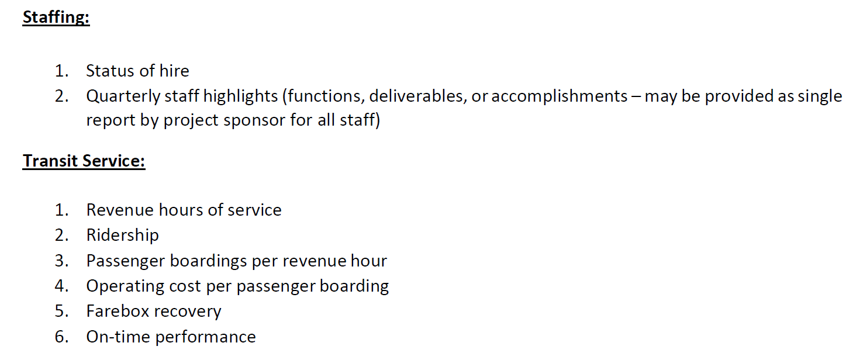
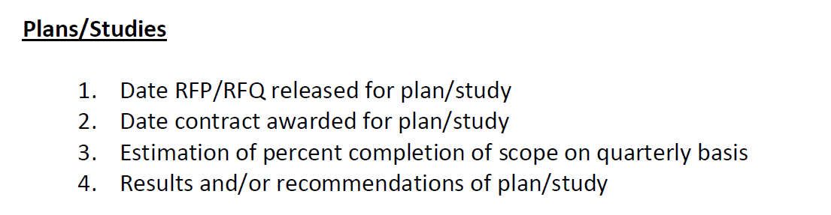
TPAC Approved Deliverables

Slide 8
FY 2027
Project
Agreement
Examples
Minimal changes from FY27 agreements (Date / Year)
  Highlighted in yellow
Expiration Dates change on:
  Operating Agreements to expire 12/31/28
  Capital Agreement to expire 12/31/30
Examples of General Capital, General Operating and Special agreements are included as part of the Agenda Attachment

