Slide 1
WAKE TRANSIT PLAN
Transit Planning Advisory Committee
TPAC REGULAR MEETING
February 17, 2021
9:30 AM

Slide 2
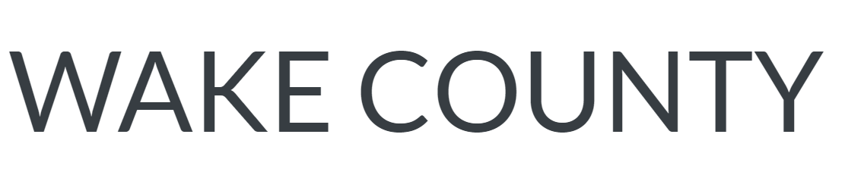
I. Welcome and Introductions
Ben Howell, TPAC Chair

Slide 3
II. Adjustments to the Agenda
Ben Howell, TPAC Chair

Slide 4
III. General Public or Agency Comment
Ben Howell, TPAC Chair

Slide 5
2021 TPAC Subcommittee Chair
and Vice Chair Elections
Stephanie Plancich, TPAC Administrator

Slide 6

PLANNING & PRIORITIZATION
Election Held: January 14, 2021
David Walker
City of Raleigh
Kevin Wyrauch
Town of Cary
Voting Agencies:
CAMPO GoTriangle
Wake County Raleigh
Cary Apex
Fuquay-Varina Garner
Holly Springs Knightdale
Wake Forest
Notes:
In January, we held the 2021 Chair and Vice Chair elections for each of the TPAC Subcommittees. The votes were unanimous for each result presented for TPAC confirmation today.
For P&P – David Walker, with the City of Raleigh, is shifting from Vice Chair up into the Chair role and Kevin Wyrauch from the Town of Cary was elected to act as the new Vice Chair.
For B&F – Steve Schlossberg, from GoTriangle, was selected to serve as Chair for a second term. Shavon Tucker, from the City of Raleigh became the committee’s new Vice Chair in a mid-year election held last fall. She has been elected to remain int hat position for her 1st full term.
For

Slide 7

BUDGET & FINANCE
Election Held: January 21, 2021
Steve Schlossberg
GoTriangle
Shavon Tucker
City of Raleigh
Voting Agencies:
CAMPO GoTriangle
Wake County Raleigh
Holly Springs
Notes:
In January, we held the 2021 Chair and Vice Chair elections for each of the TPAC Subcommittees. The votes were unanimous for each result presented for TPAC confirmation today.
For P&P – David Walker, with the City of Raleigh, is shifting from Vice Chair up into the Chair role and Kevin Wyrauch from the Town of Cary was elected to act as the new Vice Chair.
For B&F – Steve Schlossberg, from GoTriangle, was selected to serve as Chair for a second term. Shavon Tucker, from the City of Raleigh became the committee’s new Vice Chair in a mid-year election held last fall. She has been elected to remain int hat position for her 1st full term.
For

Slide 8

ENGAGEMENT & COMMUNICATIONS
Election Held: January 28, 2021
Andrea Epstein
City of Raleigh
Sharon Chavis
GoTriangle
Voting Agencies:
CAMPO GoTriangle
Wake County Raleigh
Cary Apex
Fuquay-Varina Garner
Holly Springs Knightdale
Wake Forest Morrisville
Notes:
The PE&C Subcommittee voted for Andrea Epstein, with the City of Raleigh, to move up from the Vice Chair position to become the new Chair, and selected Sharon Chavis, with GoTriangle, to act as the new Vice Chair.

Slide 9
2021 TPAC Subcommittee Chair
and Vice Chair Elections
Requested Action:
Consider confirmation of the 2021
TPAC Subcommittee Election Results.

Slide 10
V. February-July TPAC
Subcommittee Work Task Lists
Attachment A
Stephanie Plancich, TPAC Administrator

Slide 11
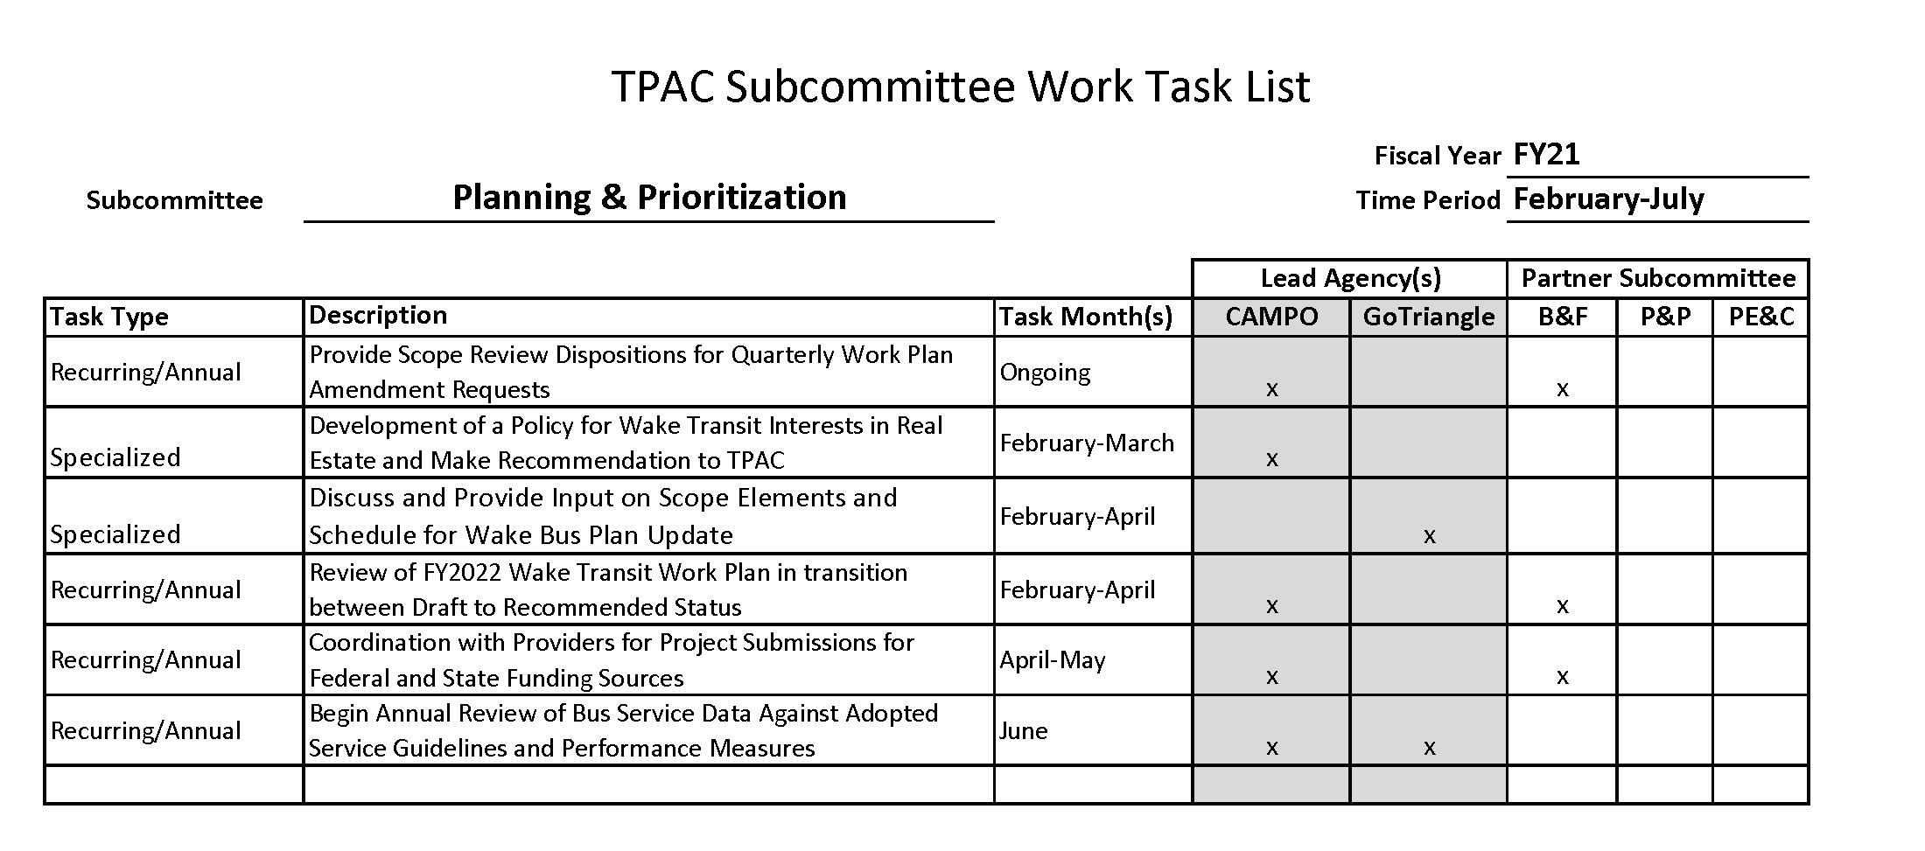
P&P

Slide 12
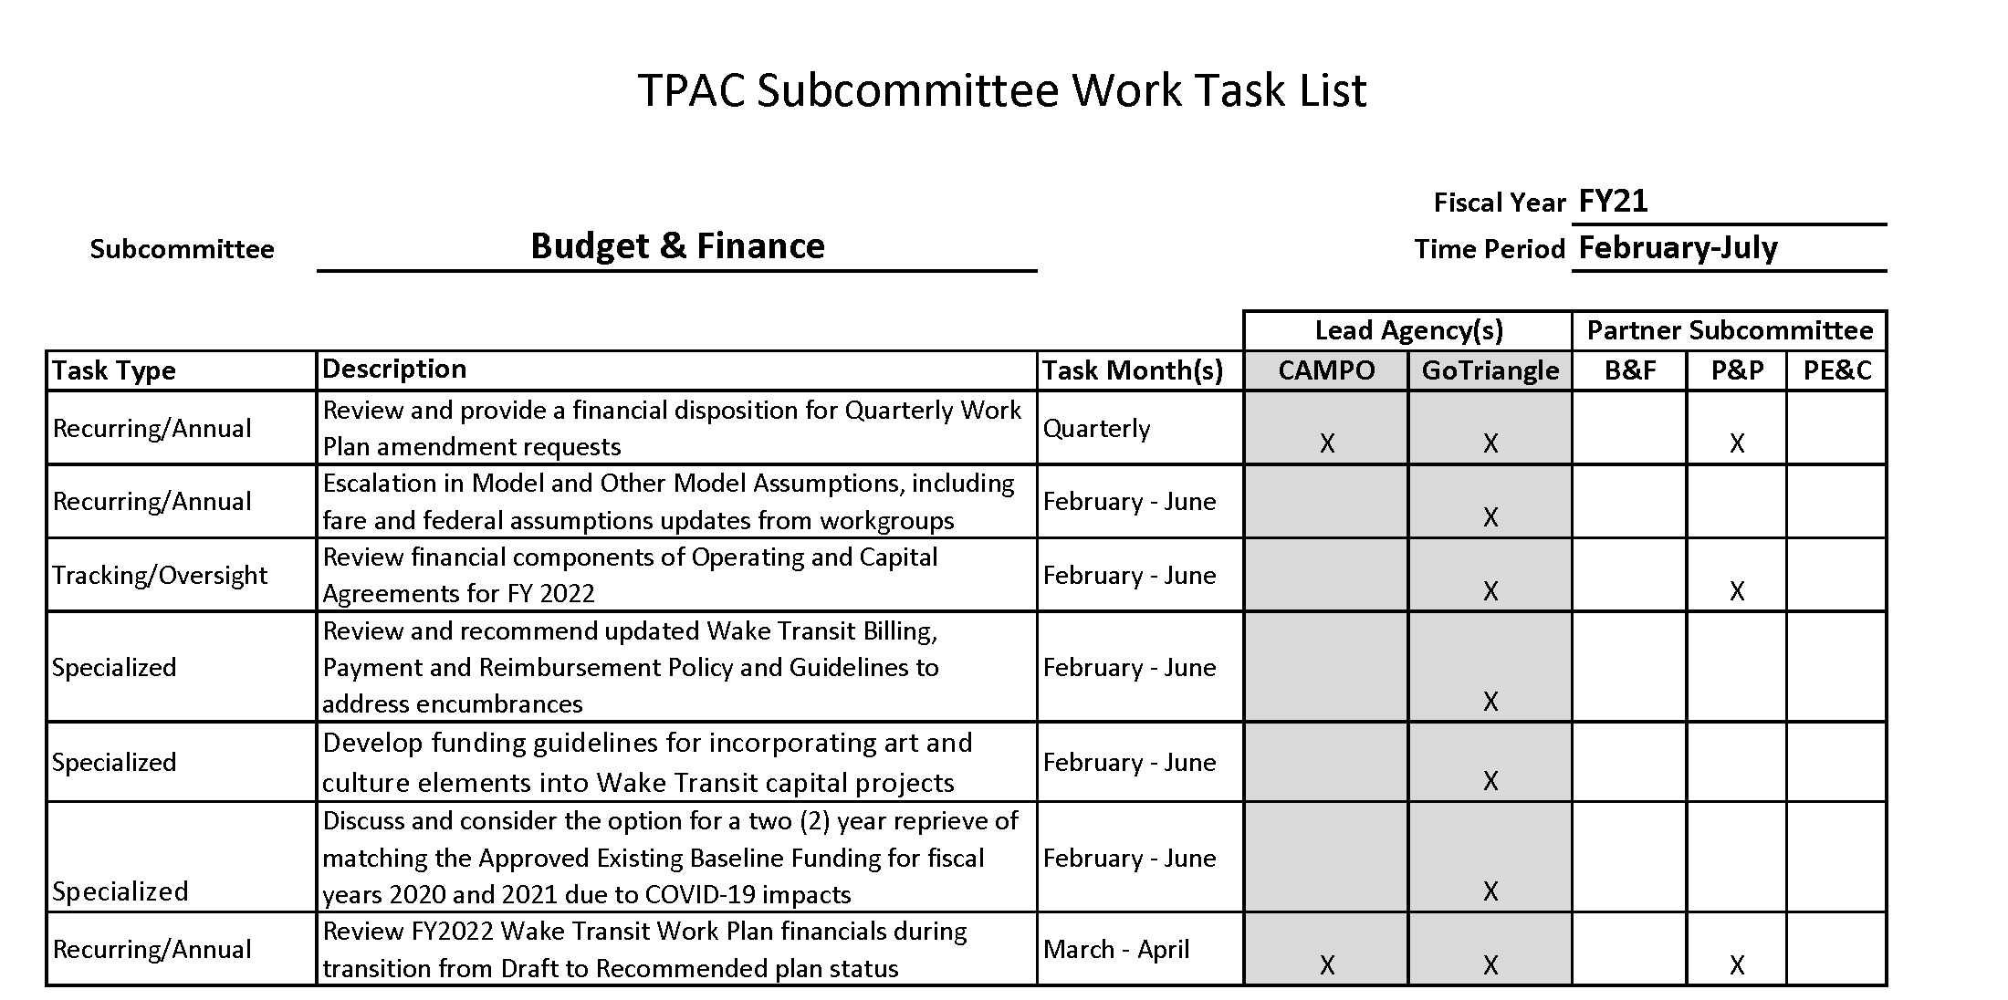
B&F

Slide 13
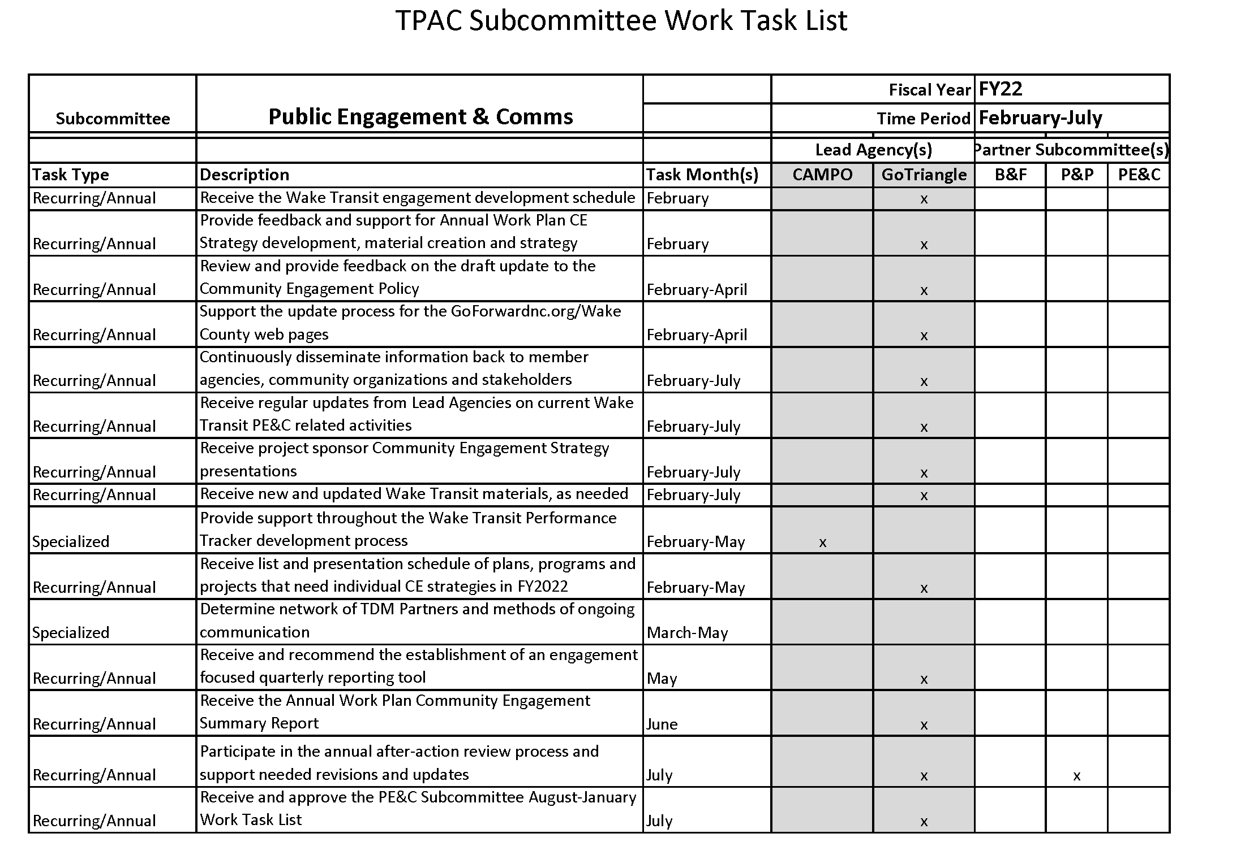
PE&C

Slide 14
V. February-July TPAC
Subcommittee Work Task Lists
Requested Action:
Consider endorsement of the February-July Subcommittee Work Task Lists

Slide 15
Release of Draft
FY2022 Wake Transit Work Plan
Attachment B
Bret Martin, CAMPO

Slide 16
FY 2022 Work Plan Development Schedule - Important Dates
ACTION | DATE
TPAC Considers Draft Work Plan for Public Release | February 17th
Public Comment Period | February 19th – March 21st
Updated/Modified Work Plan Funding Requests Due | By March 30th
Planning & Prioritization/Budget and Finance Subcommittees Discussion on Changes to Draft Work Plan | Week of April 5th
Distribute Draft of Recommended Work Plan to TPAC | By April 14th
TPAC Considers Recommending Work Plan for Adoption | April 21st
Considered for Adoption by GoTriangle and CAMPO Boards | By June 30th

Slide 17
FY 2022 Draft Wake Transit Work Plan
Financial Assumptions
TPAC Meeting
February 17, 2021

Slide 18
Wake Transit Draft Work Plan – FY22 Modeled Revenues
(in millions)
FY20 Actuals - $106.0M
*
* - FY21 Included Federal Share of Wake BRT: New Bern

Slide 19
Wake Transit Draft Work Plan – FY22 Modeled Expenditures
(in millions)
Operating Expenditures
*
* - Bus Operations includes Fixed Route / ADA / Maintenance of Facilities, etc.

Slide 20
Wake Transit Draft Work Plan – FY22 Modeled Expenditures
(in millions)
Capital Expenditures

Slide 21
Questions?

Slide 22
Work Plan Structure
Main Body of Document: FY 22 Operating and Capital Budgets – includes project profile sheets for new FY 22 operating and capital projects
Financial Model Assumption Updates
Appendix: FYs 22-30 Multi-Year Operating Program and Capital Improvement Plan
  Summary of current FY and programmed future-year expenses
  Project profile sheets for continuing operating projects initiated in prior fiscal years
  Project profile sheets for future-year operating and capital projects

Slide 25
Future-Year Project Profiles for Projects Programmed No Later Than FY 24

Slide 27
General Notes on Content
Reflects recommendations of Budget & Finance/Planning & Prioritization Subcommittees for an early draft, but…
  Need to exercise caution for recommended Work Plan
  Allow data/information to better develop as we approach FY 22
Does not reflect LAPP funding awards
Scopes of projects developed from request forms and prior Work Plan CIP/operating program project descriptions
Some new projects not previously programmed are included
Increases in assumed costs and updates to implementation timelines

Slide 28
Operating Requests Vs. Programmed
Budget Category | Programmed for FY 22 | Requested for FY 22 | Change
Bus Operations | $24,113,786 | $22,225,895 | -$1,887,891
Tax District Admin | $501,338 | $501,338 | --
Transit Plan Admin | $4,411,194 | $4,689,998 | +$278,804
TOTAL | $29,026,318 | $27,417,231 | -$1,609,087
Note: Some new projects but substantial savings from reductions to assumed expenses for GoRaleigh bus service expansion, bus infrastructure maintenance, and ADA service

Slide 29
Capital Requests Vs. Programmed (FYs 22 and 23)
Budget Category | Programmed for FY 22 | Requested for FY 22 | Change
Vehicle Acquisition | $15,206,642 | $12,773,312 | -$2,433,330
Bus Infrastructure | $59,484,747 | $71,361,553 | +$11,878,806
Other Capital | $4,630,000 | $4,730,000 | +$100,000
BRT | $12,000,000 | $12,000,000 | --
CRT | -- | -- | --
TOTAL | $91,321,389 | $100,864,865 | +$9,543,476
Budget Category | Programmed for FY 23 | Requested for FY 23 | Change
Bus Infrastructure | $13,015,307 | $42,331,141 | +$29,315,834
Note: Higher assumed bus infrastructure costs for certain facilities

Slide 30
FY 22 Major Scope, Schedule, Cost Modifications - Capital
GoCary Maintenance & Operations Facility: $17.6M → $35M
Regional Transit Center (Wake Share): $5M → $28.5M
Hillsborough/I-440 Park-and-Ride: $2.6M → $7.42M
Fewer Paratransit Replacement Vehicles Requested = Reduced Cost
Construction of Cary Downtown Multimodal Facility Delayed to FY 23
Bus Stop Improvement Projects Disaggregated Into New vs. Existing Again
Still currently able to accommodate within modeling parameters. However, remaining 10-year capital liquidity above required fund balance minimums is low = $23M. This may be problematic for future critical capital projects.

Slide 31
FY 22 Major Scope, Schedule, Cost Modifications – Operating
Additional DRX Trips (Wake Share)
New Projects:
  GoCary Transit Planner
  Downtown Cary Transit Center Temporary Real Estate Carrying Costs
  GoTriangle NCSU TRM Contract
Tax District Admin Staff Combined Into Single Project
Reductions to Assumed Staffing Expenses: Cary and Raleigh
GoRaleigh FY 22 Bus Service Costs Significantly Below Programmed Amounts

Slide 32
****CAUTION****
Viability and Competitiveness of Additional Bus Service Not Accounted For in Programming
  Should Be Supported By Bus Service Performance Data
  Advancing Ahead of Other Higher Priority Service Investments
Project Readiness
  Progress on Prior Project Phases
  Progress on Prior Project Allocations
Reasonableness of Schedule for Phases of Project Life Cycle
  Don’t Bite Off More Than You Can Chew
  Closer Look at Realistic Schedules for Project Phases
Projects Not Caught Up on Concurrence Policy Requirements – Difficult to Agree to Fund Design and Land Acquisition Phases When There is No Concurrence on Preferred Alternative

Slide 33
Comments Received
Add Major Destinations in Holly Springs to Route 305 Expansion Project Profile Sheet
Recharacterize Future Replacement of GoRaleigh Service as Reduction in Service
Route 305 Cost Accounting for Delayed Start to August?
Location of Leased Apex Park-and-Ride for Route 305?
GoTriangle Bus Stop Improvements in Apex?
Revisit Prior Year Allocations in Programming/Financial Model Crosswalk

Slide 34
Release of Draft FY2022 Wake Transit Work Plan
Requested Action:
Consider releasing the FY2022 Draft Wake Transit Work Plan for public review and comment

Slide 35
VII. Release of Draft Wake Transit Community Engagement Policy
Attachment C
Liz Raskopf, GoTriangle

Slide 36
Draft Wake Transit Community Engagement Policy
Public Engagement now Community Engagement
Added clarity for partners responsible for Wake Transit engagement
  Seven steps for effective community engagement
Added table defining requirements by project type
Added glossary, including definition of significant change
Streamlined public comment periods
Clarified joint hearing requirements
Notes:
7 steps will be the guiding base for the toolkit/guidebook that will start in FY22

Slide 37
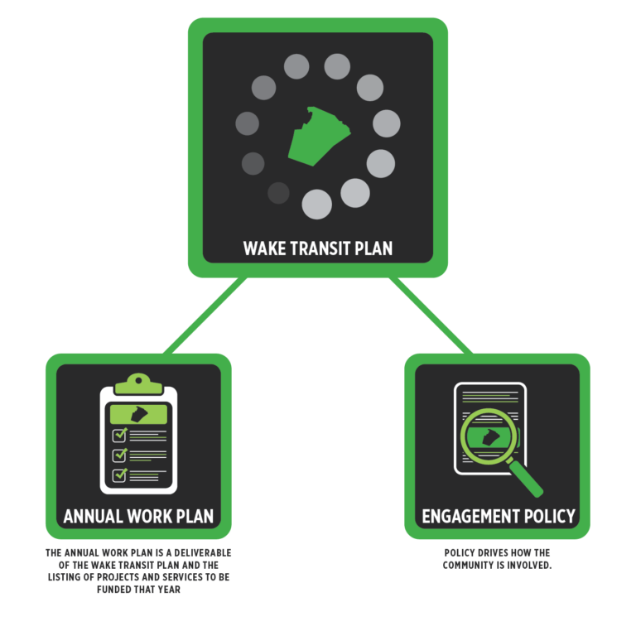
Combined Wake Transit Engagement Strategy
1 engagement effort; 3 opportunities to comment:
  The draft 10-year Wake Transit Plan Update through 2030
  The Draft FY22 Wake Transit Work Plan
  The draft Community Engagement Policy
Submit comments at goforwardnc.org/wakeinput

Slide 38
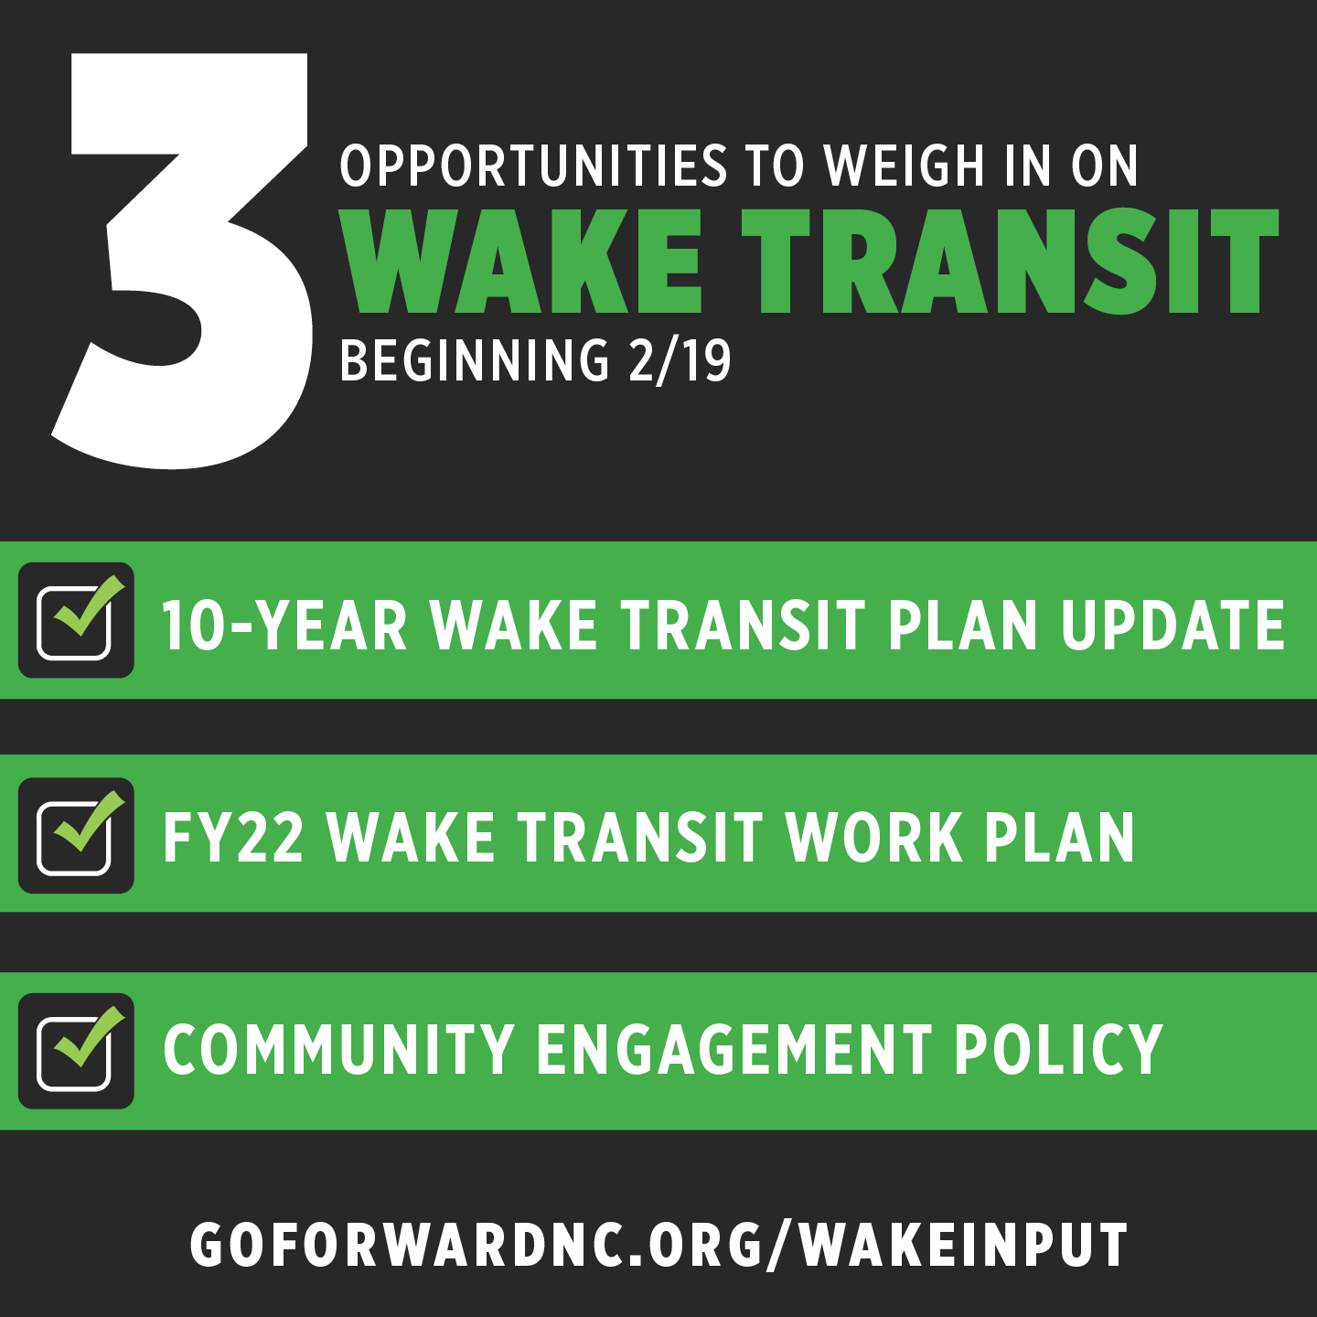
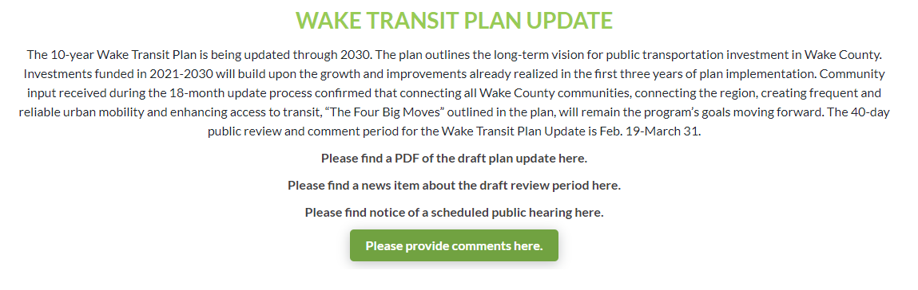
Combined Wake Transit Engagement Strategy: Materials
News Release & 3 tailored news items
Website Update (goforwardnc.org/ wakeinput)
Email Campaign
Social Media Posts and Graphics
  Facebook, Twitter, Next Door, Reddit
3 Separate Comment Boxes Social Media Targeting
Public-facing PowerPoint Presentation
One-page Printable Flyer
Translated Materials

Slide 39
Combined Engagement Strategy: Outreach
2/11-2/19 direct outreach to:
  25 Wake Community Organizations
  44 Wake County Minority Churches
  Wake County municipal partners
2/11 Wake Up Wake County
2/11 North Carolina Society of Hispanic Professionals
2/12 Dorcas Ministries
2/23: Wake County Habitat for Humanity
2/24: Wake Tech Community College
2/24 or 3/10: North Carolina Society of Hispanic Professionals virtual Youth Event
3/9 Town of Wendell virtual focus group
TBD Dorcas Ministries virtual event
TBD Town of Zebulon virtual event

Slide 40
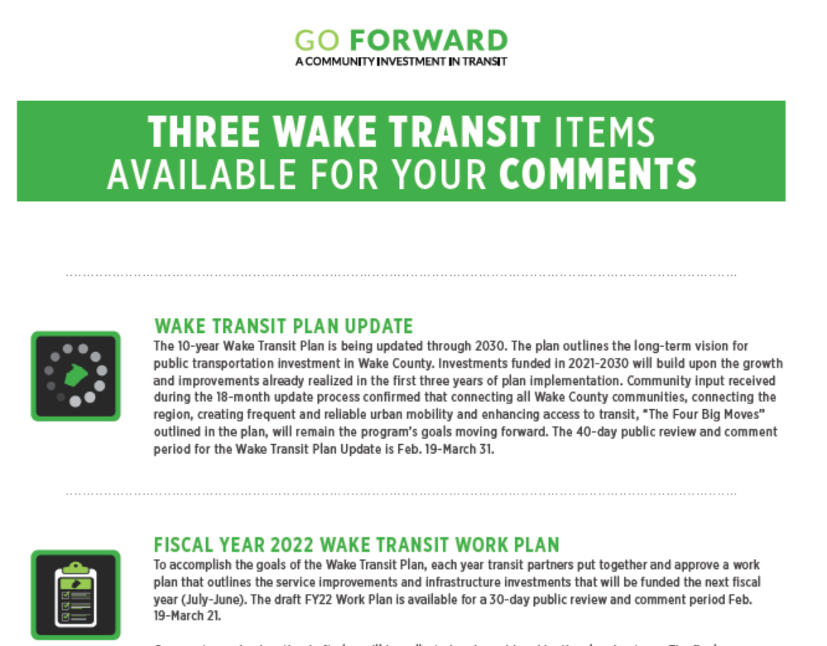
Combined Engagement Strategy:
Equity & Inclusion
Printable one-page flyer
Translated materials
Distribution of flyer in Dorcas Ministries food boxes

Slide 41
VII. Release of Draft Wake Transit Community Engagement Policy
Requested Action:
Consider releasing the draft FY2022 Wake Transit Work Plan for public review and comment

Slide 42
TPAC Member Roll Call Vote:
Action Item #1:
Confirm the Subcommittee 2021 Election Results
Action Item #2:
Endorse the Feb-July Subcommittee Work Task List
Action Item #3:
Release the Draft FY2022 Work Plan for public review and comment
Action Item #4:
Release the draft Community Engagement Policy for public review and comment

Slide 43
VIII. FY2021-2030 Wake Transit Plan Update Progress Report
Attachment D (Appendix D1-D7)
Bret Martin, CAMPO

Slide 44
Wake Transit Plan Update Schedule
Refine Original Plan Project Costs/
Schedule
Transit Market Reassessment
Assess
Future Financial Capacity
Reprioritize Planned Investments
Reprogram Planned Investments
Finalize Plan Update
Oct 2019-
Feb 2020
Oct 2019-
Dec 2019
June 2020
Aug-Oct 2020
Nov 2020
Dec 2020
-April 2021
Public Outreach
Stakeholder Outreach
Plan Update Process

Slide 45

Wake Transit Plan Update Next Steps
DATES | TASK
February 17th | TPAC Receives Plan Update as Information
February 19th | Begin 40-Day Public Comment Period
February 24th | GoTriangle Board Receives Plan Update as Information
March 4th | CAMPO TCC Receives Plan Update as Information
March 10th | TPAC Considers Action on Plan Update
March 17th | CAMPO Executive Board Receives Plan Update as Information and Holds Joint Public Hearing with GoTriangle Board
March 31st | End 40-Day Public Comment Period
April 1st | CAMPO TCC Considers Recommendation of Adoption
April 14th | DCHC MPO Board Receives Plan Update as Information
April 21st | CAMPO Executive Board Considers Adoption
April 28th | GoTriangle Board of Trustees Considers Adoption

Slide 46
Plan Update Document Organization
Four Chapters:
Background and Plan Development Process
Wake County Transit Plan Update
2020 Market Assessment
Financial Plan
Follows General Flow and Present Information at Same Level of Detail and Explanation as Original Plan
Appendices:
Major Capital Project Cost and Schedule Feasibility Assessment
2020 Market Analysis
Financial Assumptions
Prioritization/Reprogramming Guidance
FYs 21-30 Reprogramming of Investments
Community Engagement Report
Post-2030 Unconstrained High-Capacity Transit Corridors

Slide 47
Plan Update Document Content
Explains Plan Update Development Purpose and Recurrence Every 4 Years
Explains Original Plan Development Process and Important Points That Carry Over to Plan Update
Explains Plan Update Development Themes and Steps, Engagement Efforts, and Outcomes

Slide 48
Plan Update Document Content
Explains Plan Implementation Governance, Annual Work Plans, and Implementation Planning to Date
Recaps 4 Big Moves, Progress to Date, and Any Changes to Associated Investments
More Detailed Explanation of Investment Priorities, Tradeoffs,
and Transit Modes/Investments That Address Those Priorities

Slide 49
Plan Update Document Content
Recap of Community Goals and Measuring Success of Investments
Vision for Beyond 2030/What’s Next?
Market Assessment

Slide 50
Plan Update Document Content
Financial Assumptions for Original Transit Plan
Updated Assumptions and Comparison to Original Plan

Slide 51
Plan Update Takeaways
Extending Planning Horizon from 2027 to 2030 = 3 Additional Years of Revenue Collections and Investment Implementation
Some Assumed Revenue Reductions Compared to Early 2020 But Still Slightly Higher Than Original Plan
Carrying Forward Original Investments Under 4 Big Moves
Project Cost Assumptions for BRT and CRT Have Increased With Further Study and Schedules Elongated to Match Feasibility Findings
  BRT to Assume More Dedicated Infrastructure
New Projects = BRT Extensions to RTP and Clayton (Funded By Newly Assumed State Revenue)
Investment Mix Under 4 Big Moves (Including Prioritization and Programming Thereof) Still Supports Community Priorities and Goals
Transit Market Supports Original Transit Plan Investments and Supports Investments Identified for Beyond 2030
Overall, Some Minor Reduction to Ability to Implement Originally Planned/Programmed Bus Service Expansion By 2030

Slide 52
Final Impact on Bus Service Expansion and Infrastructure
Investment Type | Prior Investment Amount in Early 2020 | Investment Amount for Final Reprogramming/Plan | % Change
Bus Service Expansion (Excluding ADA) | $43,277,308 (in 2030 YOE) | $39,309,000 (in 2030 YOE) | -9%
Bus Stop Improvements | $19,581,314 (through FY 27 in YOE) | $30,359,901 (through FY 30 in YOE) | +55%
Note: Investments in park-and-rides, transit centers and transfer points, and maintenance facilities generally stayed the same

Slide 53
Final Impact on Major Capital Projects
Start of BRT/CRT Operations
BRT/CRT Corridor | Prior Start Year (FY 20 Work Plan) | Updated Start Year
New Bern BRT | FY 24 | FY 24
Western BRT | FY 25 | FY 27
Southern BRT | FY 25 | FY 28
Northern BRT | FY 27 | FY 29
Cary-RTP BRT | N/A | FY 27
Garner-Clayton BRT | N/A | TBD
Durham-Garner CRT | FY 27 | FY 29

Slide 54
Review of Most Significant Programming Changes
Changes in Capital Cost Assumptions
Project Category | Prior Cost Assumption (2016 Plan) | New Cost Assumption | % Change
Total BRT Program of Projects | $347 million | $511 million | +47%
CRT Project | $887 | $1,200 million | +35%
Bus Infrastructure | $208 million | $174 million | -16%
Vehicle Acquisition | $115 million | $161 million | +40%
Changes in Operating Cost Assumptions
Project Category | Prior FY 27 Cost Assumption | New FY 27 Cost Assumption | % Change
BRT Operations | $15 million | $15 million | --
CRT Operations | $20 million | $25 million | +25%
Note: Some cost increase is due to changes in YOE and some is due to changes in project assumptions and further study of cost
feasibility. New cost assumption for BRT also includes extensions to RTP and Clayton, which were not included in original transit plan.

Slide 55
VIII. FY2021-2030 Wake Transit Plan Update Progress Report
Requested Action:
Receive as Information

Slide 56
IX. Combined Wake Transit Engagement Strategy- Spring 2021 Attachment E – H
Liz Raskopf, GoTriangle

Slide 57
Draft Wake Transit Community Engagement Policy
Public Engagement now Community Engagement
Added clarity for partners responsible for Wake Transit engagement
  Seven steps for effective community engagement
Added table defining requirements by project type
Added glossary, including definition of significant change
Streamlined public comment periods
Clarified joint hearing requirements
Notes:
7 steps will be the guiding base for the toolkit/guidebook that will start in FY22

Slide 58
Combined Wake Transit Engagement Strategy
1 engagement effort; 3 opportunities to comment:
  The draft 10-year Wake Transit Plan Update through 2030
  The Draft FY22 Wake Transit Work Plan
  The draft Community Engagement Policy
Submit comments at goforwardnc.org/wakeinput

Slide 59
Combined Wake Transit Engagement Strategy: Materials
News Release & 3 tailored news items
Website Update (goforwardnc.org/wakeinput)
Email Campaign
Social Media Posts and Graphics
  Facebook, Twitter, Next Door, Reddit
3 Separate Comment Boxes Social Media Targeting
Public-facing PowerPoint Presentation
One-page Printable Flyer
Translated Materials

Slide 60
Combined Engagement Strategy: Outreach
2/11-2/19 direct outreach to:
  25 Wake Community Organizations
  44 Wake County Minority Churches
  Wake County municipal partners
2/11 Wake Up Wake County
2/11 North Carolina Society of Hispanic Professionals
2/12 Dorcas Ministries
2/23: Wake County Habitat for Humanity
2/24: Wake Tech Community College
2/24 or 3/10: North Carolina Society of Hispanic Professionals virtual Youth Event
3/9 Town of Wendell virtual focus group
TBD Dorcas Ministries virtual event
TBD Town of Zebulon virtual event

Slide 61
Combined Engagement Strategy:
Equity & Inclusion
Printable one-page flyer
Translated materials
Distribution of flyer in Dorcas Ministries food boxes

Slide 62
IX. Combined Wake Transit Engagement Strategy- Spring 2021
Requested Action:
Receive as Information

Slide 63
X. Wake Bus Rapid Transit (BRT) Program Progress Update
Mila Vega & Het Patel, City of Raleigh

Slide 64
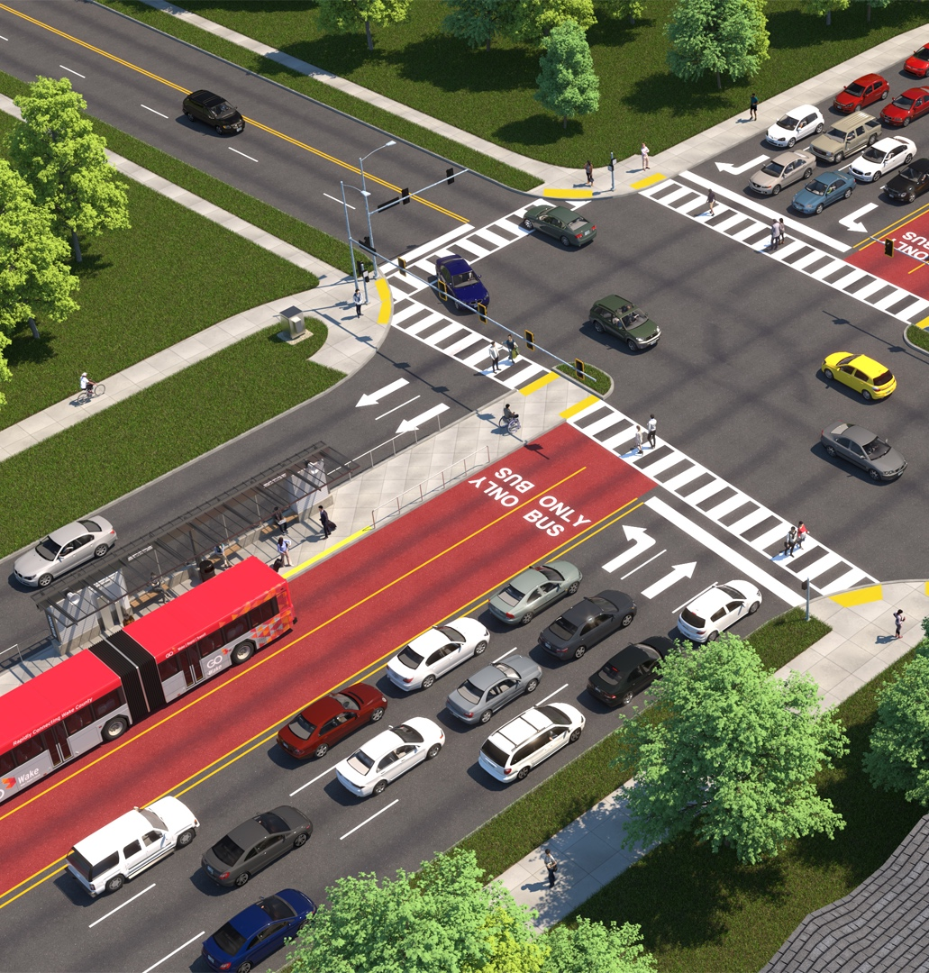
Transportation - Transit
Wake Bus Rapid Transit
Program Update
TPAC
February 17, 2021

Slide 65
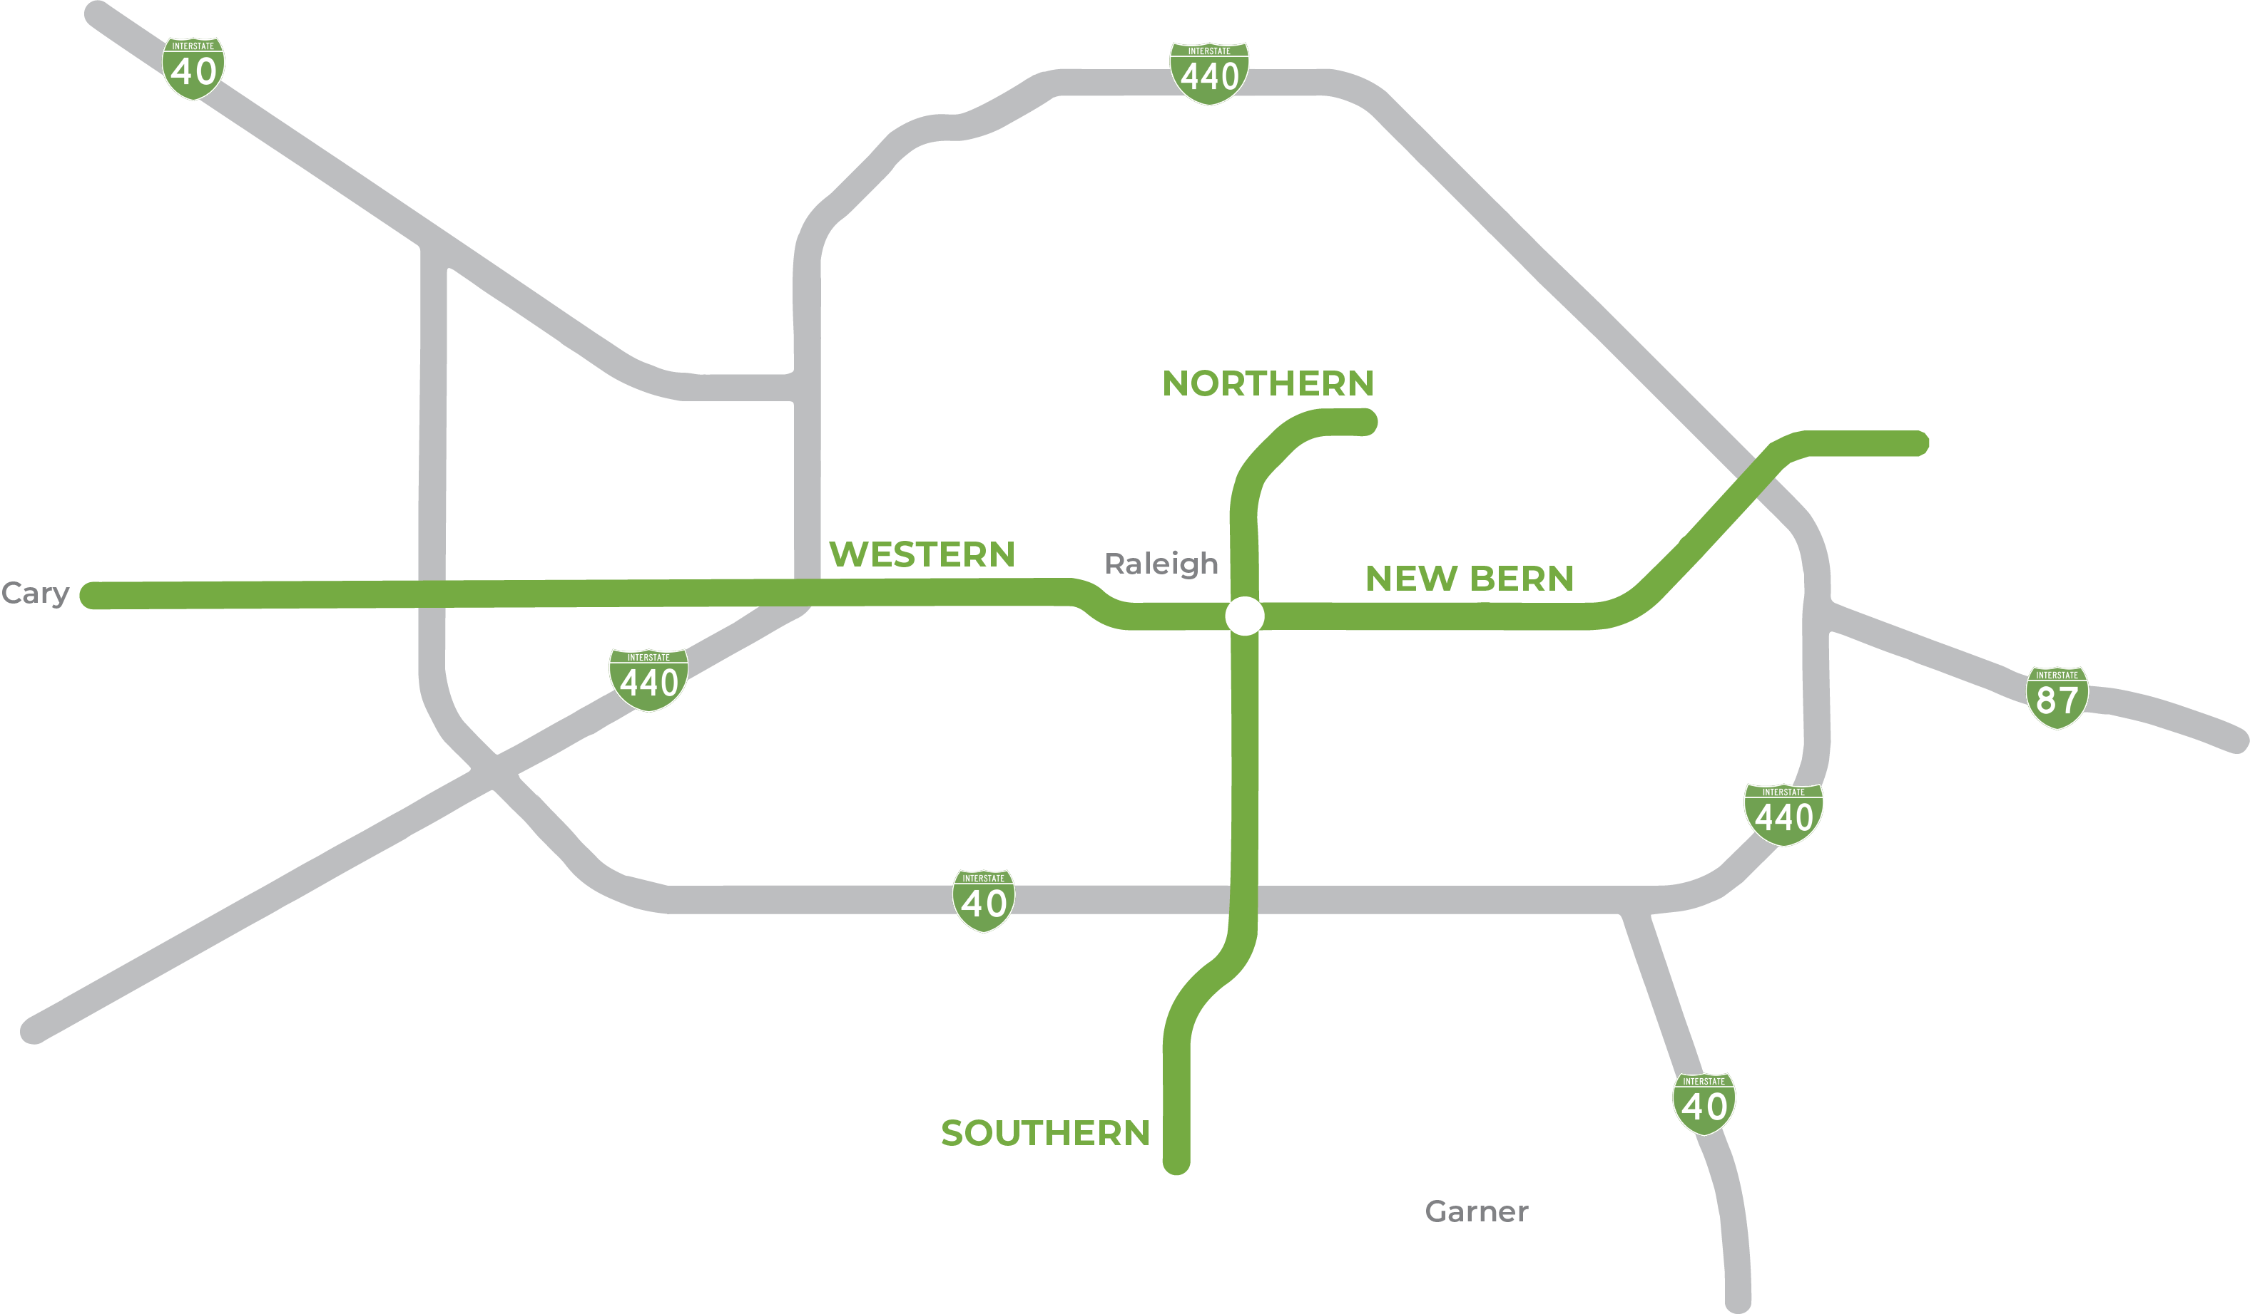
Wake BRT Program Overview
Wake BRT: Northern Corridor
Wake BRT: New Bern Avenue
STATUS: Pre-Planning Complete
STATUS: 30 - 100% Design and System Standards (HNTB)
Wake BRT: Southern Corridor
Wake BRT: Western Corridor
STATUS: Route Selection – Locally Preferred Alternative (WSP)
STATUS: 0 – 30% Design (WSP)

Slide 66
Wake BRT New Bern Avenue
Project Update
Notes:
Meg added

Slide 67
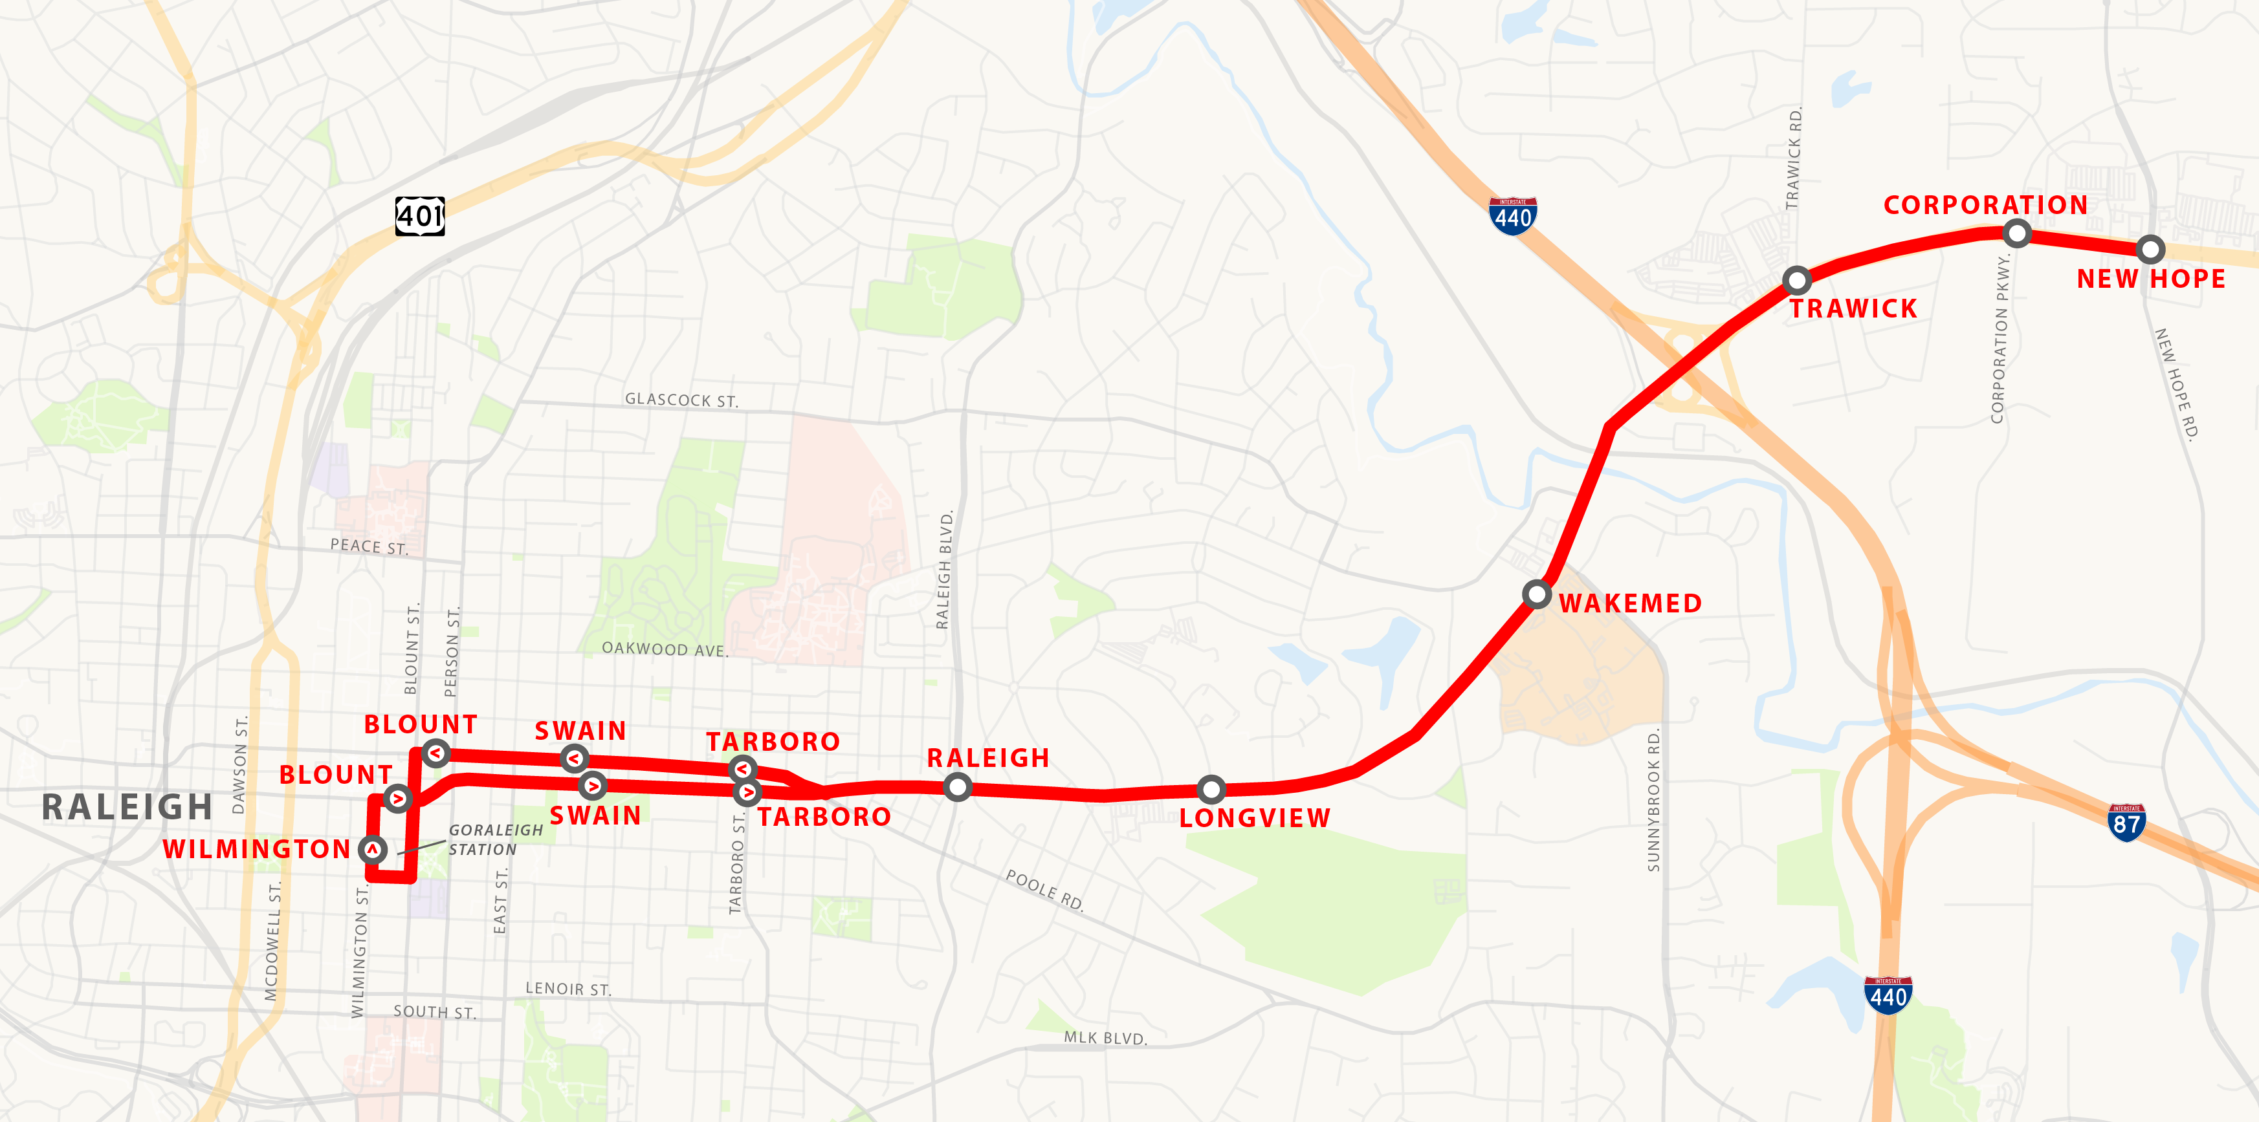
Wake BRT: New Bern Avenue

Slide 68
Wake BRT: New Bern Avenue
Project Background
Date | Milestone
Spring 2020 | 30% design plans complete
Summer 2020 | Review of 30% design plans
Fall 2020 | Begin 60% design plans
December 17, 2020 | $35 million allocation from FTA
February 2021 | Review of 60% design plans

Slide 69

Wake BRT New Bern Federal Funding
NEW BERN
STEP 1: Project Development
PD Application
Review Alternatives
Locally Preferred Alternative (LPA)
Local Funding Commitment
Ratings Application
Environmental Review (NEPA & SHPO)
3rd Party Agreements (NCDOT)
Complete Engineering, Design, and Utility Coordination
STEP 2: Full Funding Grant Agreement
Construction
NOTE – project must receive federal funding allocation before initiating Step 2
New Bern Avenue BRT received $35M federal funding allocation on December 17, 2020

Slide 70
Wake BRT: New Bern Ave
Road to Construction
Date | Milestone
Winter 2021 | 60% design plans submitted to COR, NCDOT
Spring 2021 | FTA document updates
Summer 2021 | Value engineering
Late Summer/Early Fall 2021 | Complete 90% design
Late Fall/Early Winter | Complete final design

Slide 71
Wake BRT: New Bern Ave
Memorandum of Understanding with NCDOT
Developed between NCDOT and City of Raleigh specific to New Bern BRT project
Memorializes NCDOT's approval to allow the project within NCDOT roadway facilities and ROW
Memorializes City of Raleigh's responsibilities associated with construction, maintenance and operation of the project
Also includes the responsibilities for review & oversight of final design
Raleigh City Council approved on Feb 2, 2021, currently being routed for signatures

Slide 72
Wake BRT: New Bern Ave
Coordination with Federal Transit Administration (FTA)
Monthly meetings
FTA developed roadmap for project – outlines key milestones leading to grant agreement
Coordinating with Project Management Oversight Consultant (PMOC) on subplans, schedule and cost
Completed initial risk review workshop Fall 2020
Risk refresh workshop at 60% design planned for Spring 2021

Slide 73
Wake BRT: New Bern Ave
Wake Transit Plan Concurrence Next Steps
Action | Date
LPA Consideration of Adoption by Raleigh City Council | June 4, 2019
Send Concurrence Plan to Concurrence Team | June 7, 2019
Single Concurrence Meeting with Consideration of Concurrence on Points 1,2, 3, and 4 | July 15, 2019
30-Day Public Comment Period on LPA and Schedule CAMPO Executive Board Public Hearing | July 22, 2019
LPA Consideration of Recommendation to CAMPO Board by CAMPO TCC | August 1, 2019
LPA Consideration of Adoption by CAMPO Board | August 21, 2019
Concurrence Point 5: Least Environmentally Damaging Preferred Alternative* | March 2021
Concurrent Point 6: Agreement with Jurisdictions for Additional Concurrence Points | March 2021
* Contingent on NCSHPO Section 106 review completion

Slide 74
Wake BRT Western Corridor
Project Update
Notes:
Meg added

Slide 75
Western Corridor Timeline
Date | Milestone
Fall 2019 | Western Blvd Corridor Study (WBCS) began
Summer 2020 | Town of Cary City Council endorsed the Western LPA (July)
Summer 2020 | City of Raleigh City Council endorsed the Western LPA (Aug)
Winter 2020 | Accepted into Project Development
January 2021 | Begin 0 – 30% design and NEPA
Fall 2022 | Complete 0 – 30% design and NEPA
2022-2023 | Final Design
2024-2025 | Construction to begin (contingent on Federal Funding)

Slide 76
Western Corridor Coordination
Coordination with Municipal Partners and Stakeholders
Monthly meetings for system standards and corridor design with Town of Cary
Sketch-level review at BRT Technical Committee – February 2021
Over the shoulder review for corridor design – Town of Cary and City of Raleigh
  Sketch-level – February 2021
  5% design – Target April 2021

Slide 77
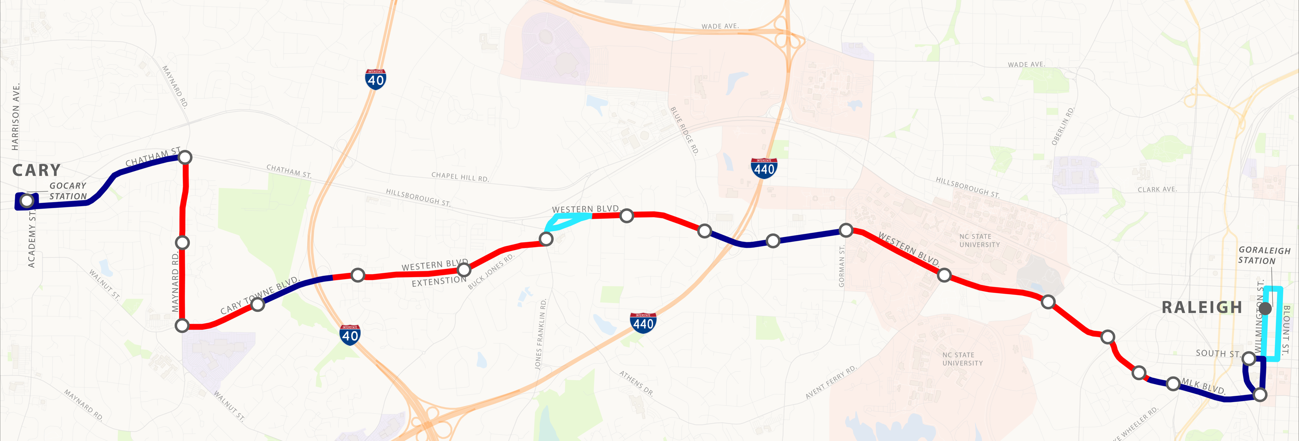
Western Corridor Sketch Level Design
Total: Approx. 12 miles
Dedicated lanes: Approx. 7.5 miles
Mixed traffic: Approx. 4.5 miles
Legend:
Dedicated Lanes (Median/Center)
New BRT Station
Business Access and Transit (Left or Right Curb)
Planned BRT Station (New Bern Avenue BRT)
Mixed Traffic
Notes:
WSP

Slide 78
Western Corridor Concurrence
Wake Transit Plan Concurrence Next Steps
Action | Date
LPA Consideration of Adoption by Town of Cary Council | July 23, 2020
LPA Consideration of Adoption by Raleigh City Council | August 18, 2020
Send Concurrence Plan to Concurrence Team | March 16, 2020
Concurrence Meeting with Consideration of Concurrence on Points 1 and 2 | March 30, 2020
Concurrence Meeting with Consideration of Concurrence on Points 3 and 4 | October 16, 2020
30-Day Public Comment Period on LPA and Schedule CAMPO Executive Board Public Hearing | October 21, 2020
LPA Consideration of Recommendation to CAMPO Board by CAMPO TCC | November 5, 2020
LPA Consideration of Adoption by CAMPO Board | November 18, 2020
Concurrence Point 5: Least Environmentally Damaging Preferred Alternative* | Fall 2022
Concurrent Point 6: Agreement with Jurisdictions for Additional Concurrence Points | Fall 2022
* Contingent on NCSHPO Section 106 review completion

Slide 79
Wake BRT Southern Corridor
Project Update
Notes:
Meg added

Slide 80
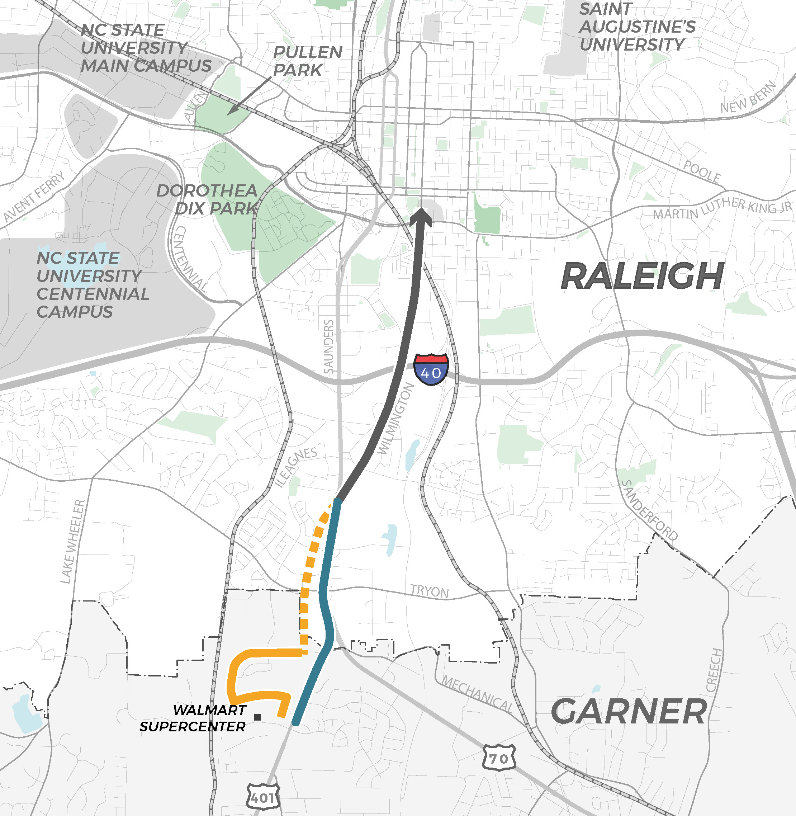
Southern Corridor
Date | Milestone
January 2020 | Began LPA selection process
February 2020 | Public Engagement
October 2020 | City of Raleigh City Council endorsed S. Wilmington Street as preferred route for the northern Section
December 2020 | Began Wilmington Extension at Tryon Road Traffic Impact Analysis (TIA)
Summer 2021 | Begin 0 – 30% design and NEPA
Fall 2022 | Complete 0 – 30% design and NEPA

Slide 81
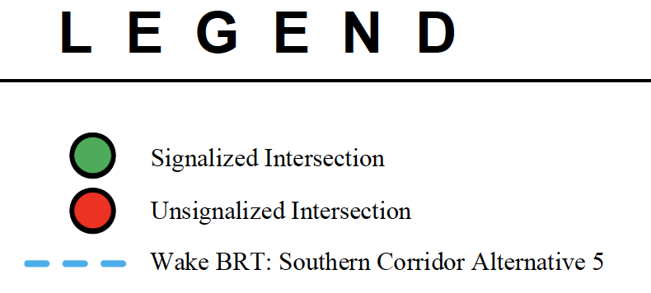
Wilmington Extension at Tryon Road
Traffic Impact Analysis (TIA)
Five (5) at-grade Build Alternatives were evaluated
Alternative appears potentially feasible
Varying access restrictions and signal phases
Provides opportunity to remain at-grade at the intersection
Notes:
Based on the 2020 and 2045 capacity analysis, each Alternative appears potentially feasible with appropriate geometric improvements, signal timing, and optimized signal coordination.
Alternative 4 – Best for BRT; most restrictive for general purpose traffic.
Alternative 2 or 5 – Preferred alternative if thru general-purpose lanes are desired
Additional coordination needed with NCDOT

Slide 82
Southern Corridor Concurrence
Wake Transit Plan Concurrence Next Steps
Action | Date
Send Concurrence Plan to Concurrence Team | March 16, 2020
Concurrence Meeting with Consideration of Concurrence on Points 1 and 2 | March 30, 2020
LPA Consideration of Adoption by Town of Garner Council | Spring 2021
LPA Consideration of Adoption by Raleigh City Council | Spring 2021
Concurrence Meeting with Consideration of Concurrence on Points 3 and 4* | Summer 2021
30-Day Public Comment Period on LPA and Schedule CAMPO Executive Board Public Hearing | Summer 2021
LPA Consideration of Recommendation to CAMPO Board by CAMPO TCC | Summer 2021
LPA Consideration of Adoption by CAMPO Board | Summer 2021
Concurrence Point 5: Least Environmentally Damaging Preferred Alternative | Fall 2022
Concurrent Point 6: Agreement with Jurisdictions for Additional Concurrence Points | Fall 2022
* Contingent on Garner and Raleigh Council LPA adoption in Spring 2021

Slide 83
Wake BRT System Standards and Public Engagement
Project Update
Notes:
Meg added

Slide 84
Wake BRT: Branding
Branding Process is underway, with final branding concept is expected early 2021.
Completed Peer Review
Branding Survey – Public and Stakeholder
3 Stakeholder Listening Sessions
Emerging Themes:
Create a brand with regional personality / geographical reference
Opportunity to integrate with existing “Go” Brand
Columbus, OH
Kansas City, MO
Austin, TX
Albuquerque, NM

Slide 85
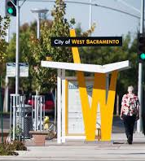
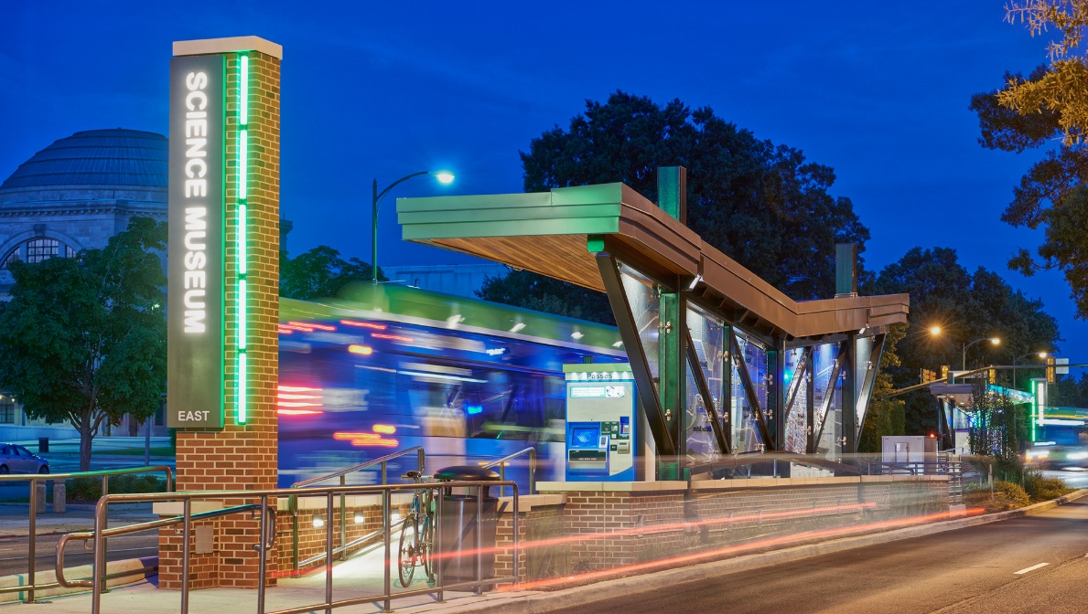
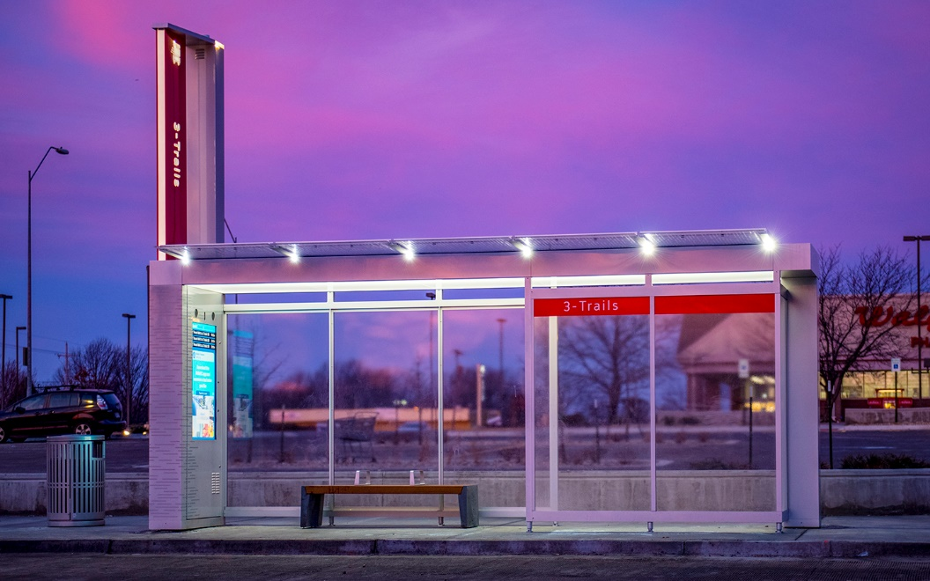
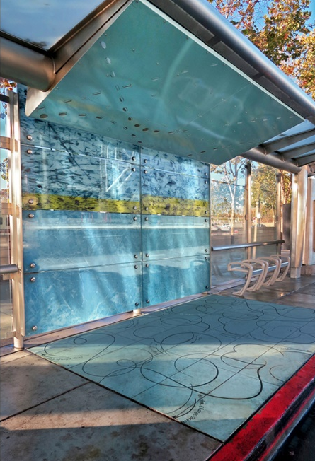
Wake BRT: Station Design
Station Design process is underway, with final design concepts expected early 2021.
Station Typologies (urban, suburban, curbside, median)
Design Workshop #1 and #2 completed
Integrate with 60% design work
Design Workshop #3 scheduled March 8th with PMT
Emerging Themes:
Design with a modern form, shape and style
Incorporate natural materials
Design should be functional, yet unique and reflective of the area

Slide 86
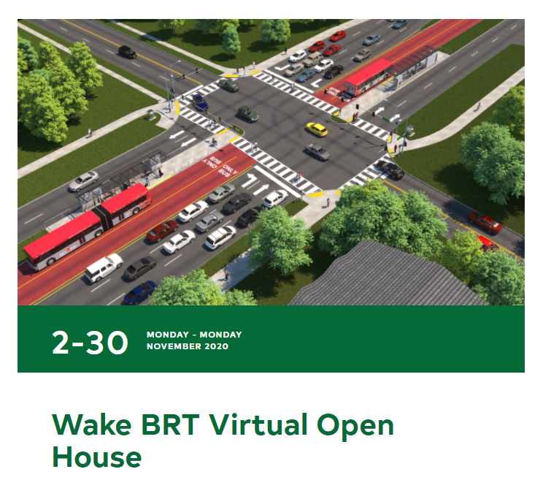
Wake BRT Public Engagement
Virtual Open House (VOH) – 1,178 views in November
Live Q&A Session on Nov 19 – 60+ viewers
17,000+ postcards sent out on Oct 28
Station design survey polling boards – 7 total (Nov 21 – 30)
Outreach to faith-based organizations – 175 contacted
Downtown Outreach
  Spring 2020, focused on downtown parking & loading zones with DRA
  Fall 2020 met with multiple DRA business owners to discuss downtown impacts (Oct 5 – Oct 8)
Next round of public engagement is planned for April 2021

Slide 87
Next Steps
Key Milestones & Council Touchpoints
Review 60% design, branding, station design (Spring 2021)
Southern Corridor Locally Preferred Alternative (LPA) – TARGET (Spring-Summer 2021)
Small Starts Ratings Application for Western Corridor – TARGET (Fall 2021)
Public Engagement & Communication – April 2021
A Virtual Open House (VOH) is planned for the end of April extending into May
Program update and information on all projects will be shared
Will include both virtual and non – virtual engagement

Slide 88
Transportation - Transit
Thank you
February 17, 2021

Slide 89
X. Wake Bus Rapid Transit (BRT) Program Progress Update
Requested Action:
Receive as Information

Slide 90
XI. GoTriangle Regional Transit Center (RTC) Feasibility Study Progress Update
Jay Heikes, GoTriangle

Slide 91


RTC Relocation Study Update
February 2021

Slide 92
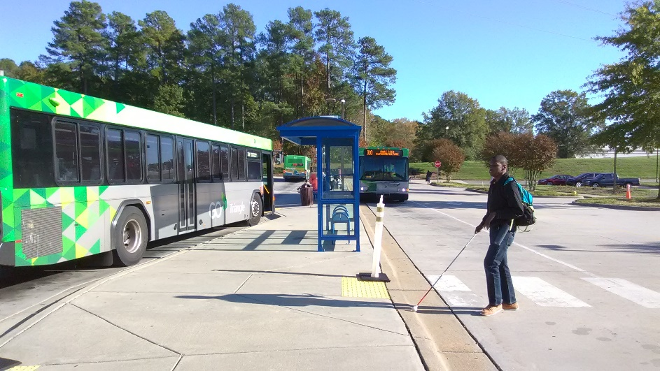
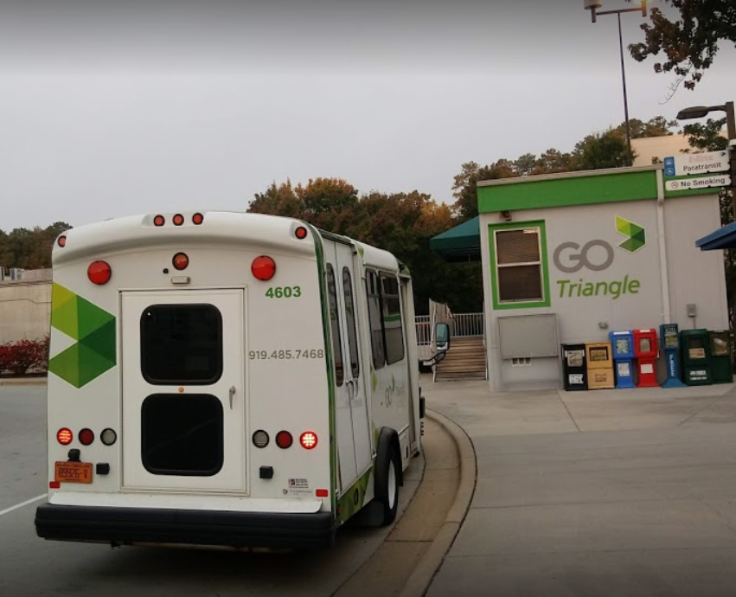
Agenda
Study Purpose
Site Search & Evaluation
Preferred Site Locations
Conceptual Program
Implementation Approach
Next Steps

Slide 93
Regional Transit Center Relocation Study
Feasibility Study
Concept Design
Engineering
Construction

Slide 94




Study Purpose
Safety & Functionality
Access & Connections
Speed & Reliability
  Purpose: Evaluate opportunities to relocate and improve the Regional Transit Center to enhance functionality, connectivity, and reliability.

Slide 95
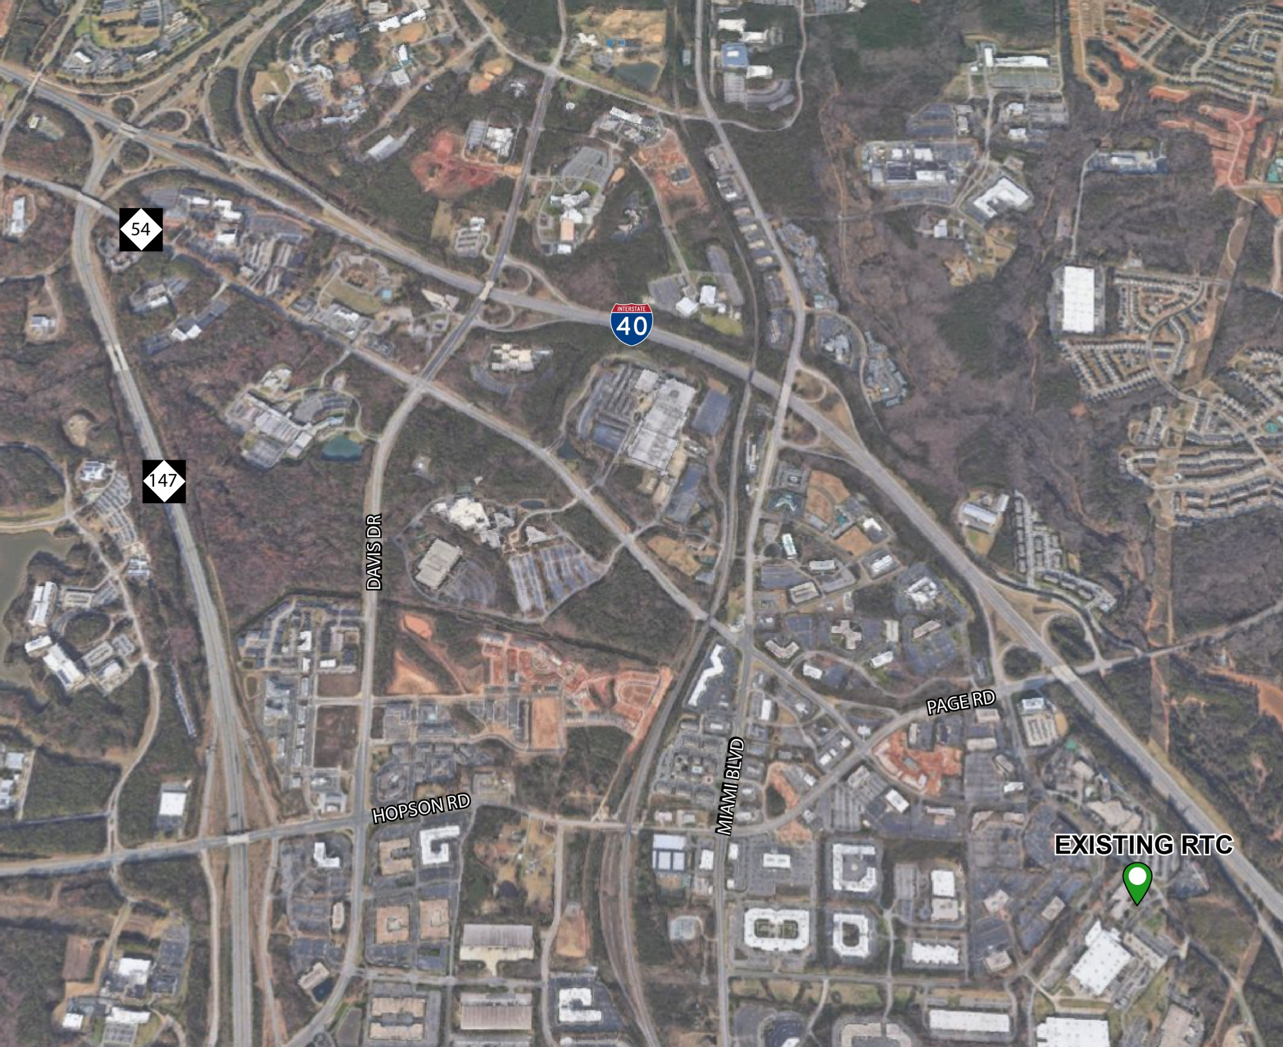
Existing Regional Transit Center

Slide 96
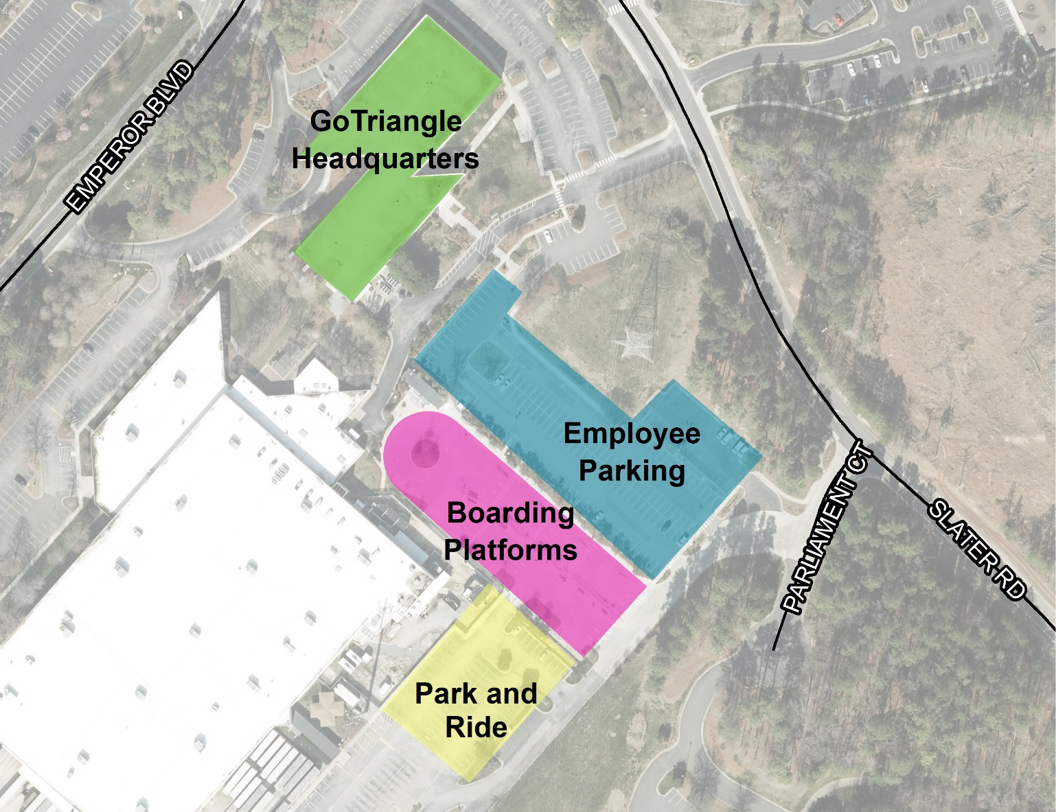
Existing Conditions
Serves 10 routes
1,000 daily boardings
100 daily park & ride users
Own headquarters building
Lease park & ride and RTC
Notes:
Site requirements came out of the first stakeholder meeting in November as well as a needs assessment which examined existing conditions at the current RTC as well as interviews conducted with key staff.

Slide 97
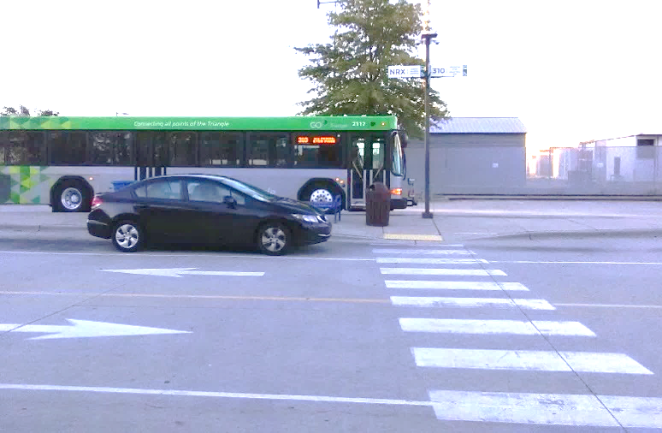
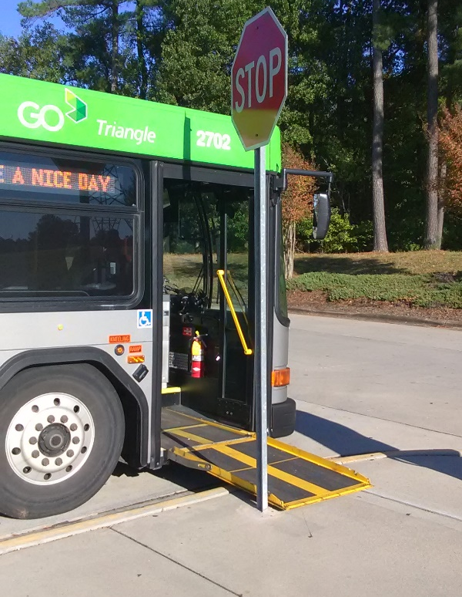
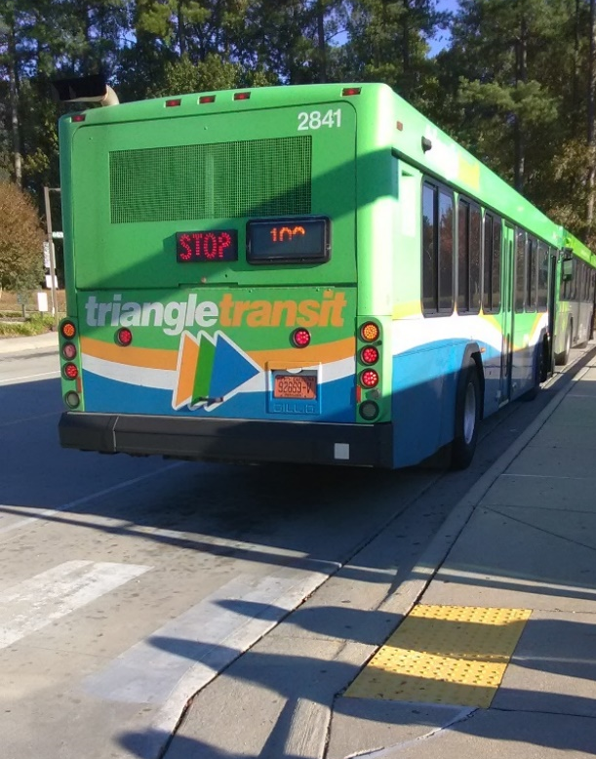
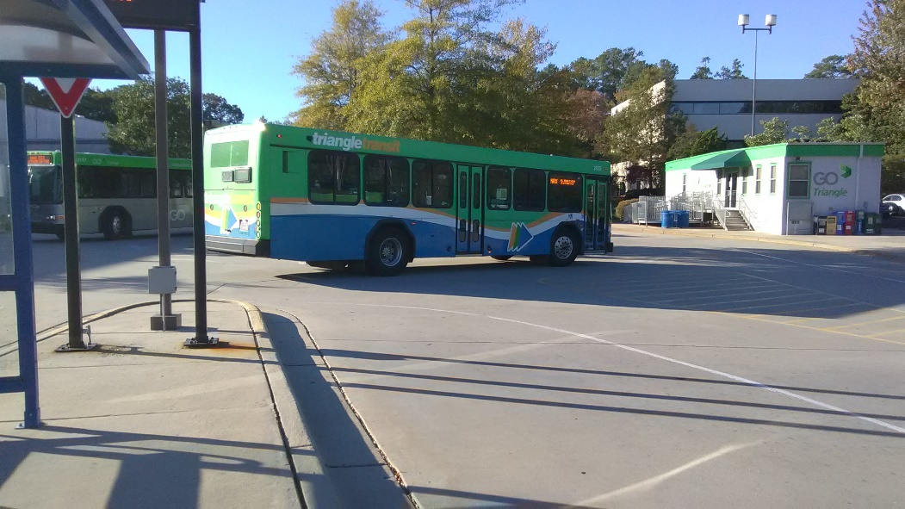
Safety and Functionality
Platform space limited and constrained
Limited separation between users
Buses share driveway with other vehicles

Slide 98
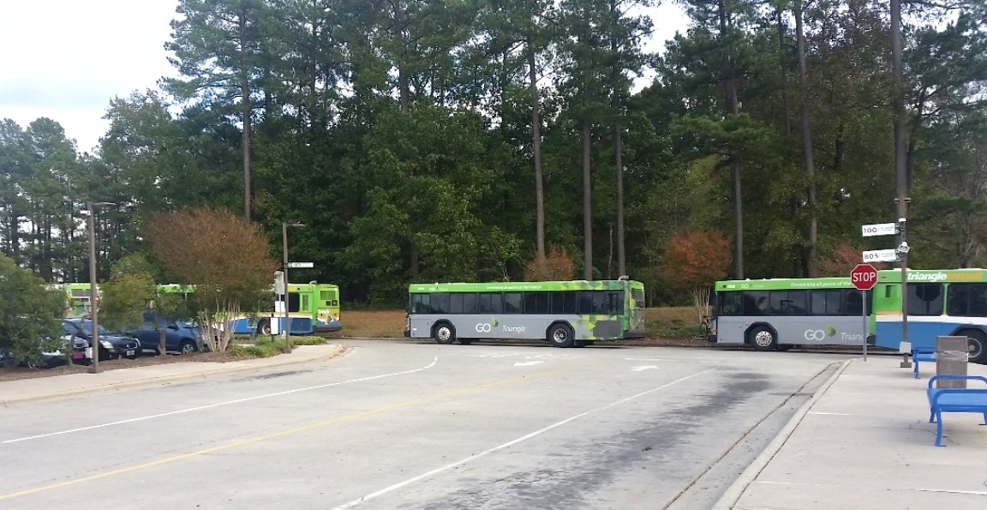

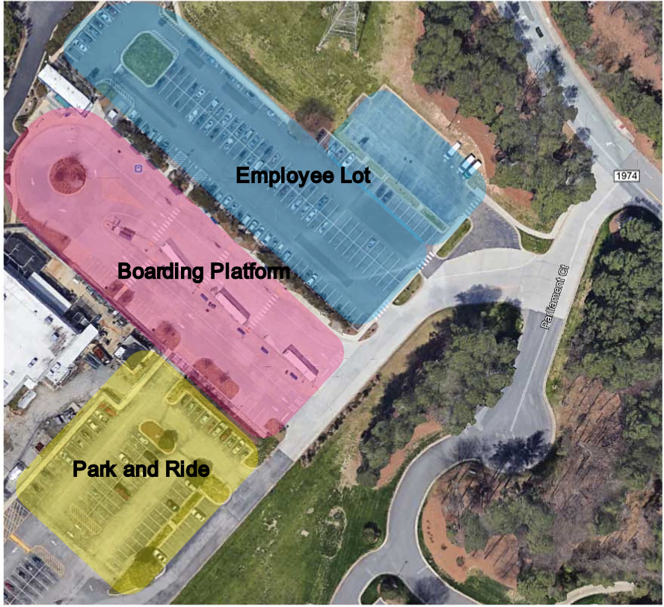
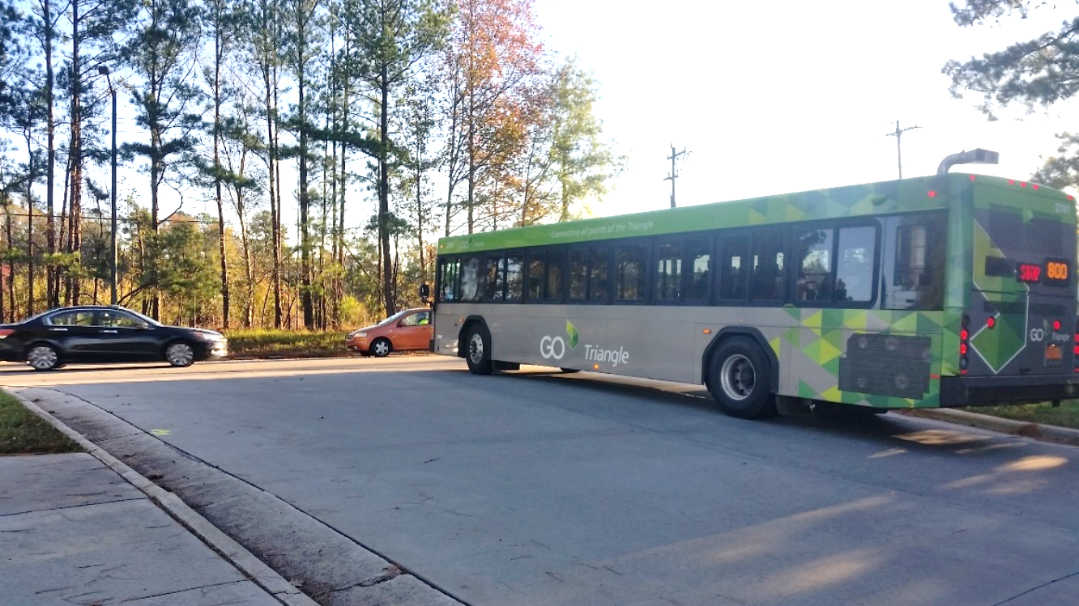
Reliability
56%
Arrive late and/or miss transfer due to delays
Shared, unsignalized entrance to the site causes delays for buses
Boarding platform location creates access conflicts between cars and buses

Slide 99
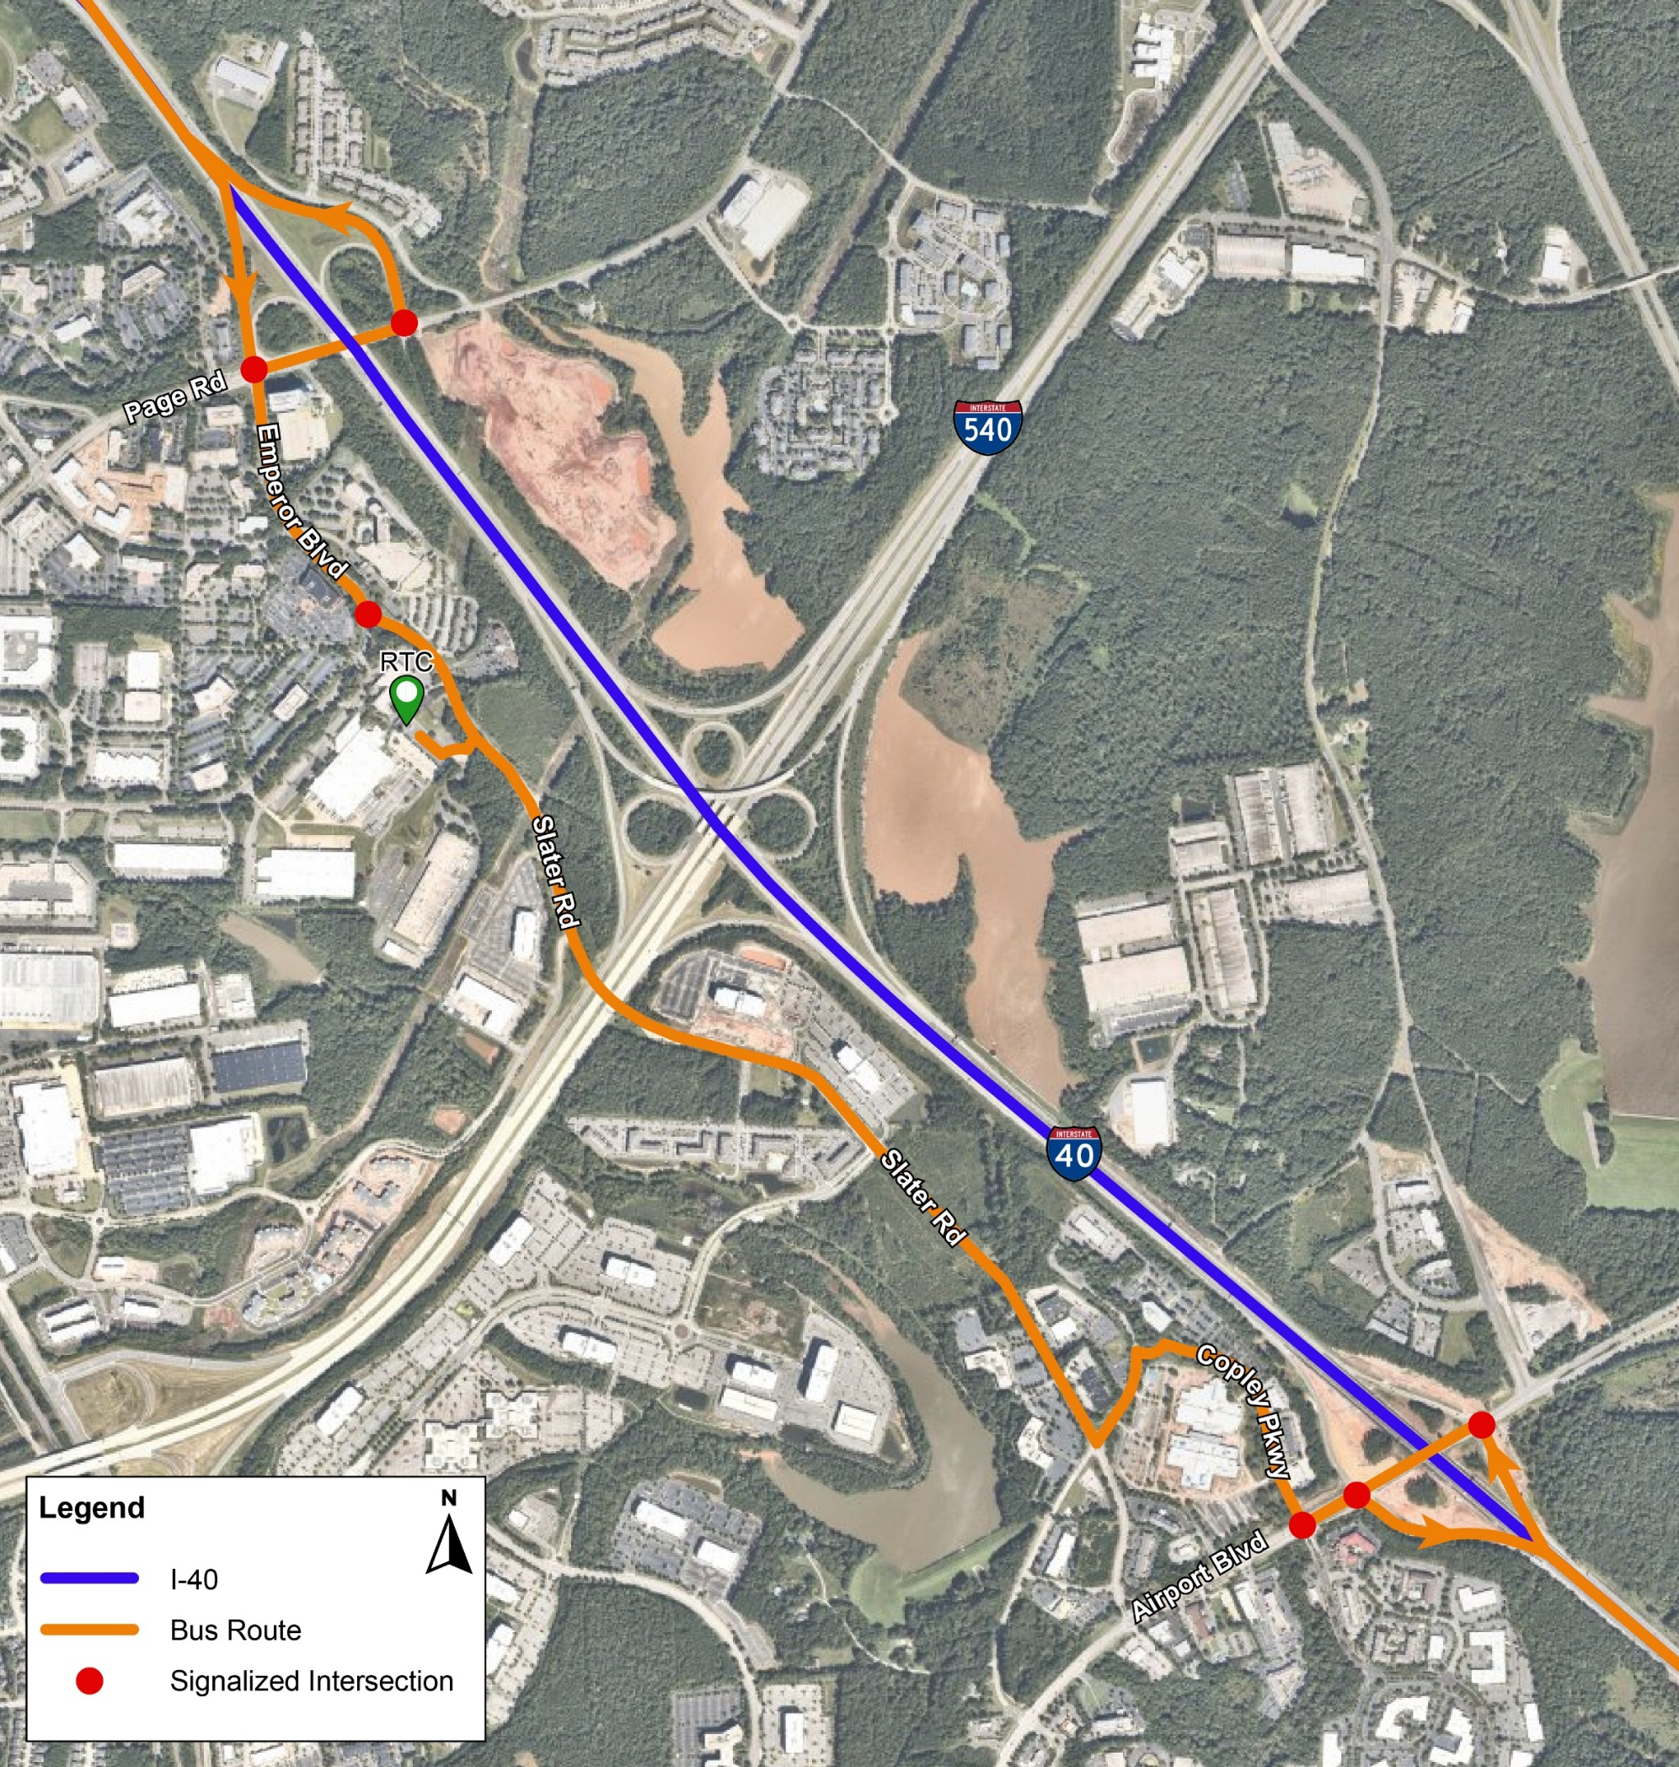

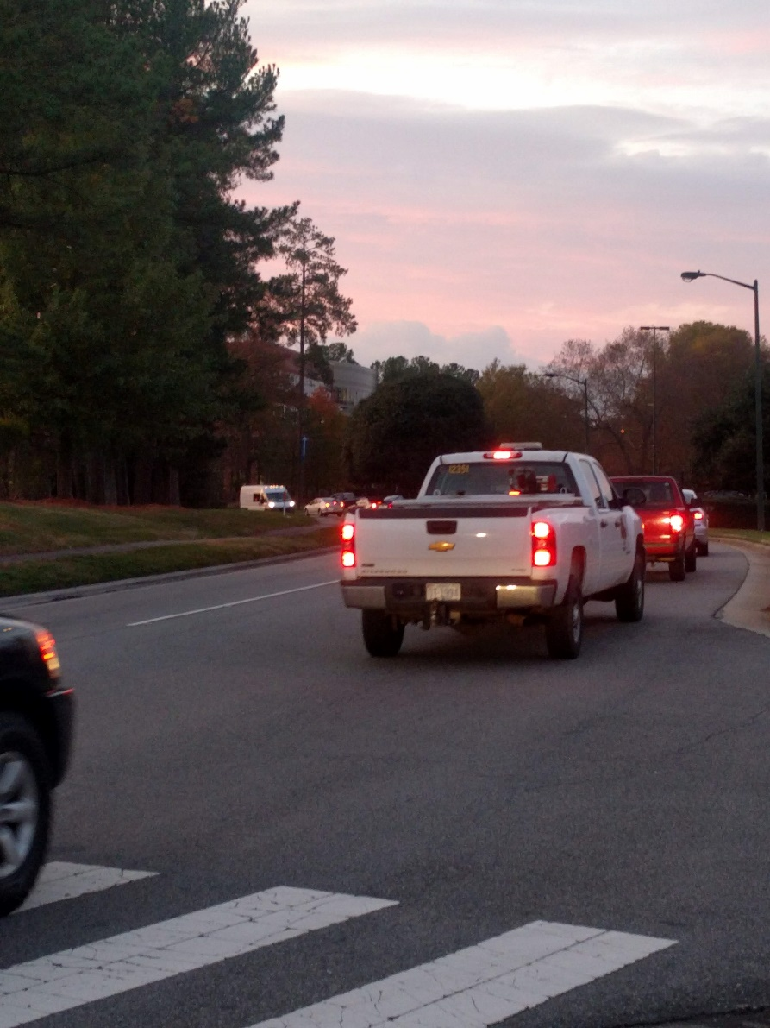
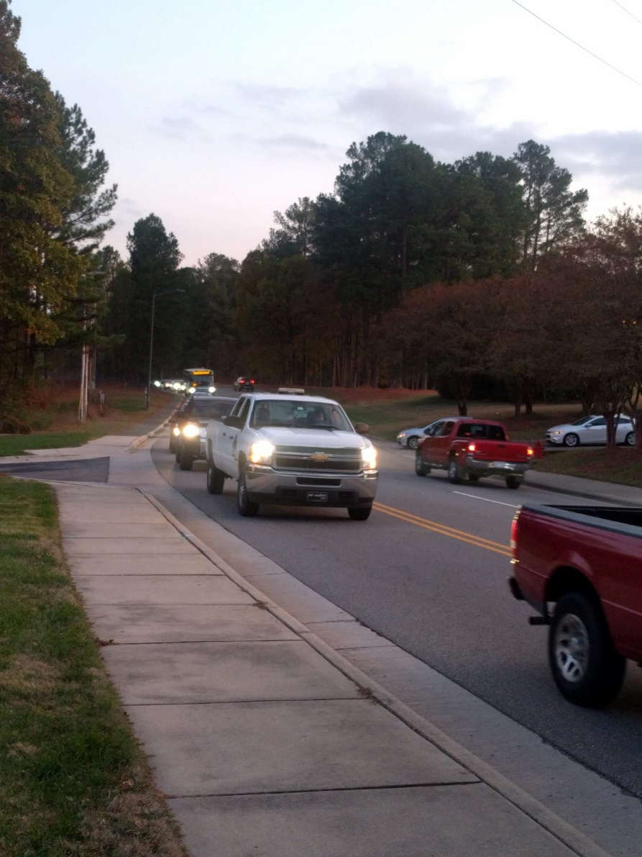
Speed
82%
Rated improving bus speeds as important or very important
Access to freeway network
Multiple areas of delay
Notes:
1 mile deviation from I-40 causes delays making service planning more difficult, multiple areas of delay along the 1 mile route, GoTriangle being a regional transit agency has longer routes so need to increase efficiencies where possible.

Slide 100
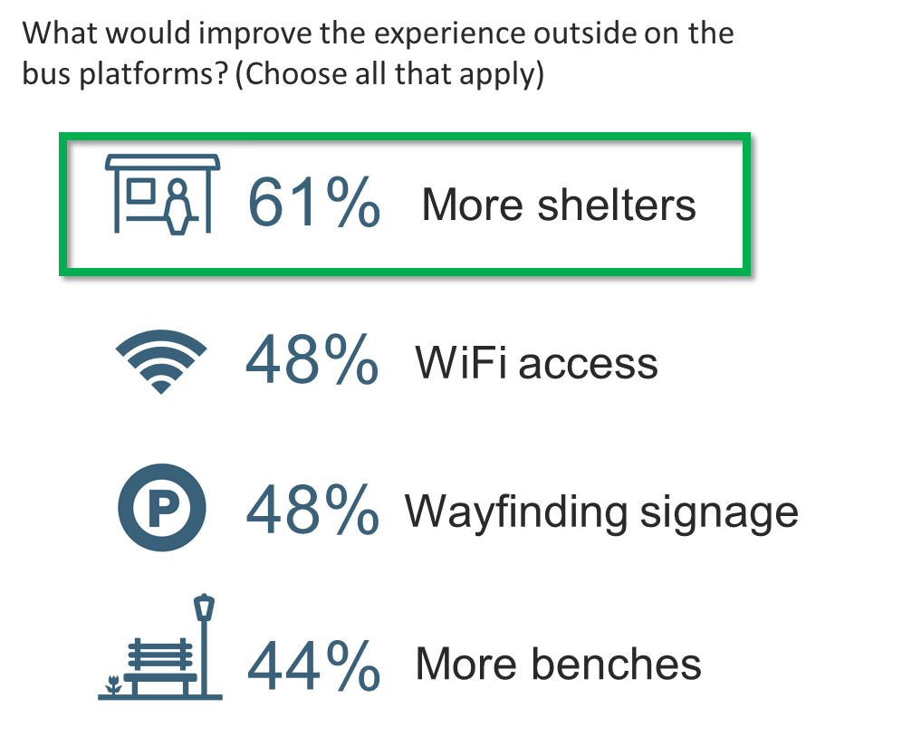
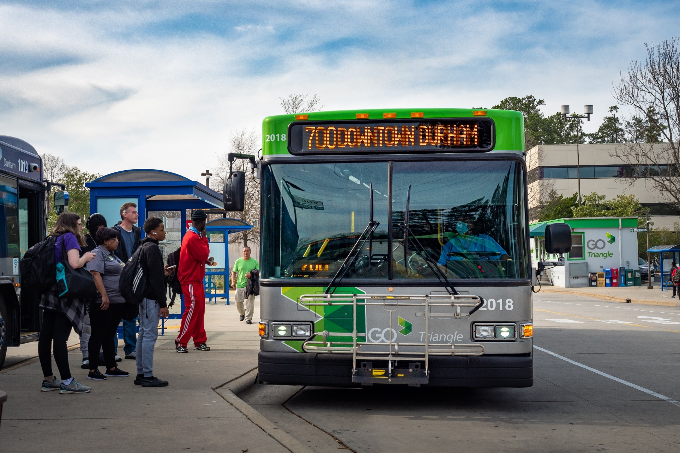
Passenger Amenities

Slide 101
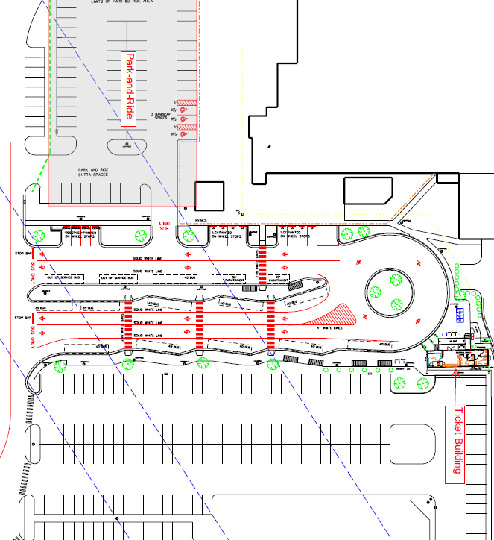
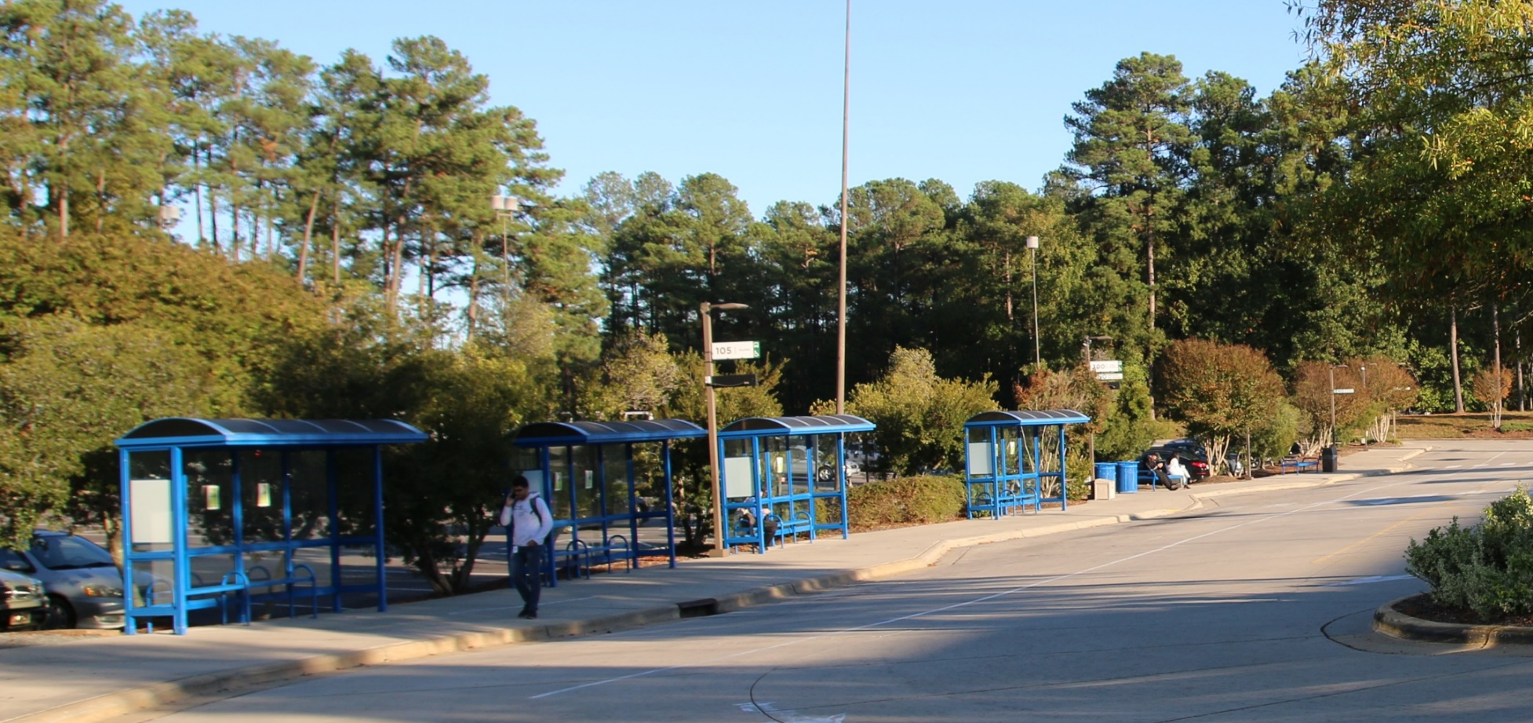
Passenger Amenities
Limited shelter coverage
Duke Energy Easement precludes ability to add more shelters on site
DUKE ENERGY POWER EASEMENT
SHELTERS
SHELTERS

Slide 102
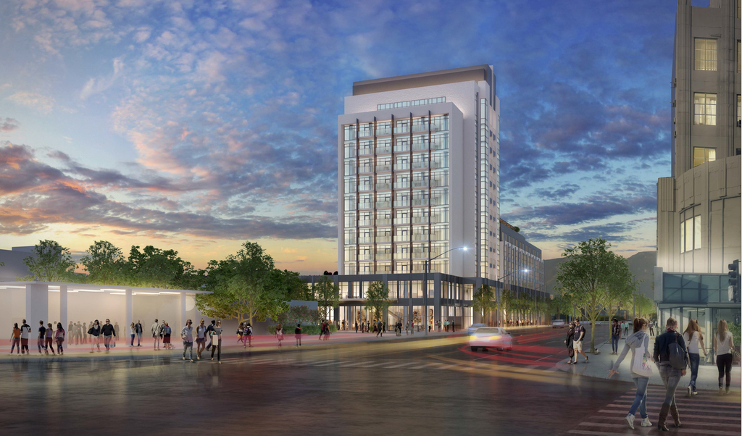

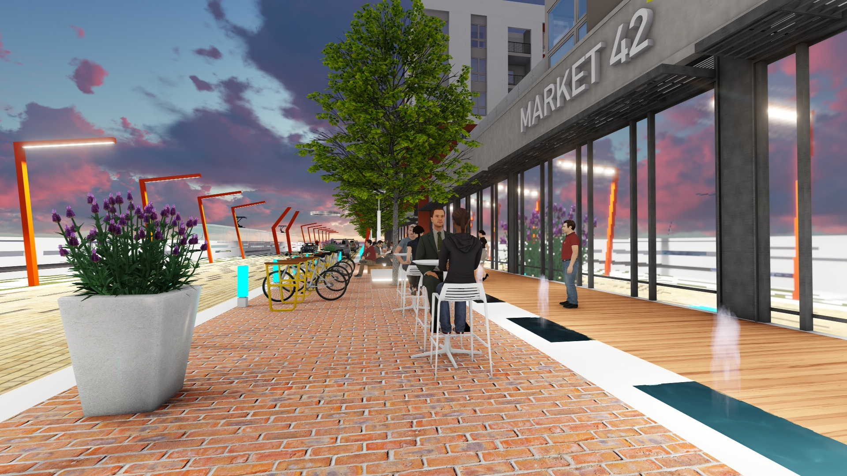
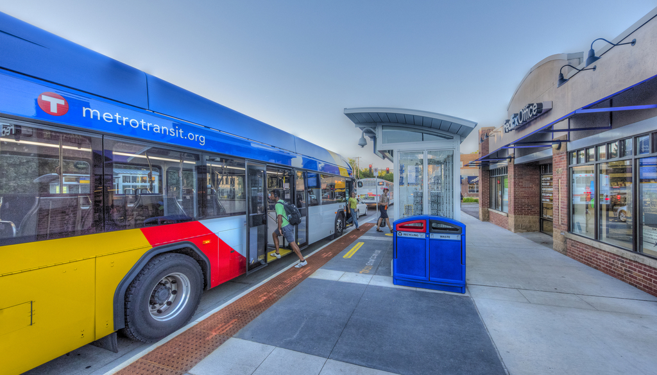
Access
What would improve the experience at the RTC?
60%
Shops and Services Nearby
Notes:
Access: Improve access to jobs and goods and service (potential for future Transit-Oriented Development)

Slide 103
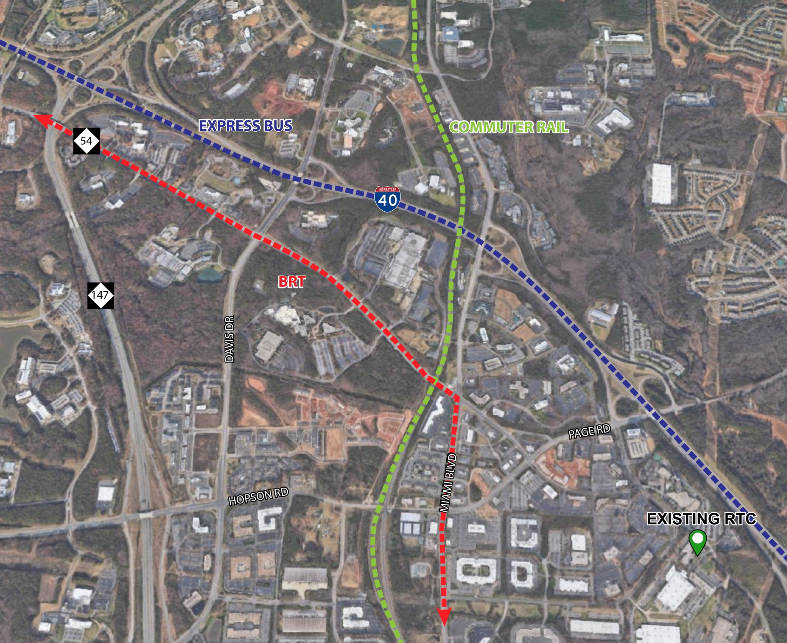
Connectivity
Notes:
Connectivity: co-locate with CRT and BRT

Slide 104
Site Search and Evaluation

Slide 105
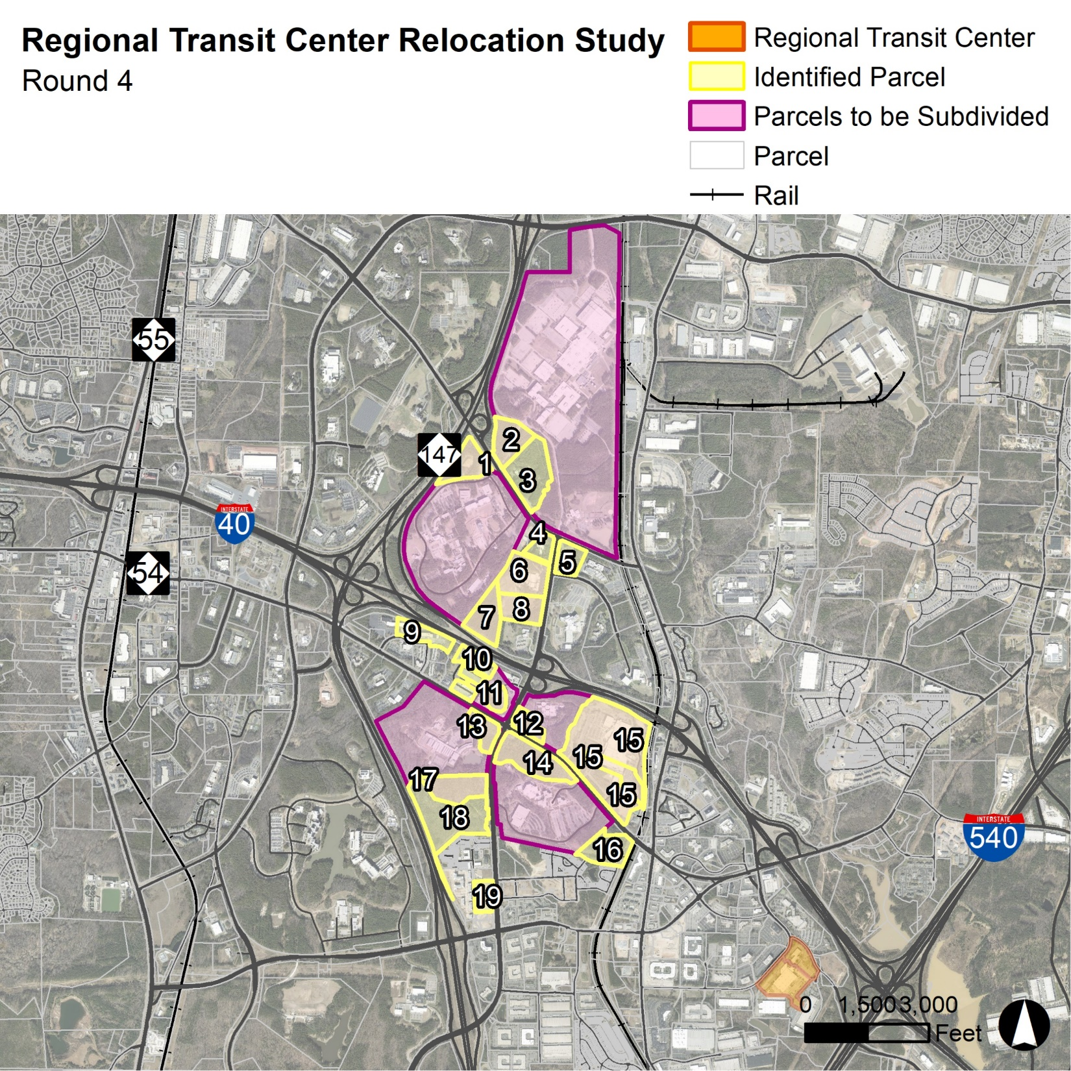
Parcel Search Process
Site Requirements
Multiple points of entry
1 mile max. from I-40
Close to other major freeways
Signalized and dedicated entrance
200 park-and-ride spaces min.
Without headquarters: 7 acres min.
With headquarters and/or potential
Joint Development: 14 acres min.
Round 1
113 sites
Round 2
97 sites
Round 3
43 sites
Round 4
19 Sites
Round 5
6 sites

Slide 106
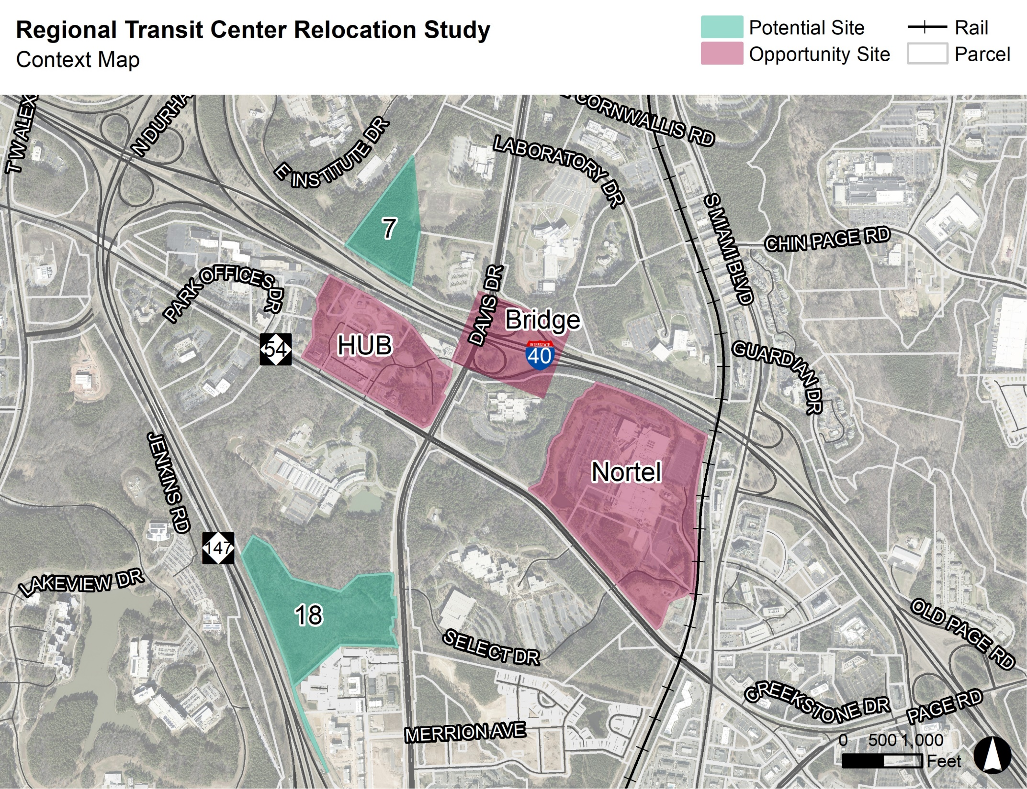
Parcel Search Process – Results
Parcel search process yielded 6 potential sites
3 sites are GoTriangle identified opportunity sites
16
Notes:
Final five sites included sites identified through the criteria-based search and three “opportunity” sites identified by GoTriangle

Slide 107
Top Scoring Sites

Slide 108
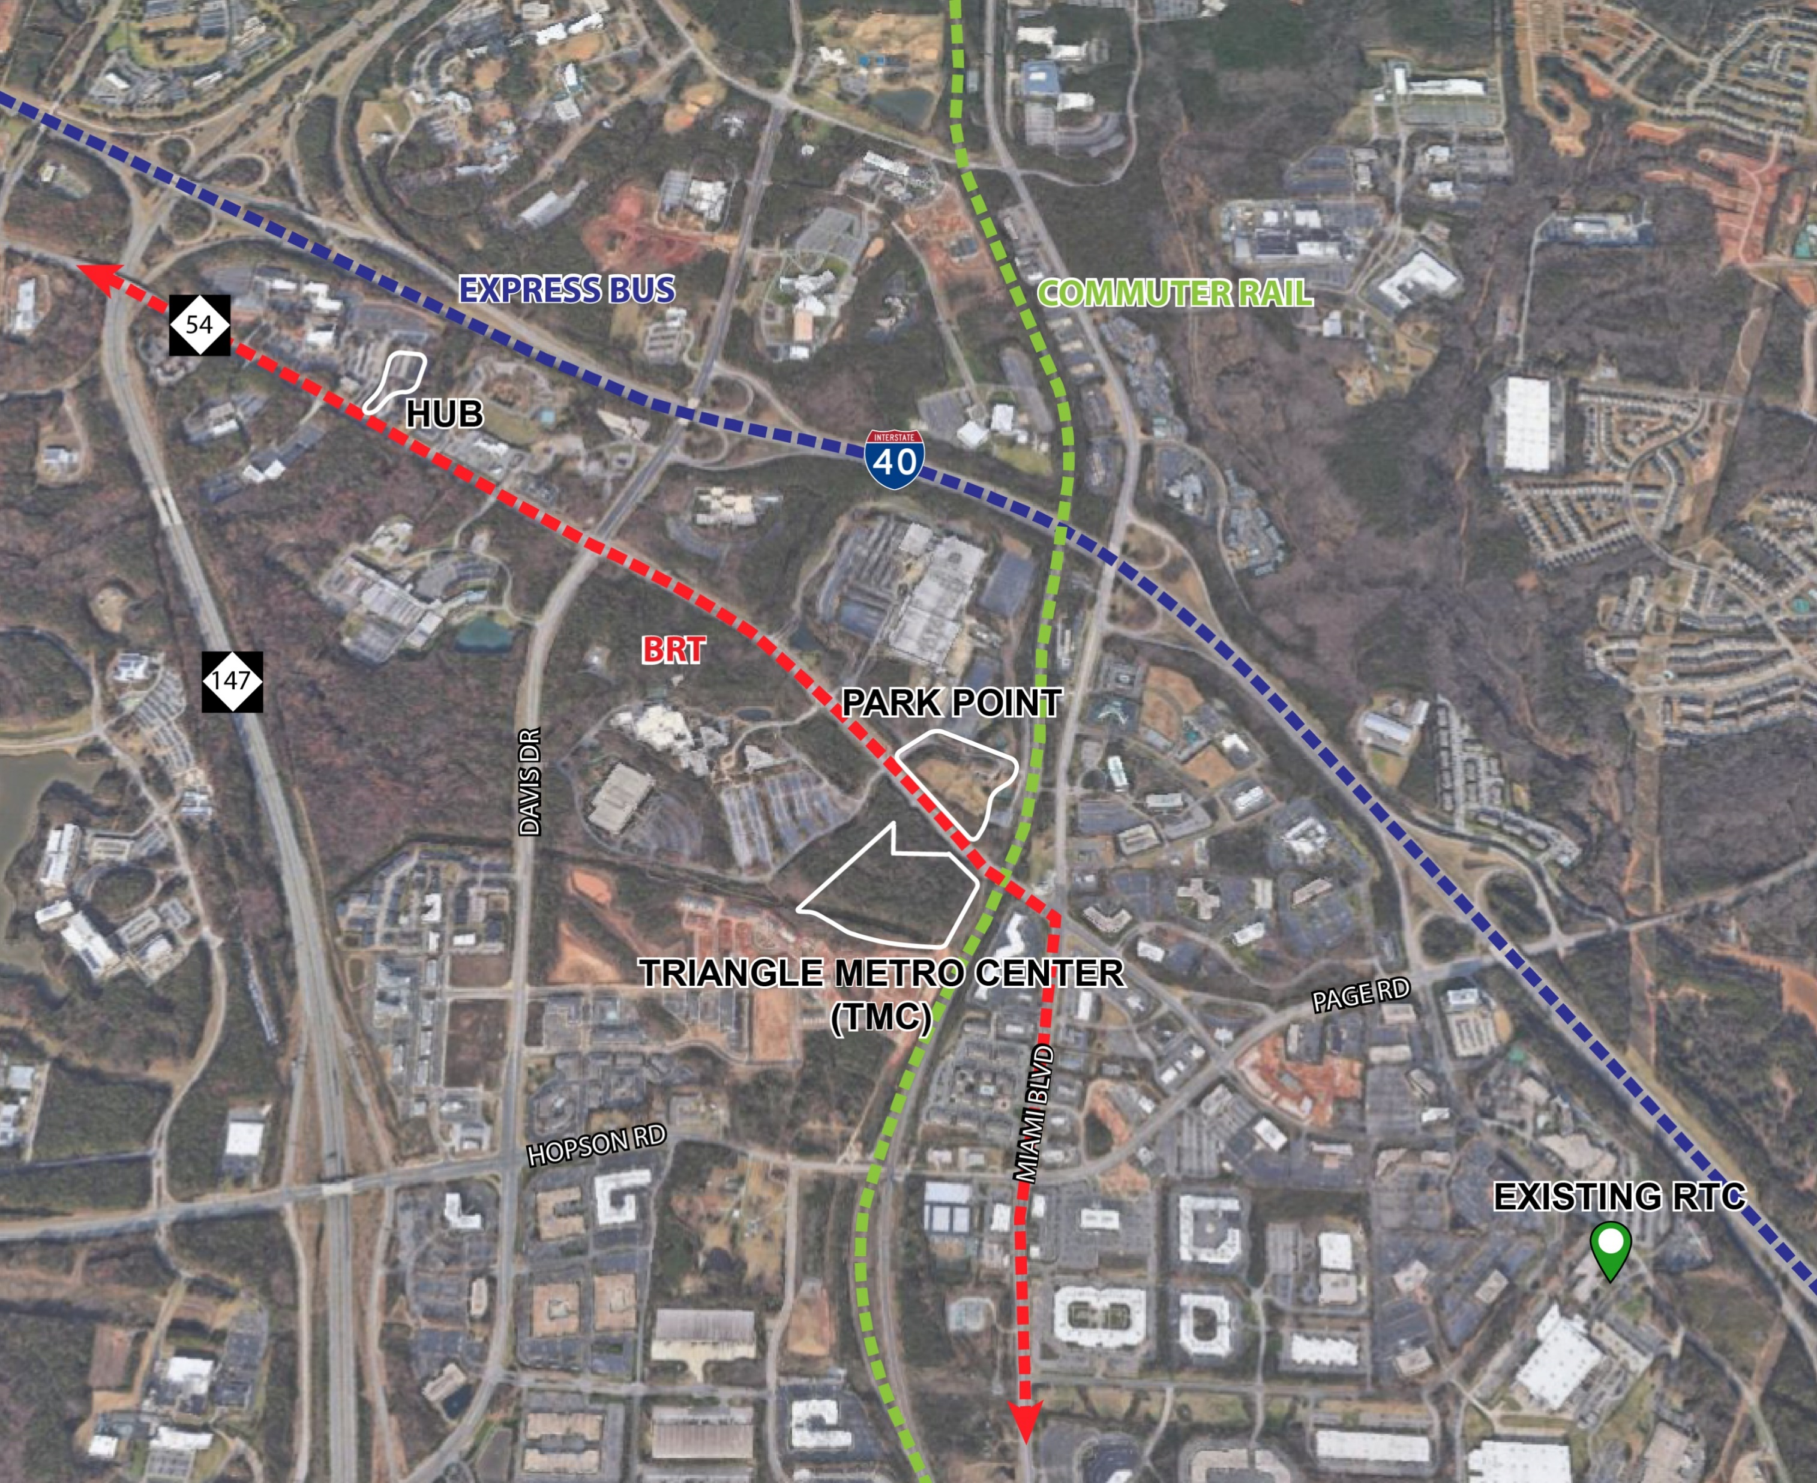
Top Scoring Sites

Slide 109

Location Evaluation
TMC
Goal |  | HUB | Park Point | TMC | Existing
Mobility (30%) | Reduce travel time to and from highway network | 3.80 | 3.80 | 3.00 | 2.60
Community (20%) | Improved access to goods, services, and potential development | 4.50 | 4.50 | 3.00 | 1.25
Viability (20%) | Ease of acquisition and constructability | 3.40 | 3.40 | 3.80 | 2.40
Walk Access (10%) | Access to existing employment | 2.00 | 3.00 | 4.00 | 1.00
Multimodal (20%) | Provide connections to commuter rail and BRT | 3.60 | 5.00 | 5.00 | 1.35
Total |  | 3.64 | 4.02 | 3.66 | 1.88

Slide 110
Conceptual Program

Slide 111
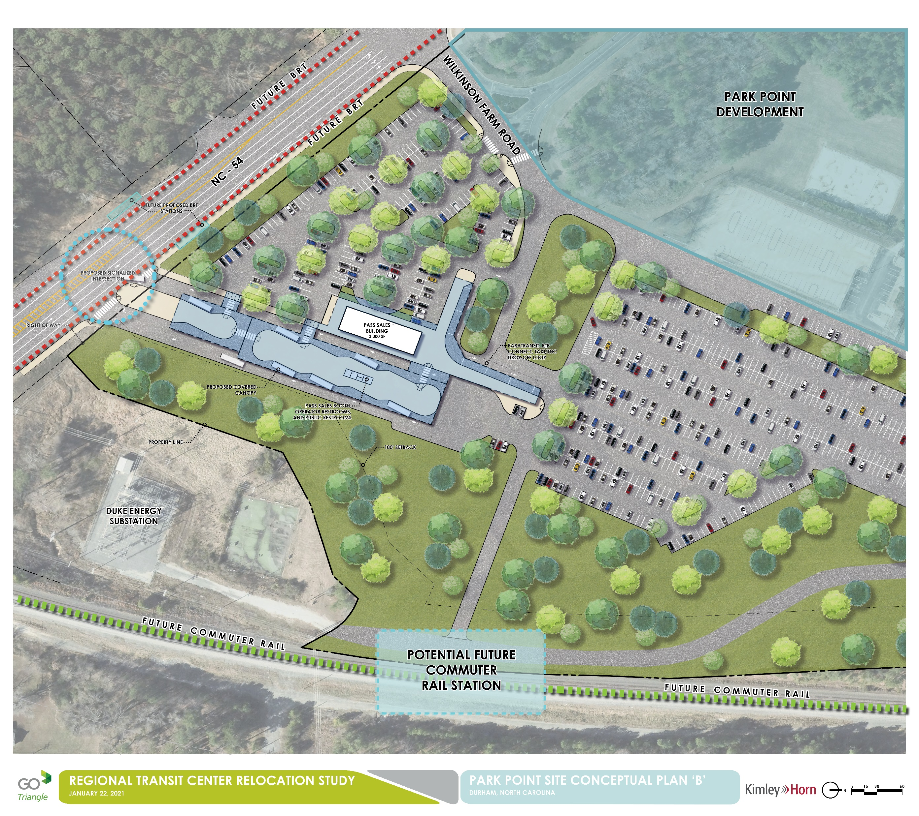
Conceptual Program
Bus-only driveway and traffic signal at NC 54
Access to planned Bus Rapid Transit, Commuter Rail, Triangle Bikeway
First / mile last mile connectivity to Hub RTP
Adjacent to Park Point adaptive re-use project
Notes:
Location program maximizes connectivity between planned transportation investments and provides excellent opportunities for first mile and last mile connections to Hub RTP (via BRT, via regional and local bus, via micro transit and/or TNCs, and via Triangle Bikeway).

Slide 112
Conceptual Program
10 Bus Boarding Bays
2 Out-of-Service Bays
Drop-Off Loop
Pass sales booth & comfort station on boarding platform
5,000 SF Waiting room / meeting space / office
$$ add cost range

Slide 113
Implementation Approach

Slide 114
Implementation Approach
Begin design and implementation of transit center
Fund design and land acquisition on FY22 County Transit Plan annual workplans
Continue to evaluate potential relocation of GoTriangle admin space to the new regional transit center location
Potential
GoTriangle Admin Building Space

Slide 115
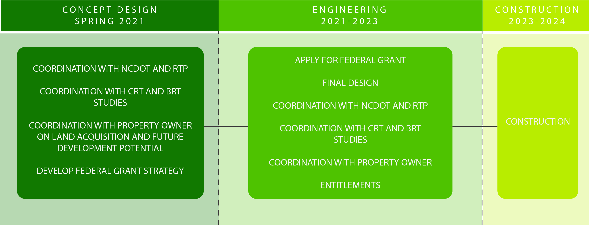
Next Steps

Slide 116
Thank you!

Slide 117
XI. GoTriangle Regional Transit Center (RTC) Feasibility Study Progress Update
Requested Action:
Receive as Information

Slide 118
XII. Subcommittee Chair Reports
Attachment I
Budget & Finance
Planning & Prioritization
Public Engagement & Communications

Slide 119
XIII. Other Business
The North East Area Study planning staff have launched an engagement opportunity that will remain open through March 10, 2021.
The community is invited to provide input on future transportation projects and priorities by attending a virtual-open house and completing an online survey at www.NEASupdate.com/Events
Other New or Old business items to discuss?

Slide 120
XIV. Adjourn
Next TPAC Meeting:
March 10, 2021 @ 9:30am
~ Cabinet meeting reminder- Starts in 15 minutes ~

