Slide 1
Novel genetic subgroups inform on shared pathobiology within adult and pediatric Burkitt lymphoma
Nicole Thomas
Morin Lab
SFU
Burnaby, BC, Canada

Slide 2
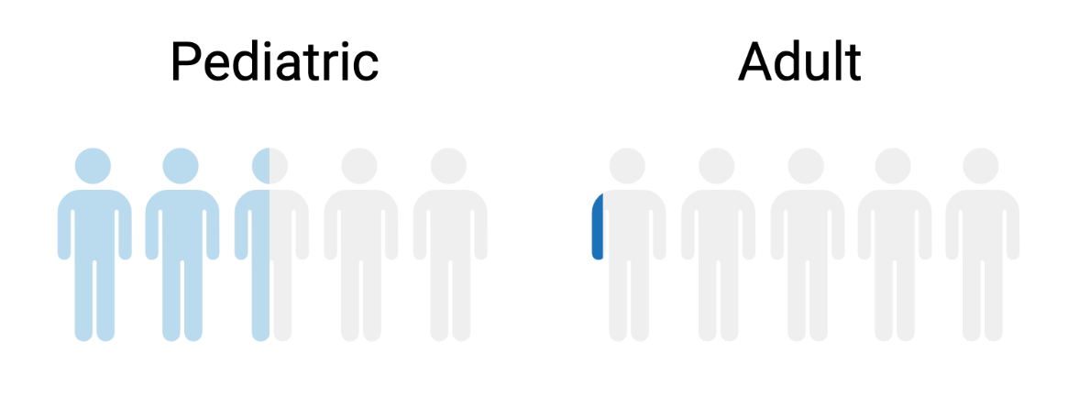
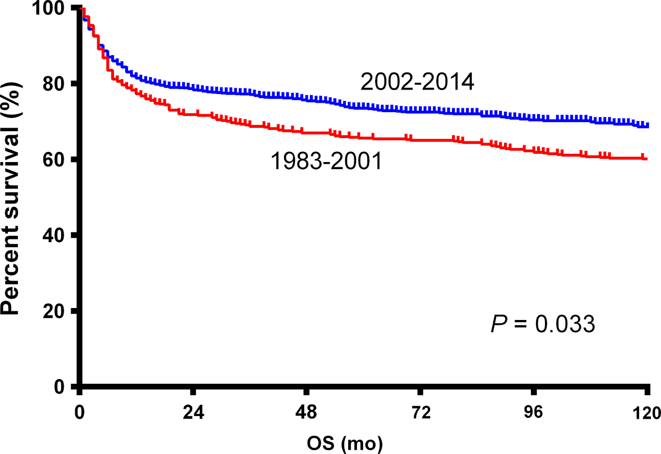
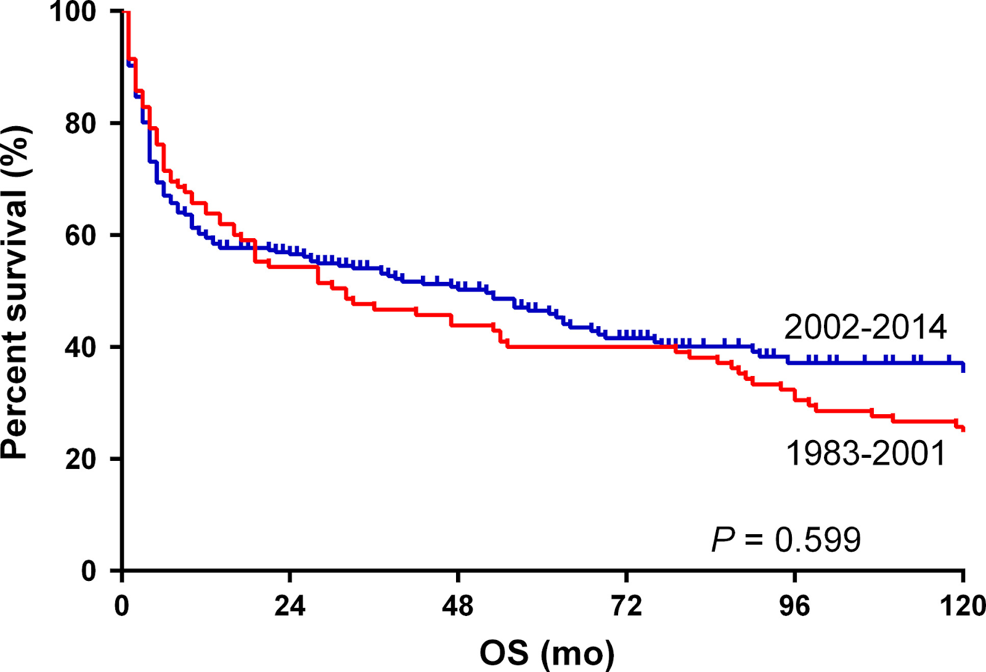
Burkitt lymphoma disproportionally affects children
Pediatric OS
Adult OS
Swerdlow et al., 2016; Liu et al. (2019).

Slide 3
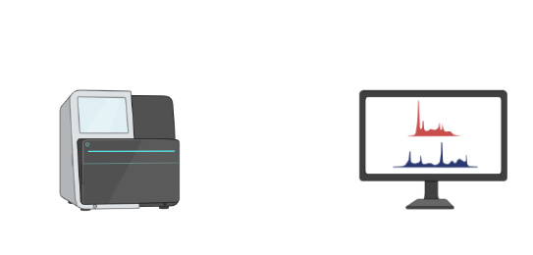

230 BL tumors analyzed through the Burkitt Lymphoma Sequencing Project in conjunction with 252 DLBCL genomes
WGS & RNA
Sequencing
DNA
Data analysis
(n=92)
(n=230)
30 (33%)
62 (67%)
112 (49%)
RNA
This study was supported through the following grants from the foundation for Burkitt Lymphoma research,
National Cancer Institute: R21CA156168 and R01CA136895. 16 pediatric BLs were derived from Love et al, Nature Genetics 2012.
252 DLBCLs derived from Arthur et al, Nature Comm. 2018; Hubschmann et al., Leukemia, 2021; Hilton et al., Blood, 2019; Morin et al., Blood, 2013

Slide 4
Comprehensive mutational profiling identifies similarities between adult and pediatric patients

Slide 5
EBV status reveals more significant differences

Slide 6
Six distinct genetic subgroups identified
NMF clustering of genomic features from BL and DLBCL genomes

Slide 7
Three distinct DLBCL subgroups
Partially overlap subgroups described by Wright et al.
DLBCL-1 enriched for EZB
DLBCL-3 enriched for ST2

Slide 8
Three unique BL subgroups identified

Slide 9
M53-BL
Characterized by MYC translocations and TP53 mutations
Quiescent genomes
Do not resemble TP53-deficient DLBCL subgroup

Slide 10
DGG-BL
Characterized by DDX3X, GNA13, GNAI2 mutations
Enriched for FOXO1 hotspot mutations, HNRNPU mutations, BACH2 TSS aSHM

Slide 11
IC-BL
Characterized by ID3 and CCND3 mutations
Highest frequency of ARID1A mutations
Paucity of other DGG-BL mutations

Slide 12
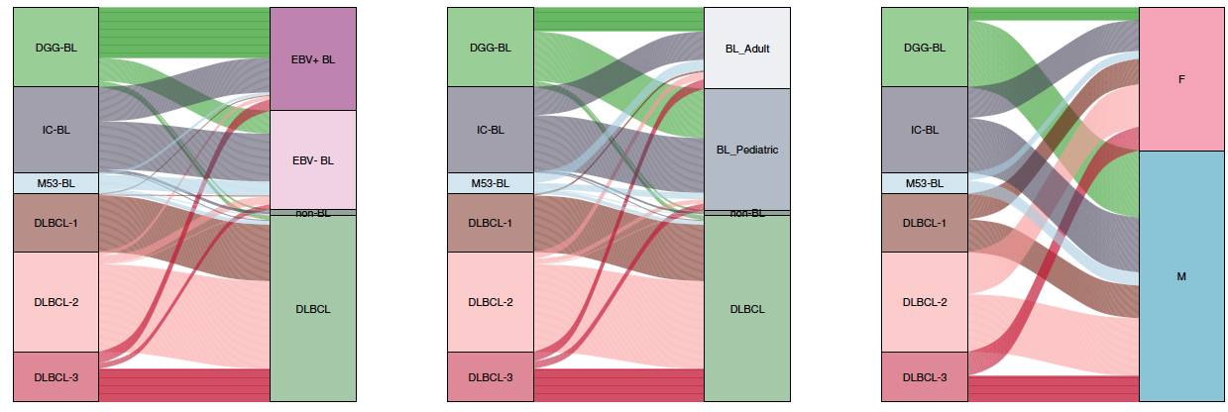
DGG-BL is predominately EBV+ BL while M53-BL is predominately adult EBV- BL
TYPE

Slide 13
DGG-BL is predominately EBV+ BL while M53-BL is predominately adult EBV- BL
TYPE
Cohort

Slide 14
DGG-BL is predominately EBV+ BL while M53-BL is predominately adult EBV- BL
TYPE
Cohort

Slide 15
86 differentially expressed genes
IRF4, TNFRSF13B, and SERPINA9 show strongest differential expression
  Components of DLBCL COO and DHITsig classifiers

Slide 16
Elevated IRF4 and TNFRSF13B expression are associated with IC-BL

Slide 17
IC-BL is associated with elevated IRF4 induction pathways
IC-BL

Slide 18
IC-BL is associated with elevated IRF4 induction pathways
DGG-BL

Slide 19
TP53 and ID3 mutations are associated with overall survival in adult BL

Slide 20
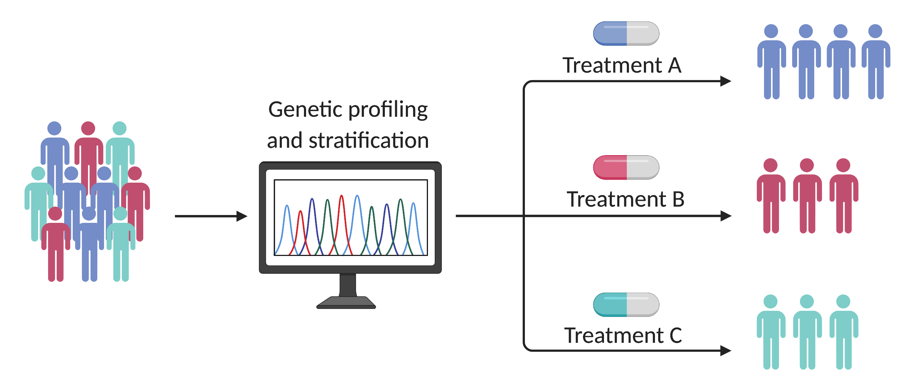
New insights into the biology of BL
Shared pathobiology between adult and pediatric BL
Clustering reveals 3 distinct BL subgroups
  IRF4 therapeutic target in IC-BL
TP53 and ID3 mutations predictive of OS
  Stratification/prognostication for treatment alternatives

Slide 21
Acknowledgements
Belo Horizonte
Belo Horizonte, Brazil
Jeffrey Bethony
Massachusetts General Hospital
Boston, MA
Jeremy S. Abramson Nancy Lee Harris
Memorial Sloan Kettering Cancer Center
New York, NY
Ariela Noy
National Institutes of Health
Bethesda, MD
Daniela S. Gerhard Elaine S. Jaffe
British Columbia Cancer
Vancouver, BC
Andy J. Mungall Karen Novik Marco A. Marra
David Scott
Laura Hilton
Jasper Wong
Simon Fraser University
Burnaby, BC
Kostia Dreval Manuela Cruz
Chris K. Rushton Ryan D. Morin *
Foundation for BL Research
Geneva, Switzerland
J P & M-R Martin John D. Irvin
Louis M. Staudt * Patee Gesuwan
Kishor Bhatia Nicholas B. Griner
St. Jude Children’s Hospital
Memphis, TN
Charles G. Mullighan John Kim Choi
John T. Sandlund Thomas B. Alexander
George Washington University
Washington, DC
Fabio E. Leal Jeffrey M. Bethony
Sam M. Mbulaiteye Steven J. Reynolds
Tanja M. Davidsen Thomas G. Gross
Wyndham H. Wilson Yiwen He
Nationwide Children’s Hospital
Columbus, OH
St. Mary’s Hospital Lacor
Gulu, Uganda
Martin D. Ogwang Patrick Kerchan
Infectious Disease Research Institute
Seattle, WA
Corey Casper
Leidos Biomedical Research
Frederick, MD
Maureen A. Dyer
Lyon University Hospital
Lyon, France
Alexandra Traverse-Glehen
Benjamin Hanf Hilary Petrello
Tara M. Lichtenberg
Cynthia Taylor Jay Bowen
Julie Gastier-Foster
Uganda Cancer Institute
Kampala, Uganda
Abraham Omoding Jackson Orem
Constance Namirembe
Robert Bosch Hospital
Stuttgart, Germany
German Ott
University of Nebraska Medical Center
Omaha, NE
Timothy C. Greiner
*indicates senior author

